Slide 1
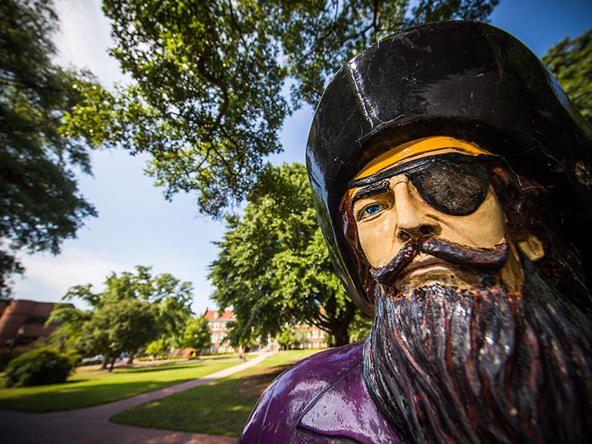
TEACH at ECU

Slide 2
T: Turn to Colleagues for Support

Slide 3
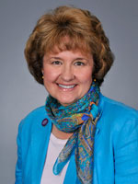
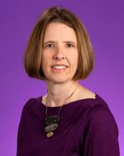
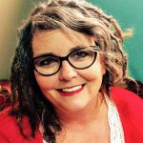
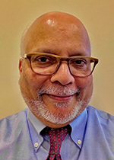
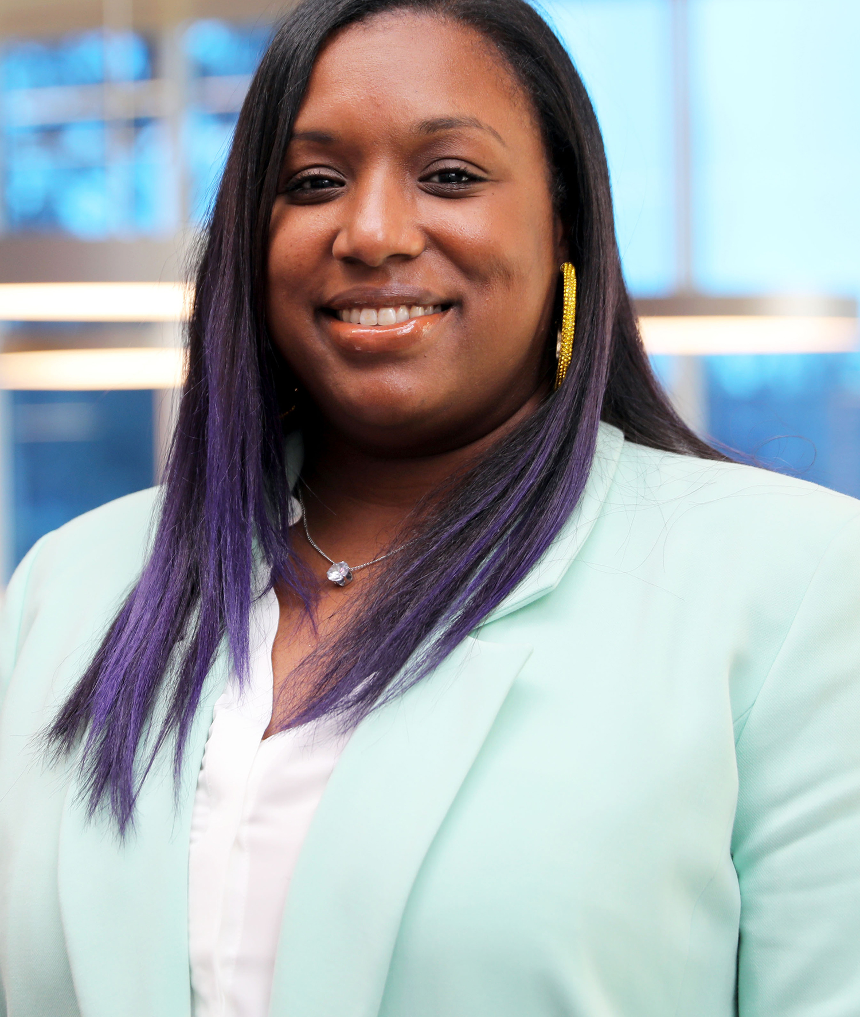
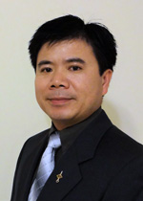
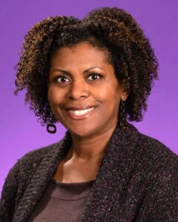
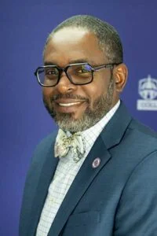
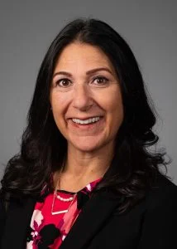
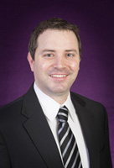
T: Turn to Colleagues for Support
Leigh Cellucci
Allied Health Sciences
Marianne Montgomery
Arts and Sciences
Amy McMillian
College of Business
Ike Aukhil
School of Dental Medicine
Janeé Avent-Harris
College of Education
Jason Yao
Engineering & Technology
Eboni Baugh
Health and Human Performance
Michael Jones
College of Nursing
Allison Flowers
Brody School of Medicine
Jay Juchniewicz
College of Fine Arts & Communication

Slide 4
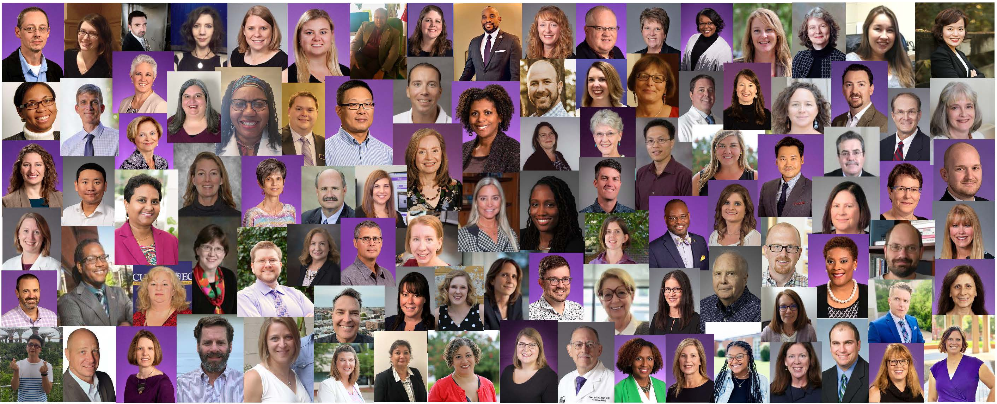
T: Turn to Colleagues for Support

Slide 5
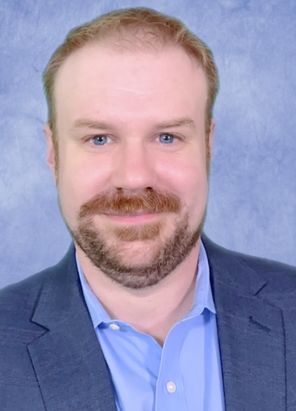
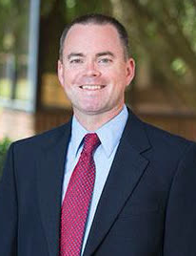
T: Turn to Colleagues for Support
Office for Faculty Excellence
Faculty Fellow 2024-2025
Faculty Fellow for Support
and Belonging 2024-2025
Tim Madden,
COB
Travis Lewis,
COE

Slide 6
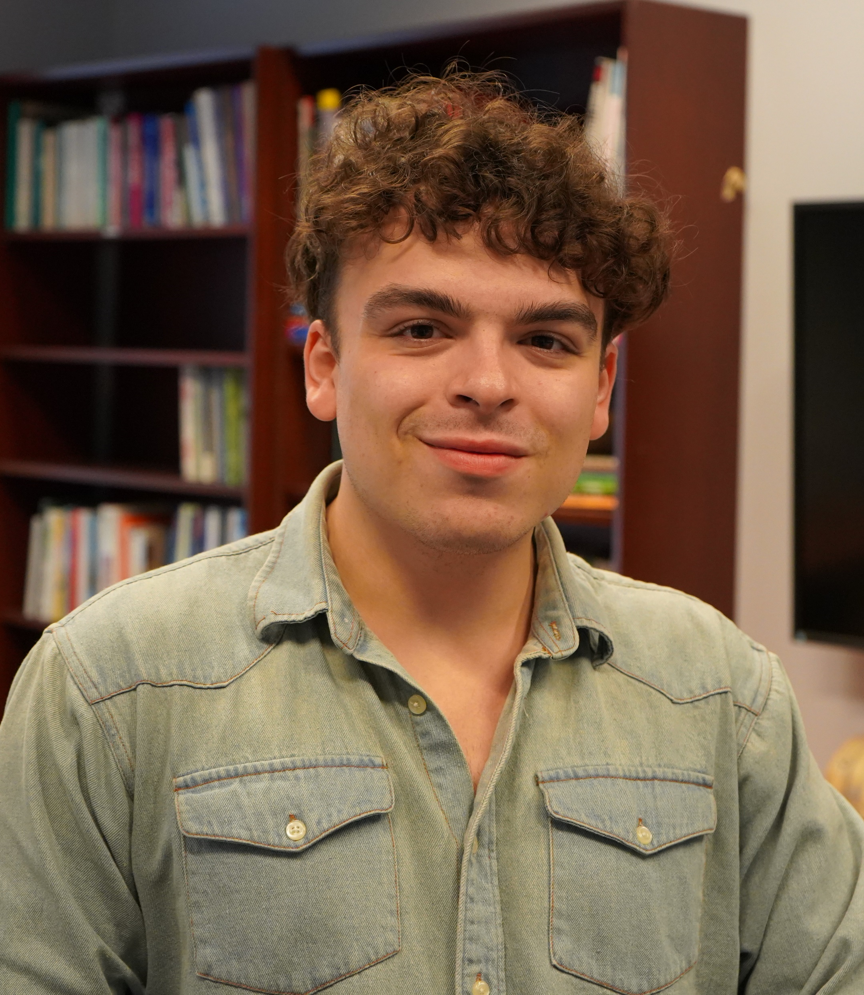
T: Turn to Colleagues for Support
Manny
Shanna
Ray
OFE Student Design Support Team

Slide 7
E: Explore Workshops on the OFE Calendar

Slide 8
E: Explore Workshops on the OFE Calendar
ofe.ecu.edu

Slide 9
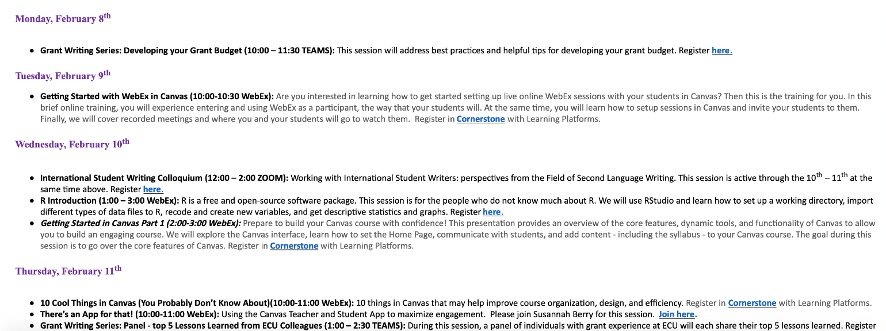
E: Explore Workshops on the OFE Calendar
Weekly and Monthly Emails

Slide 10
A: Access Online Resources

Slide 11
A: Access Online Resources
Table Teams
ofe.ecu.edu

Slide 12
A: Access Online Resources
Table Teams
Teaching Resources on the OFE Website
Everyone at your table has at least one thing in common.
Can you figure it out?
Two-Minute challenge
Guide to required and preferred syllabus elements at ECU

Slide 13
A: Access Online Resources
Teaching Resources on the OFE Website
Step by step guide for building a high-quality online course

Slide 14
A: Access Online Resources
Teaching Resources on the OFE Website
Links to hundreds of teaching ideas

Slide 15
A: Access Online Resources
Teaching Resources on the OFE Website
Training resources related to Universal Design for Learning (UDL)

Slide 16
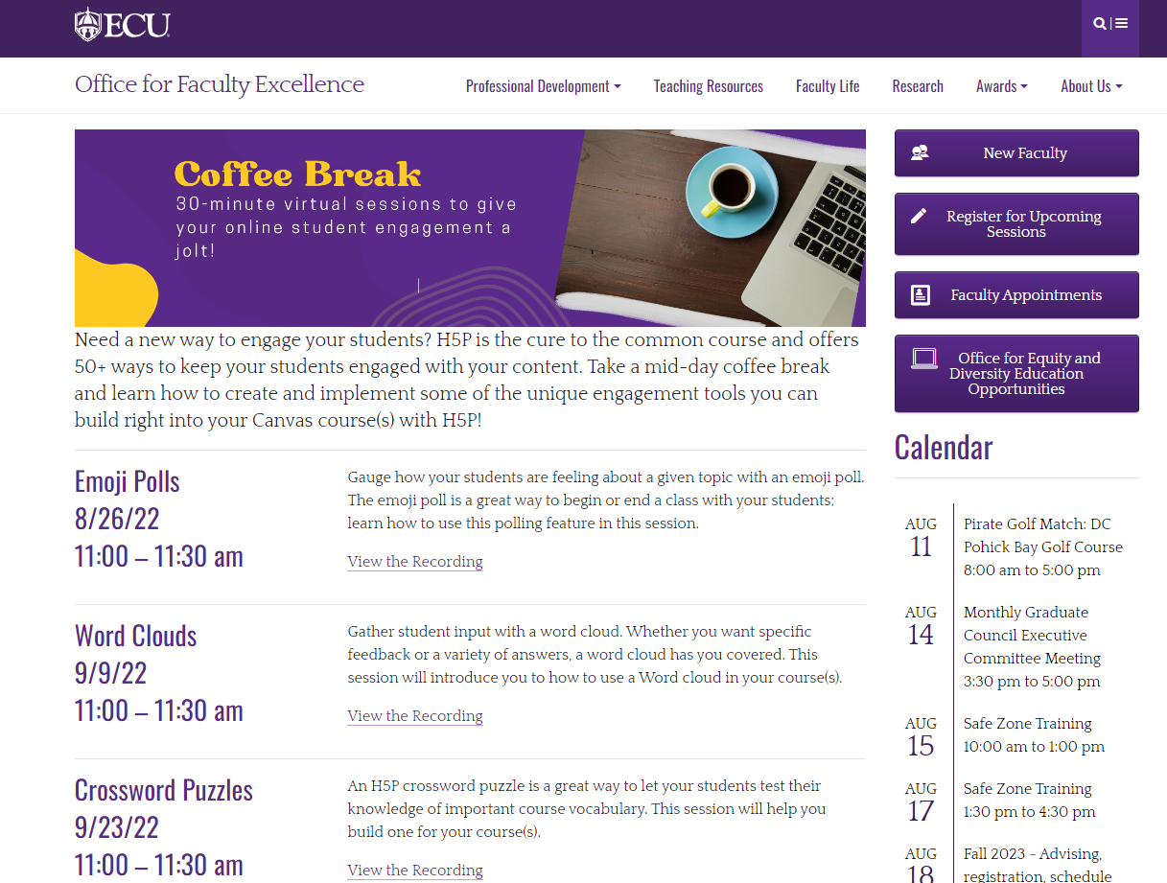
A: Access Online Resources

Slide 17
C: Commit to Continuous Improvement

Slide 18
C: Commit to Continuous Improvement
Peer Observations
Learning Communities
Institutes
Introduction to
College Teaching
CourseFIT
Faculty Resource Community

Slide 19
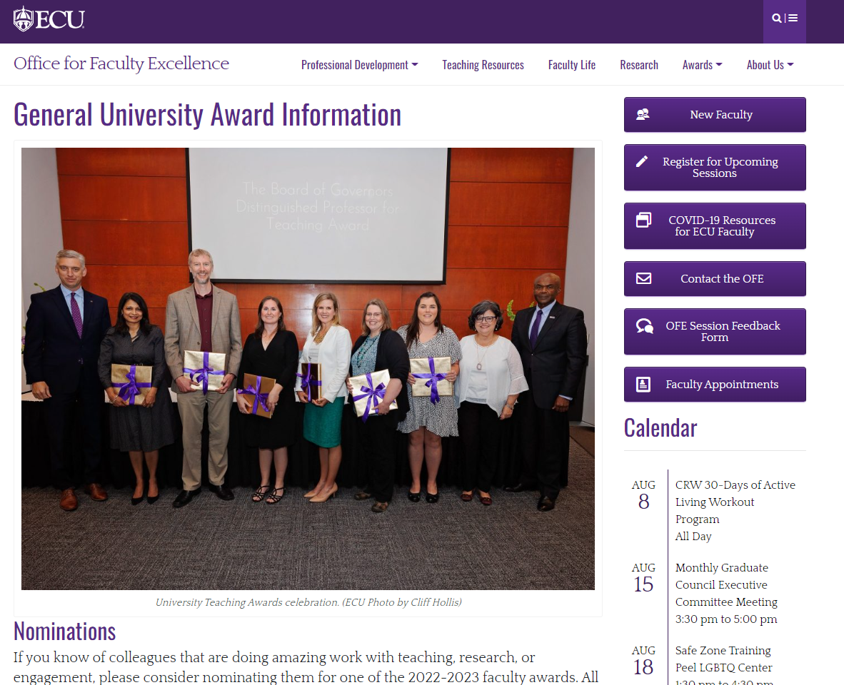
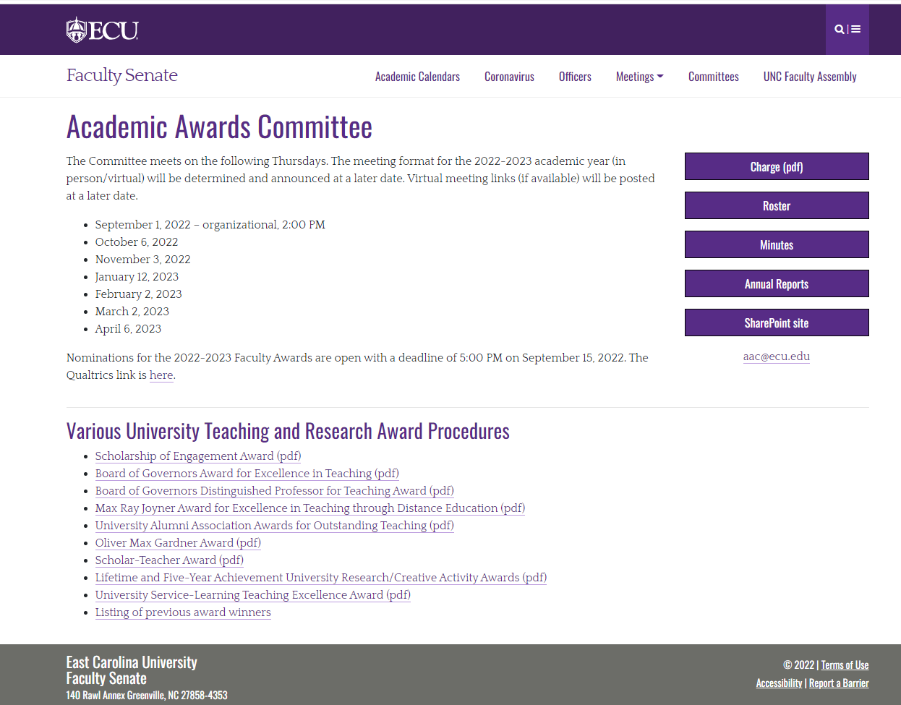
C: Commit to Continuous Improvement
ofe.ecu.edu/
facultysenate.ecu.edu/

Slide 20
H: Have a great year.
We are so glad you are here!

