Slide 1
Startup Tips
For new startup recipients

Slide 2
Getting started in your research…
First two months…
Check over your original proposal, budget and chair letter
Make a timeline (research goals, manuscript and grant submission)
Create a Grant Advisory Panel (GAP) and/or identify research mentors (ask your chair and/or ADR if need suggestions)
Schedule face to face meetings
Mentors need to understand your interests, goals, proposed grant idea(s) and how or if they can assist you
Role of mentor is most often a facilitator
Mentors can offer far more than just grant review
Case report: First contact should not be via email one month prior to grant submission deadline

Slide 4
https://rede.ecu.edu/bustour/

Slide 5
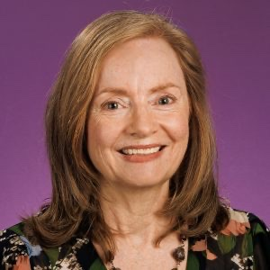
Questions?
Mary Farwell
Assistant Vice Chancellor Research Development

