Slide 2
Office of Research Development​ ​
Office of Research Administration and Compliance ​​

Slide 3
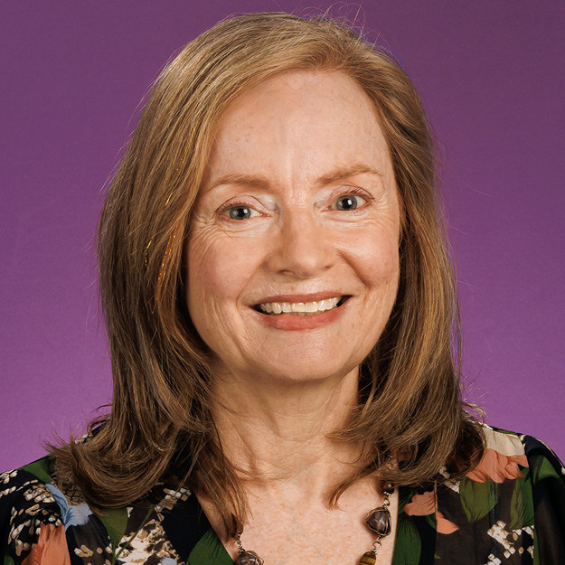
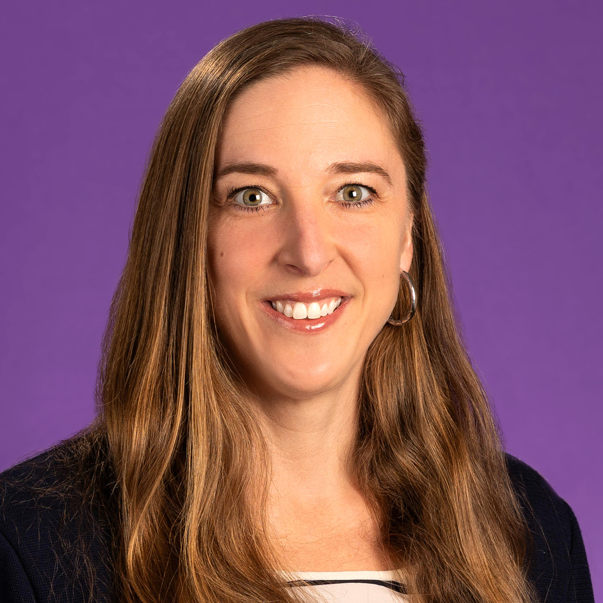
Dr. Mary Farwell
Assistant Vice Chancellor
for Research Development​ ​
Becky Welch
Assistant Vice Chancellor for Research Administration and Compliance ​​

Slide 4
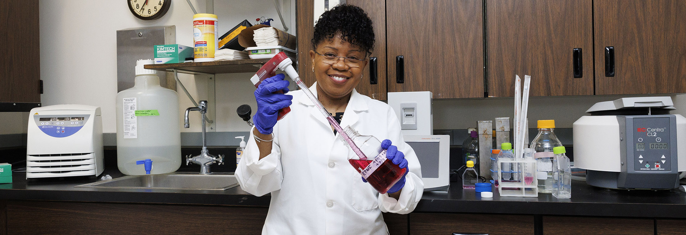
Overview
ECU Strategic Plan​
Research Growth​
Office Overview​
  Resources for research activities​ ​ ​

Slide 5

Notes:
The university adopted a new strategic plan that will guide us through 2028. This plan, Future Focused, Innovation Driven, strikes at the core of who we are as a university community. It draws on our hallmark commitments to serve and gives us space to continue our quest to be a national model for student success, public service, and regional transformation. At the same time, we envision a future where we turn our attention toward the innovations that will have deep and meaningful impact on the people and places we serve as well as the challenges around them.
To set the stage for the plan we will share with you next, we want to share guiding definitions for this work.
Our evergreen commitments – what we sometimes talk about as our “DNA” – are our mission – our reason for being. While there may be new ways to think about achieving the mission, at its core this purpose does not change. On the other hand, as we look to the future, we think about what vision we see for our campus – what do we strive to be in five years? Our values provide the culture and action to propel us forward.

Slide 6
Strategic Plan Priority Statements
University Motto
Vision Statement
Servire: To Serve
Future Focused. Innovation Driven.
Mission Priorities
Vision Priorities
Student Success (M1)​
Social and Economic Mobility (V1)​
Public Service (M2)​
​
Workforce Success (V2)​
Regional Transformation (M3)​
Rural Health and Well-Being (V3)​
Notes:
The refreshed plan maintains a focus on areas that are core to our mission while also turning an eye toward what we aspire to be. At the intersection of our mission and vision are our priorities.
Through comments made to strategic planning and advisory committee members, surveys and campus forums, there was been robust stakeholder input in this process. The Chancellor and Executive Council rely on these two groups to provide insight into the capacities, expertise, and vision for where ECU will go.
This was a “refresh” rather than the building of an entirely new plan. The three phases of this approach ensured that we canvased the landscape around us, used a data driven approach, and engaged Pirate Nation along the way. From this iterative process, we built an inclusive, focused, and impactful plan that reflects the opportunities and needs of the stakeholders who helped develop it.
The campus has set the mission, vision, priorities, and objectives. Colleges, schools, divisions, and departments are now going through the process of identifying the initiatives that will measure our progress over the next five years.
That process will be ongoing through fall 2023 to ensure faculty, staff, students, and administrators have an opportunity to weigh in on those things that best represent how ECU is future focused and innovation driven. Unit alignment plans must advance the broader strategic goals and priorities of the university, connect with one or more UNC system performance metrics, and prioritize the university as future-focused and innovation driven. We will create publicly available strategic plan dashboards as well as internal tools to measure our progress.

Slide 7
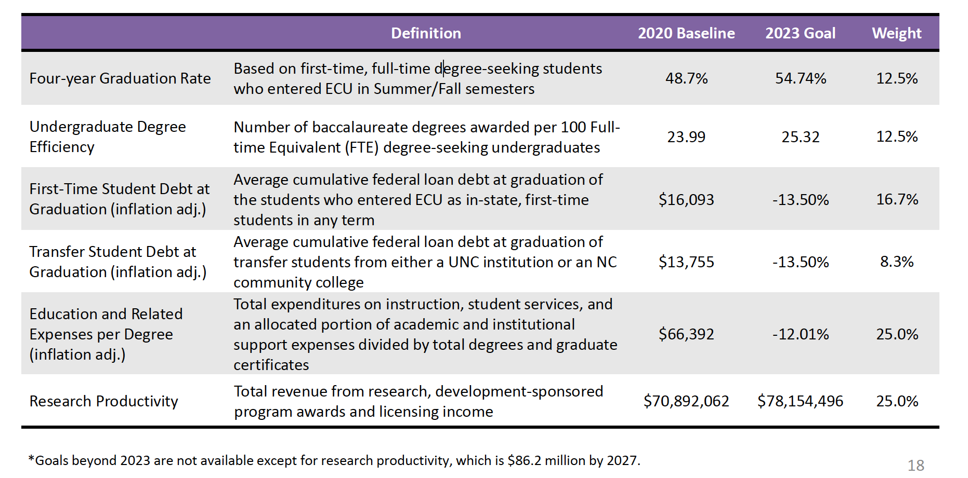
UNC Weighted Performance Metrics
Notes:
I want to connect the strategic plan with UNC system performance metrics. From a high level, the funding model is based on the sum of enrollment change and weighted performance. Weighted performance is based on the core metrics that you see here. Campuses were allowed to select one metric while the other five are required. ECU analyzed available options and chose research productivity as our elective metric.
Reporting guidelines for sponsored program awards and licensing income are identical to those used in the annual UNC Report to the President on Research and Sponsored Programs.

Slide 8
Mapping UNC Funding Model & University Strategic Plan
 | M1.1 | M1.2 | M1.3 | M2.1 | M2.2 | M3.3 | V1.1 | V1.2 | V1.3 | V3.3
UG 4-year Graduation | X
UG Degree Efficiency | X |  |  |  |  |  | X | X
First-time Student Loan Debt | X |  |  |  |  |  | X
Transfer Student Loan Debt | X |  |  |  |  |  | X
Cost per Degree | X |  | X |  |  |  | X | X
Research |  | X |  | X | X | X |  |  |  | X
SCH Production |  |  | X |  |  |  | X | X | X
Notes:
We thought it would be helpful for you to see how connected the strategic plan objectives are to our core performance metrics. Every priority in the plan connects to at least one of the performance metrics. We feel this is an important alignment of system and campus priorities as well as a way to track our progress toward our commitment to be a future focused, innovation driven organization.

Slide 9
Sponsored Programs Activity
Notes:
ECU’s growth has been from a team effort across the university, from the Chancellor down, to create systems and structures and supports to help faculty Showing from 2019-2024.

Slide 10
Sponsored Programs Activity
Notes:
ECU’s growth has been from a team effort across the university, from the Chancellor down, to create systems and structures and supports to help faculty Showing from 2019-2024.

Slide 11
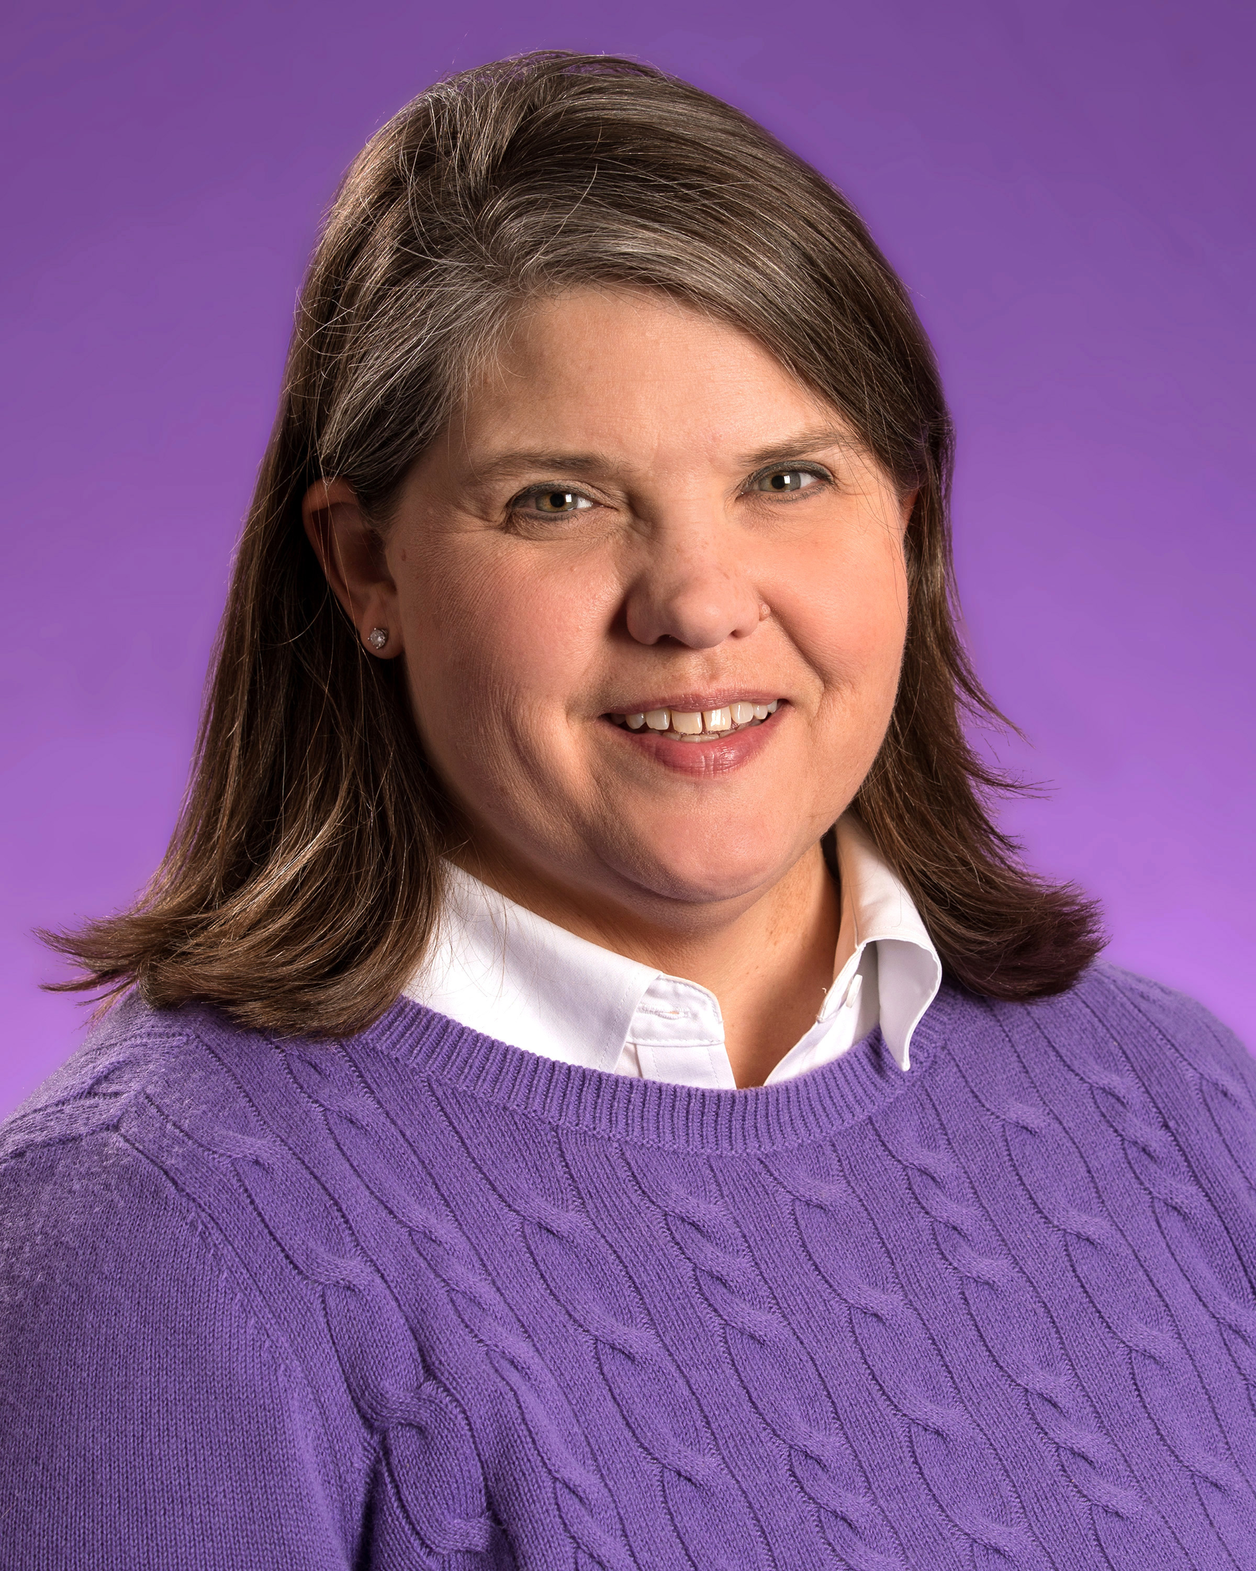
Office of Research
Leadership​:
Interim Chief Research Officer
Dr. Sharon Paynter​
AVC for Research Development
Dr. Mary Farwell​
AVC for Research Administration and Compliance
Ms. Becky Welch​
Dr. Sharon Paynter

Slide 12
Office of Research Structure
Chief Research Officer
AVC for Research Development
AVC for Research Administration and Compliance
Postdoctoral Affairs
Compliance Monitoring
Undergraduate Research
Pre-Award Services
Research Programs and Operations
​
Post-Award Services
​
Centers and Institutes
eRA and Data Analytics
Core Facilities and Shared Spaces
Human Subjects Protections
Data Governance and Stewardship
Research Integrity and Compliance
Export Controls and Foreign Influence

Slide 13
Chief Research Officer
Assistant Vice Chancellors
Associate Deans for Research
University Research Council (URC)
UNC-System Center and Institute Directors
Faculty Senate
Research and Creative Activities Committee
Faculty, Staff, Students, Fellows

Slide 14
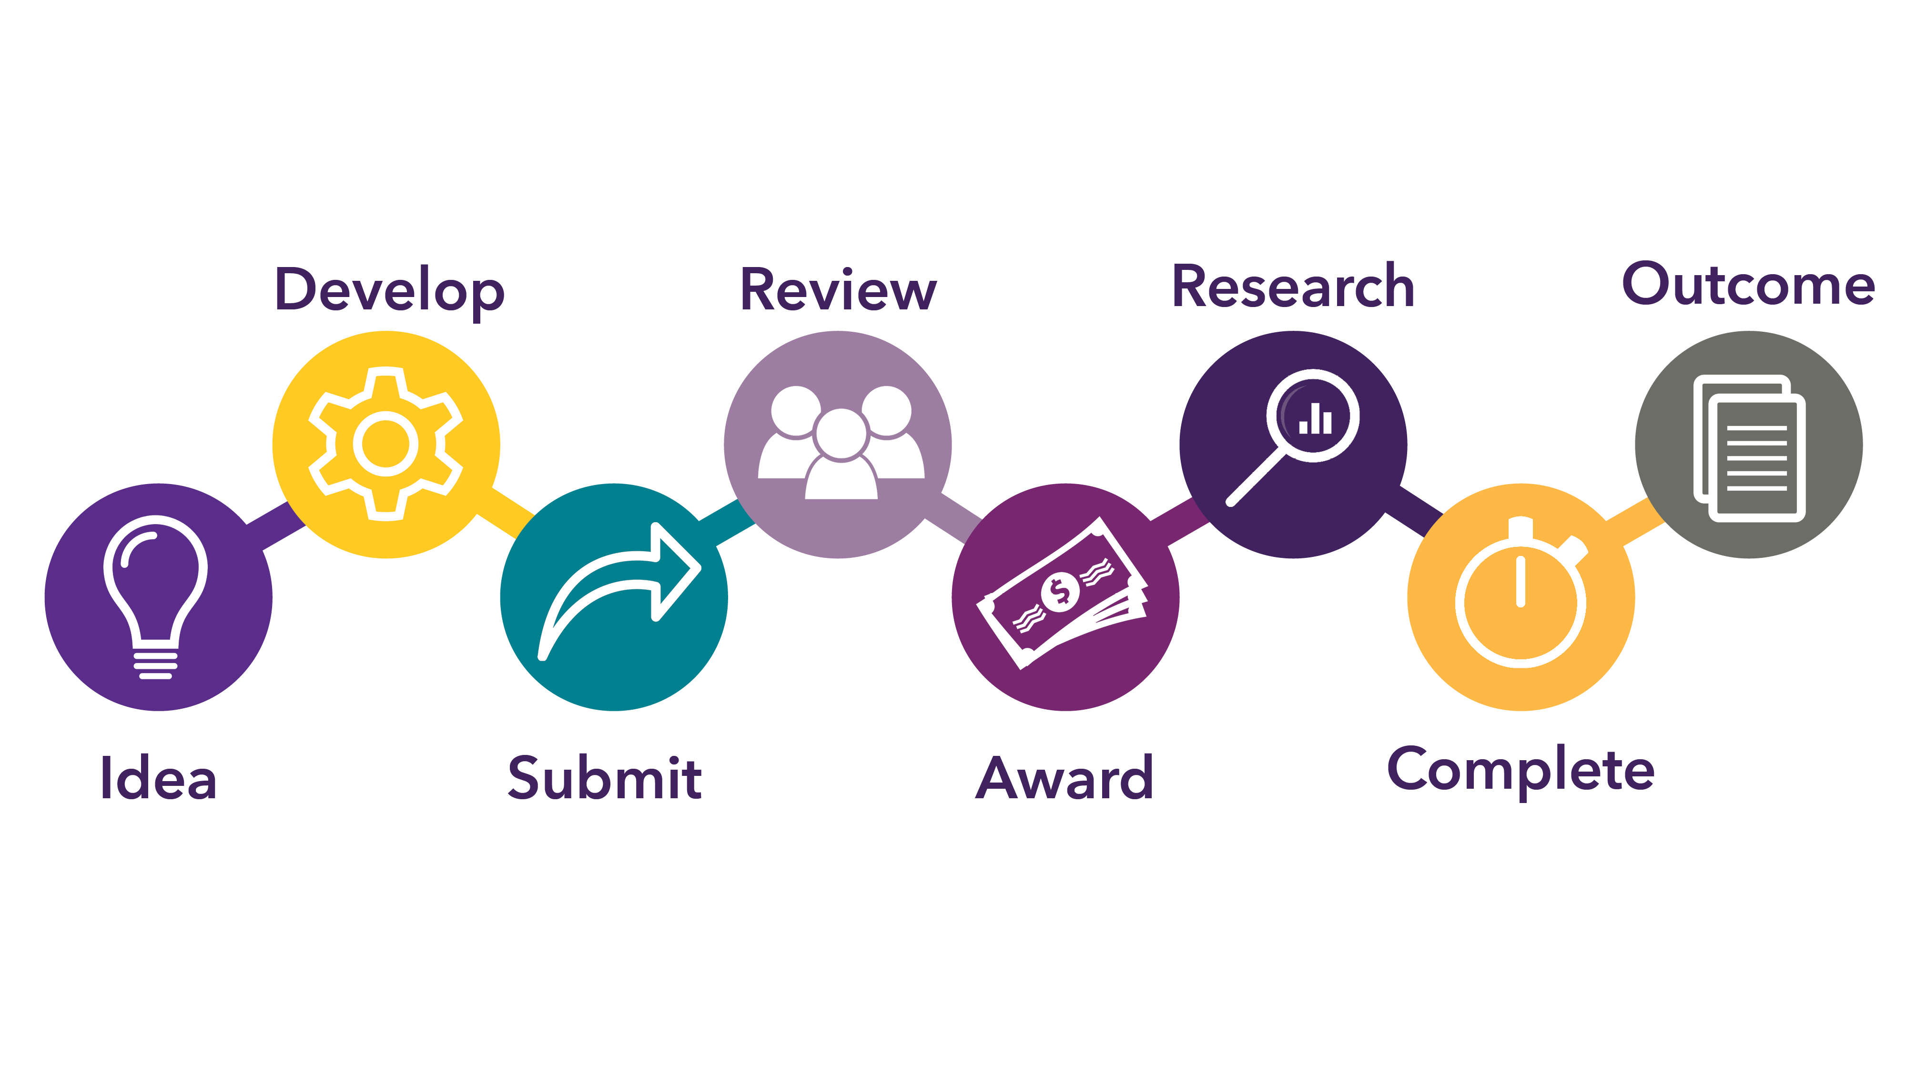
Research Project Life Cycle
14

Slide 15
Research Resources
High Performance Computing (HPC) Program​
REDE, in coordination with ITCS, has invested in two pilot programs to provide access to high performance computing (HPC) resources for primary investigators and their labs to generate the preliminary data needed to make high quality applications to extramural grant funding agencies.
The available resources consist of two sources:
NC State (see technical details below)
Microsoft Azure (see technical details below)
Internal Funding
Internal Funding
Major Funding Sources
Federal Grants
Foundations
National Endowment for the Arts
National Endowment for the Humanities
National Institutes of Health
National Science Foundation
15

Slide 16

High Performance Computing (HPC) Program
In coordination with ITCS, we've invested in two pilot programs to provide access to high performance computing (HPC) resources for primary investigators and their labs to generate the preliminary data needed to make high quality applications to extramural grant funding agencies.
The available resources consist of two sources:
NC State
Microsoft Azure
rede.ecu.edu/hpcprogram

Slide 17


Internal Funding Opportunities
Startup Program
Faculty Support and Reassignment Awards
Startup program funds are available to assist new faculty in developing a self-sustaining research program upon arrival at ECU.
This program provides funds to allow faculty dedicated time in the academic year for creative and scholarly activity and to prepare and submit a competitive application for extramural support.
Recognizes faculty who are highly effective in their research and creative activity output.
Supports scholarly activities that lead to submission of competitive extramural proposals
rede.ecu.edu/internalfunding

Slide 18
Research Project Life Cycle
18

Slide 19
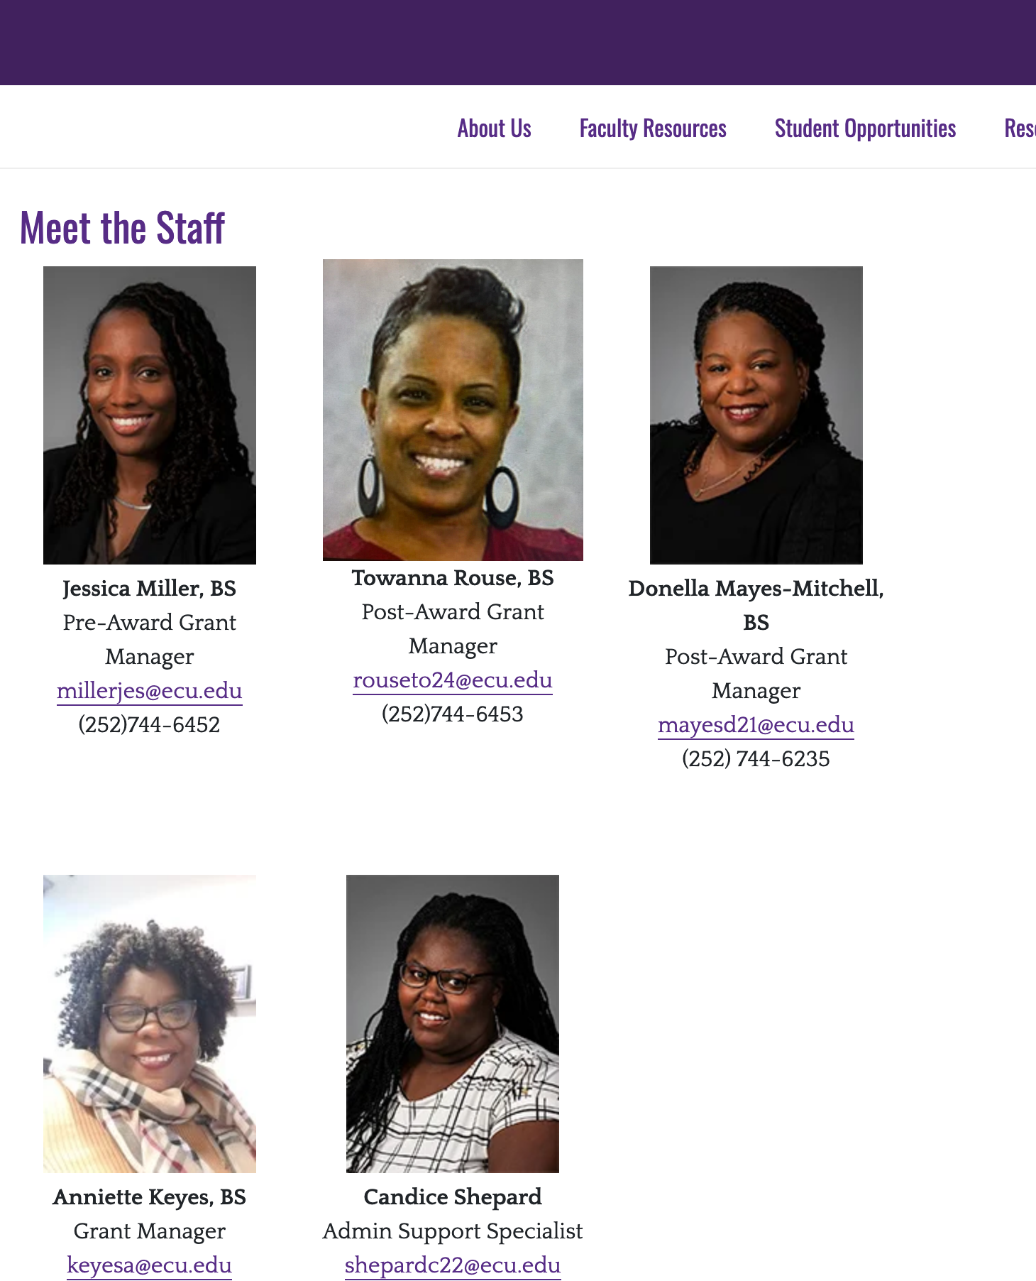
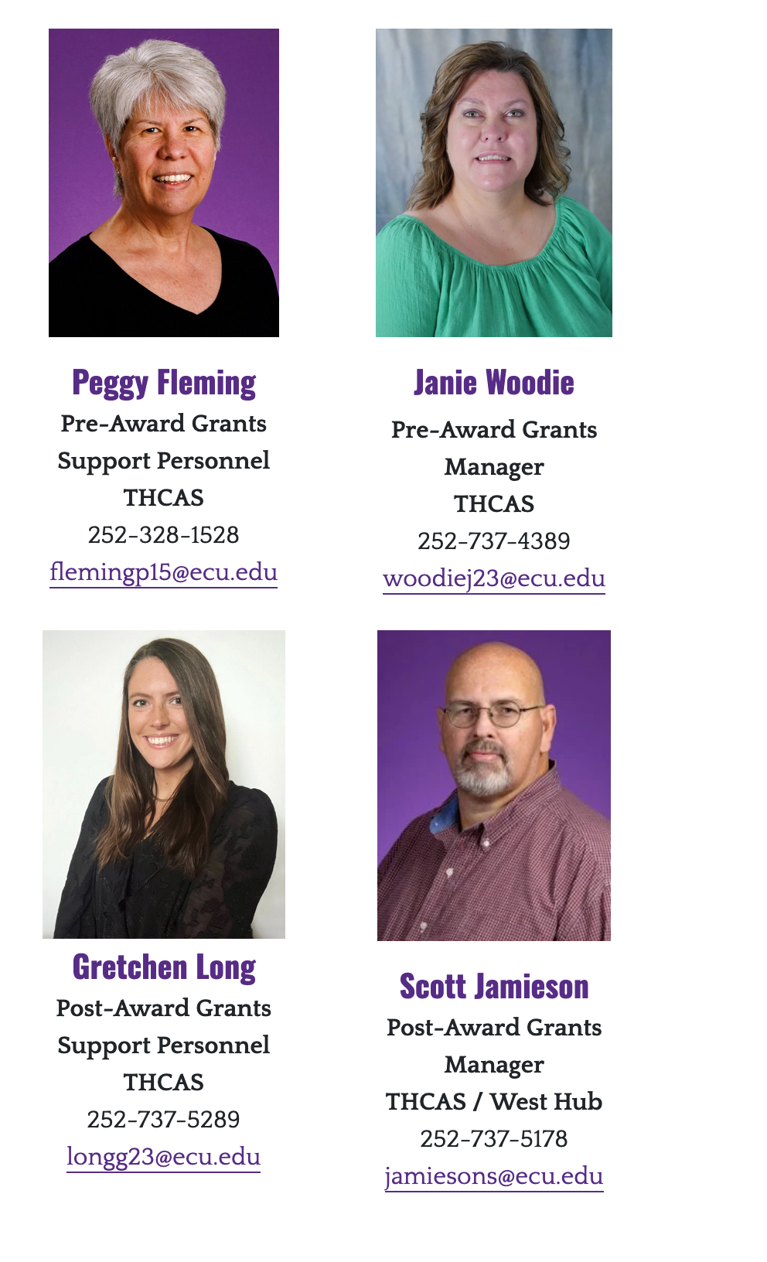
Research Administration Hubs:
Pre- and Post-award grant management

Slide 20
Office of Research Administration and Compliance (ORAC)
Provides support to the ECU research community:
  Proposal review, processing, and submission to external sponsors
  Review and Acceptance of awards
  Assistance in financial management of funded projects
  Closeout and final financial reporting
  Institutional Review Board (IRB) support and training
  Institutional Animal Care and Use Committee (IACUC) Support and training
  Responsible Conduct of Research (RCR) Training
  Conflict of Interest (COI) reporting and management

Slide 21
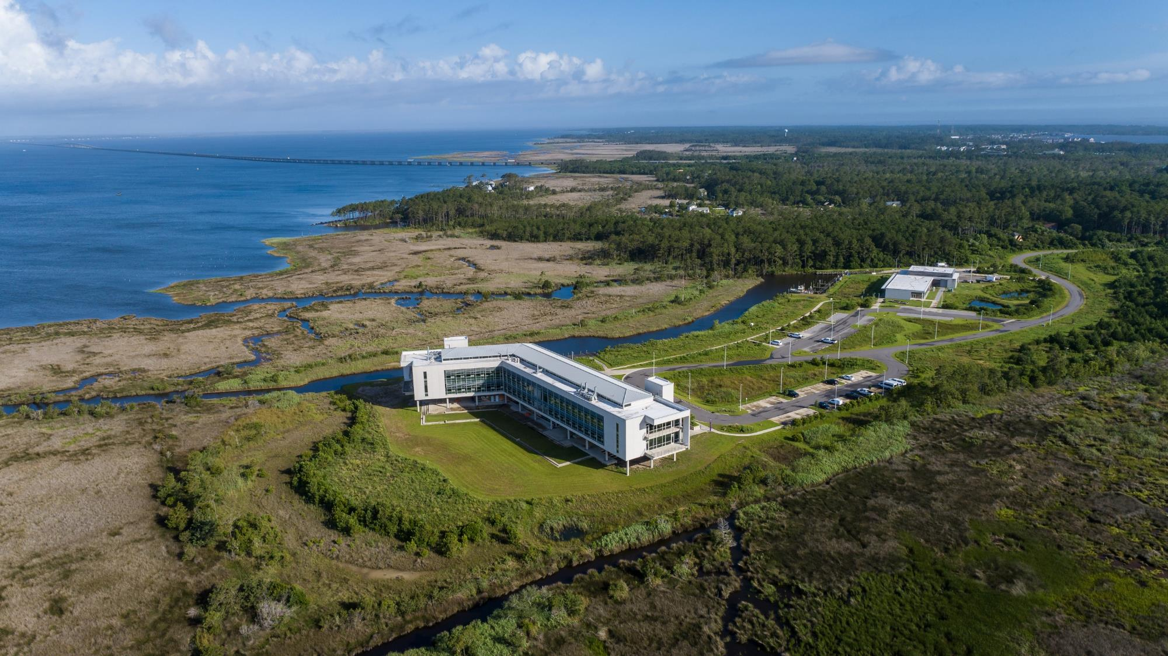



Slide 22
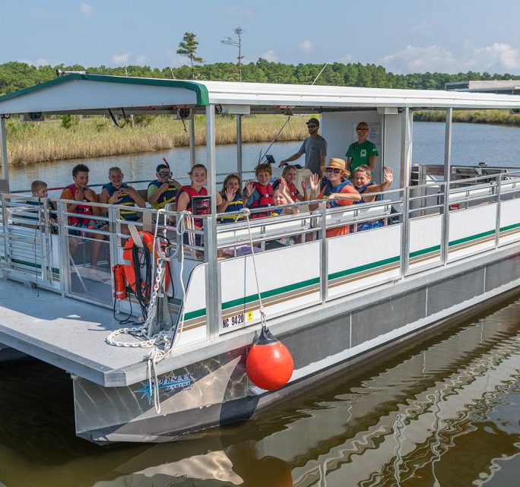
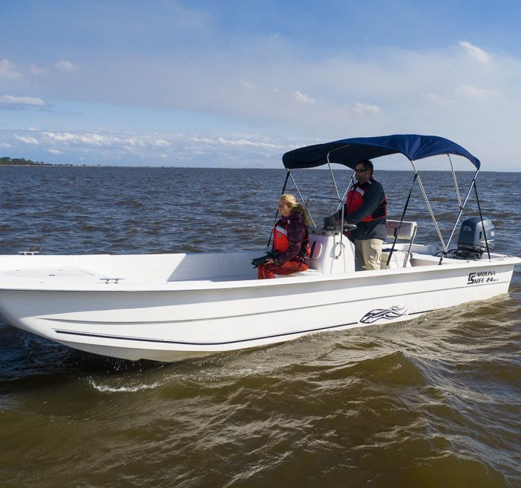
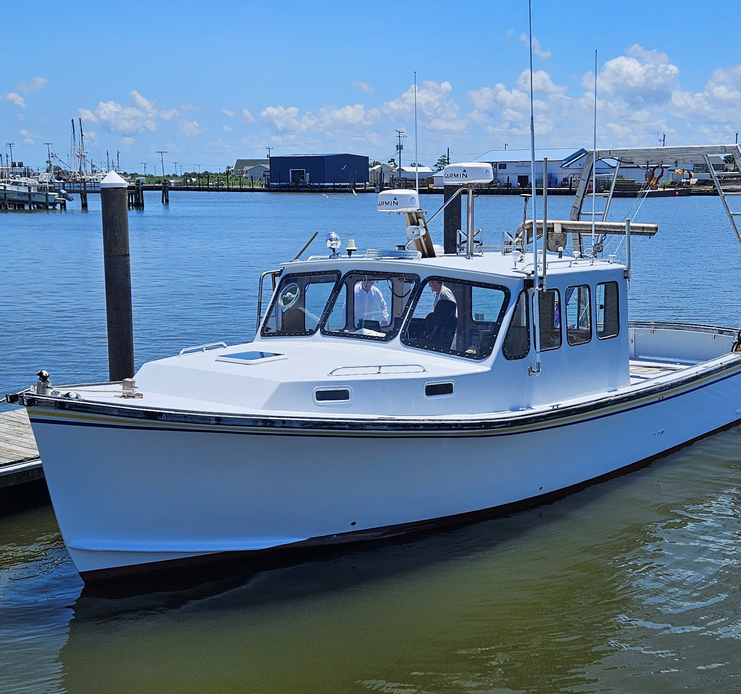
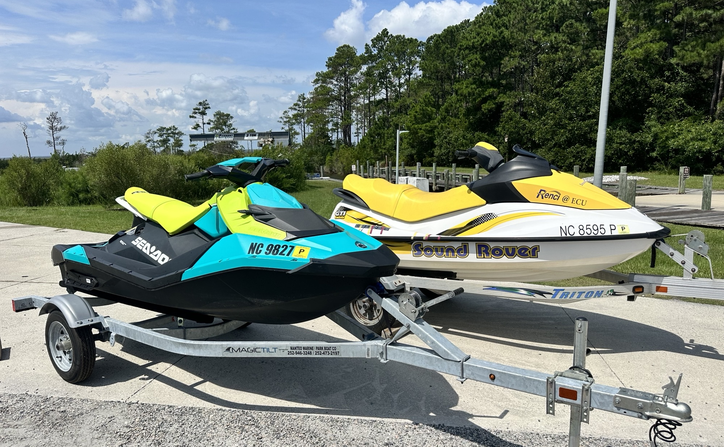
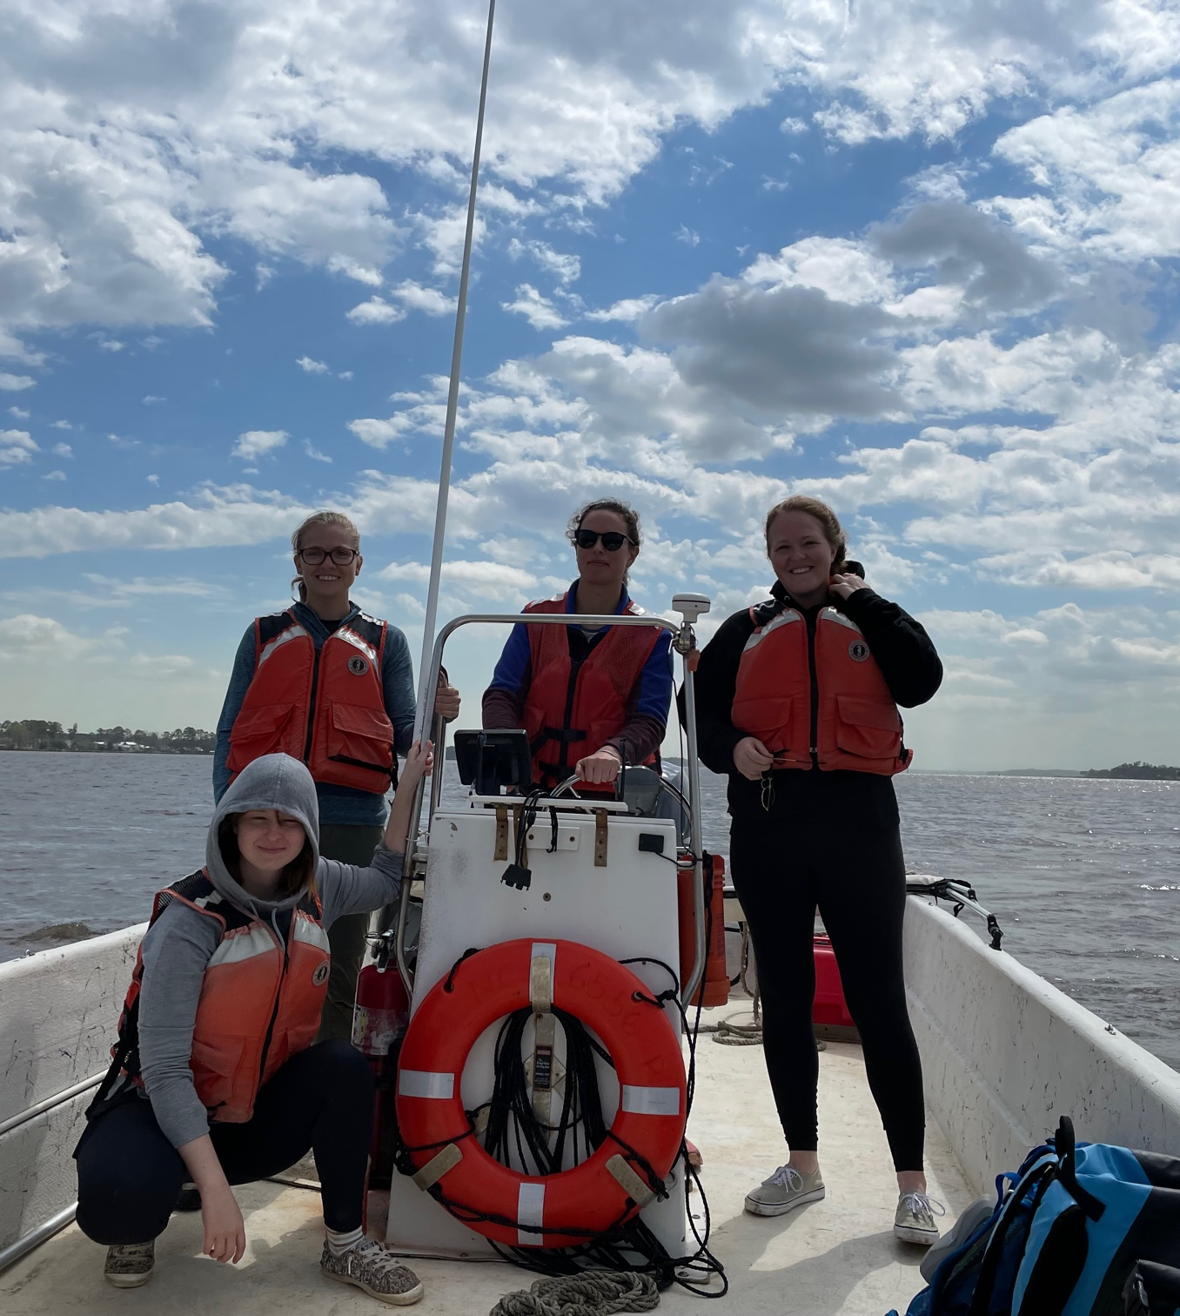
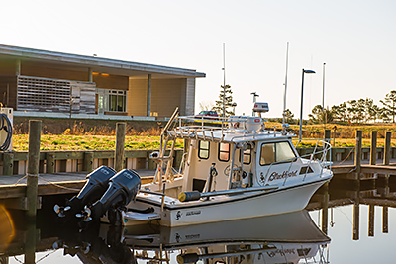
ECU Research Vessels
17 boats including
  42’ Miss Caroline – offshore work
  30’ Sightseer Pontoon
  4 skiffs from 19’ – 25’ – sound and river work
Primary users
  CSI
  Department of Coastal Studies
  Program in Maritime History
  Biology Department
  Geology Department
  Geography Department
  DWS Staff Trained 20 Students, faculty and staff in the State Department’s Motorboat Operation Certification Course in the last fiscal year

Slide 23
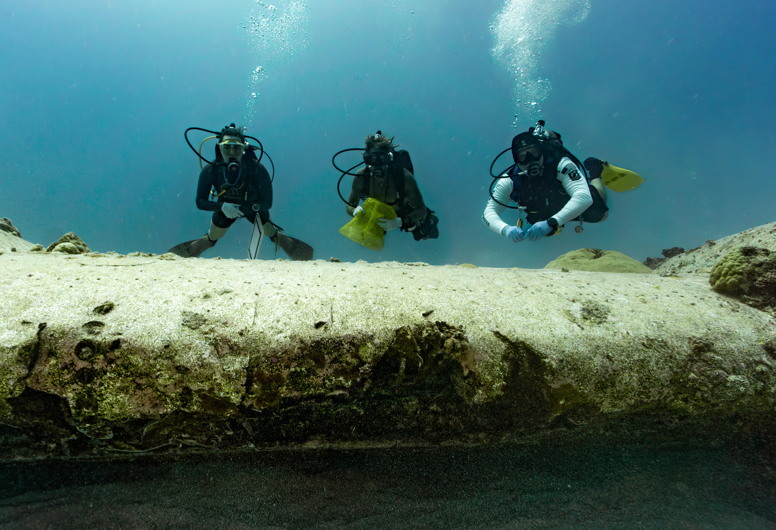
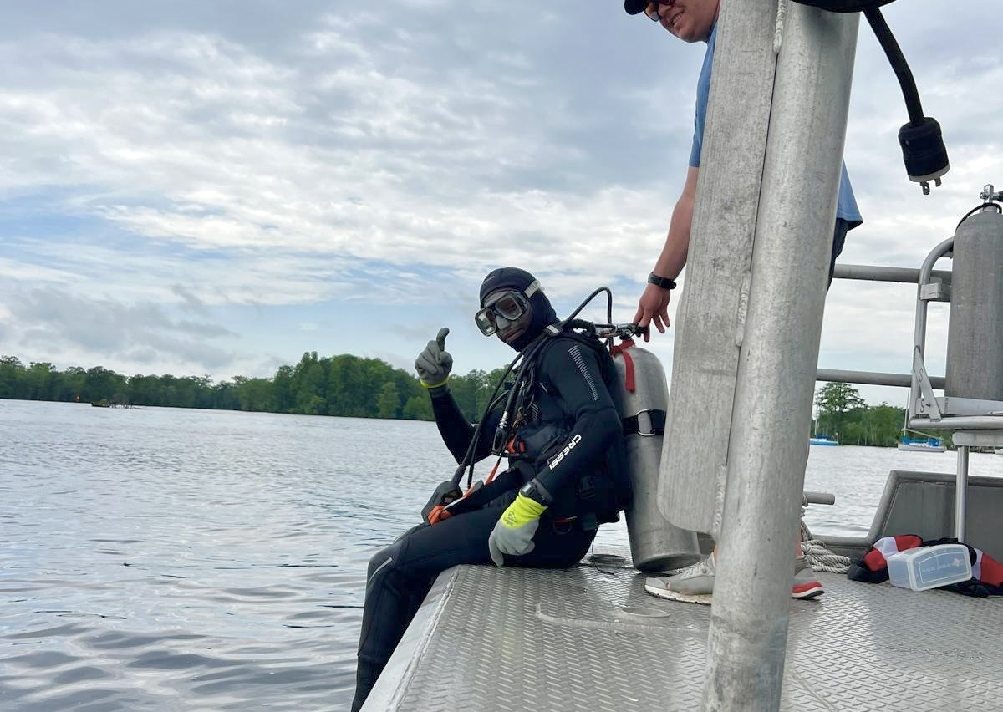
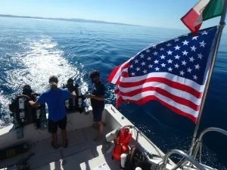
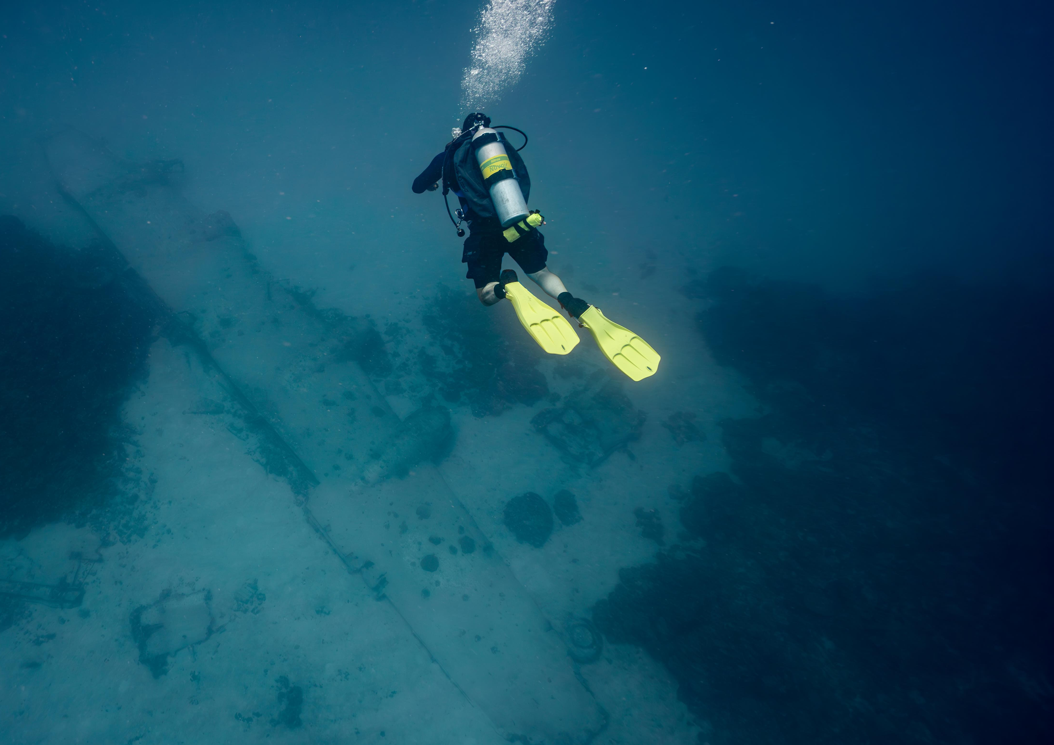
ECU Scientific Diving
46 active student, faculty, and staff scientific divers from
  CSI, Department of Coastal Studies, Program in Maritime History, Biology Department, Geology Department
Students, faculty, and staff conducted 779 scientific and proficiency dives in the waters of Bermuda, Florida, Maryland, North Carolina, Saipan, and Washington in the last fiscal year, spending 522 hours underwater
Certified in the American Academy of Underwater Sciences, Diver Alert Network Diver First Aid Providers, Scuba Diving International, Technical Diving International, and Closed-circuit Rebreathers
Additional training provided in drysuits for cold water diving, full-face mask for top to bottom communications, dark water instructional program.

Slide 24
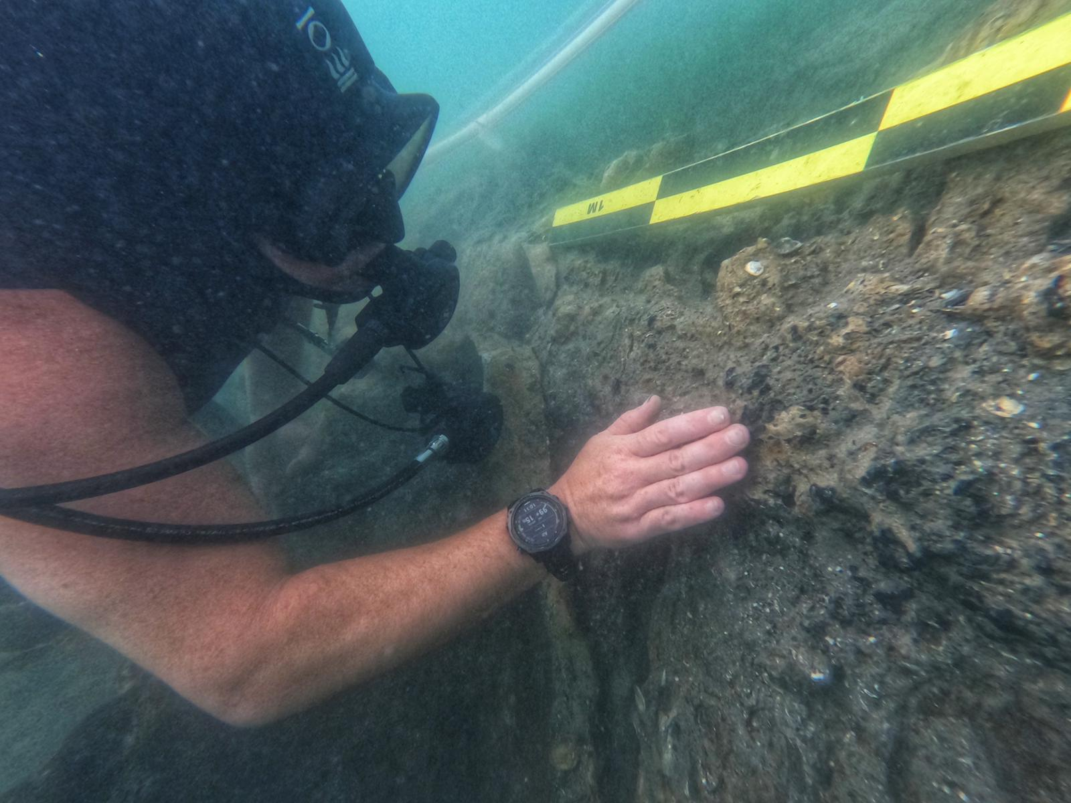
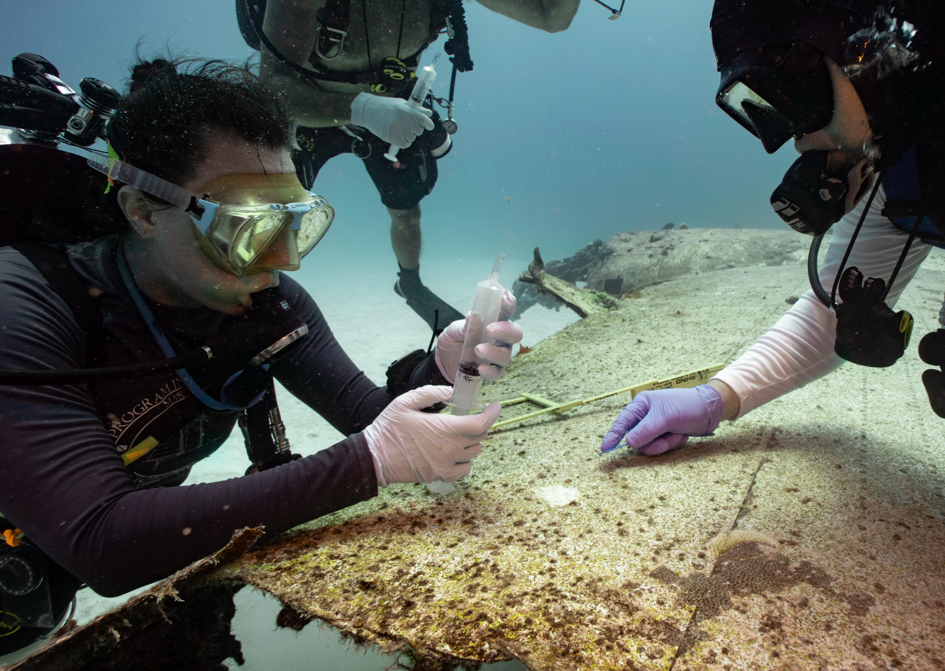
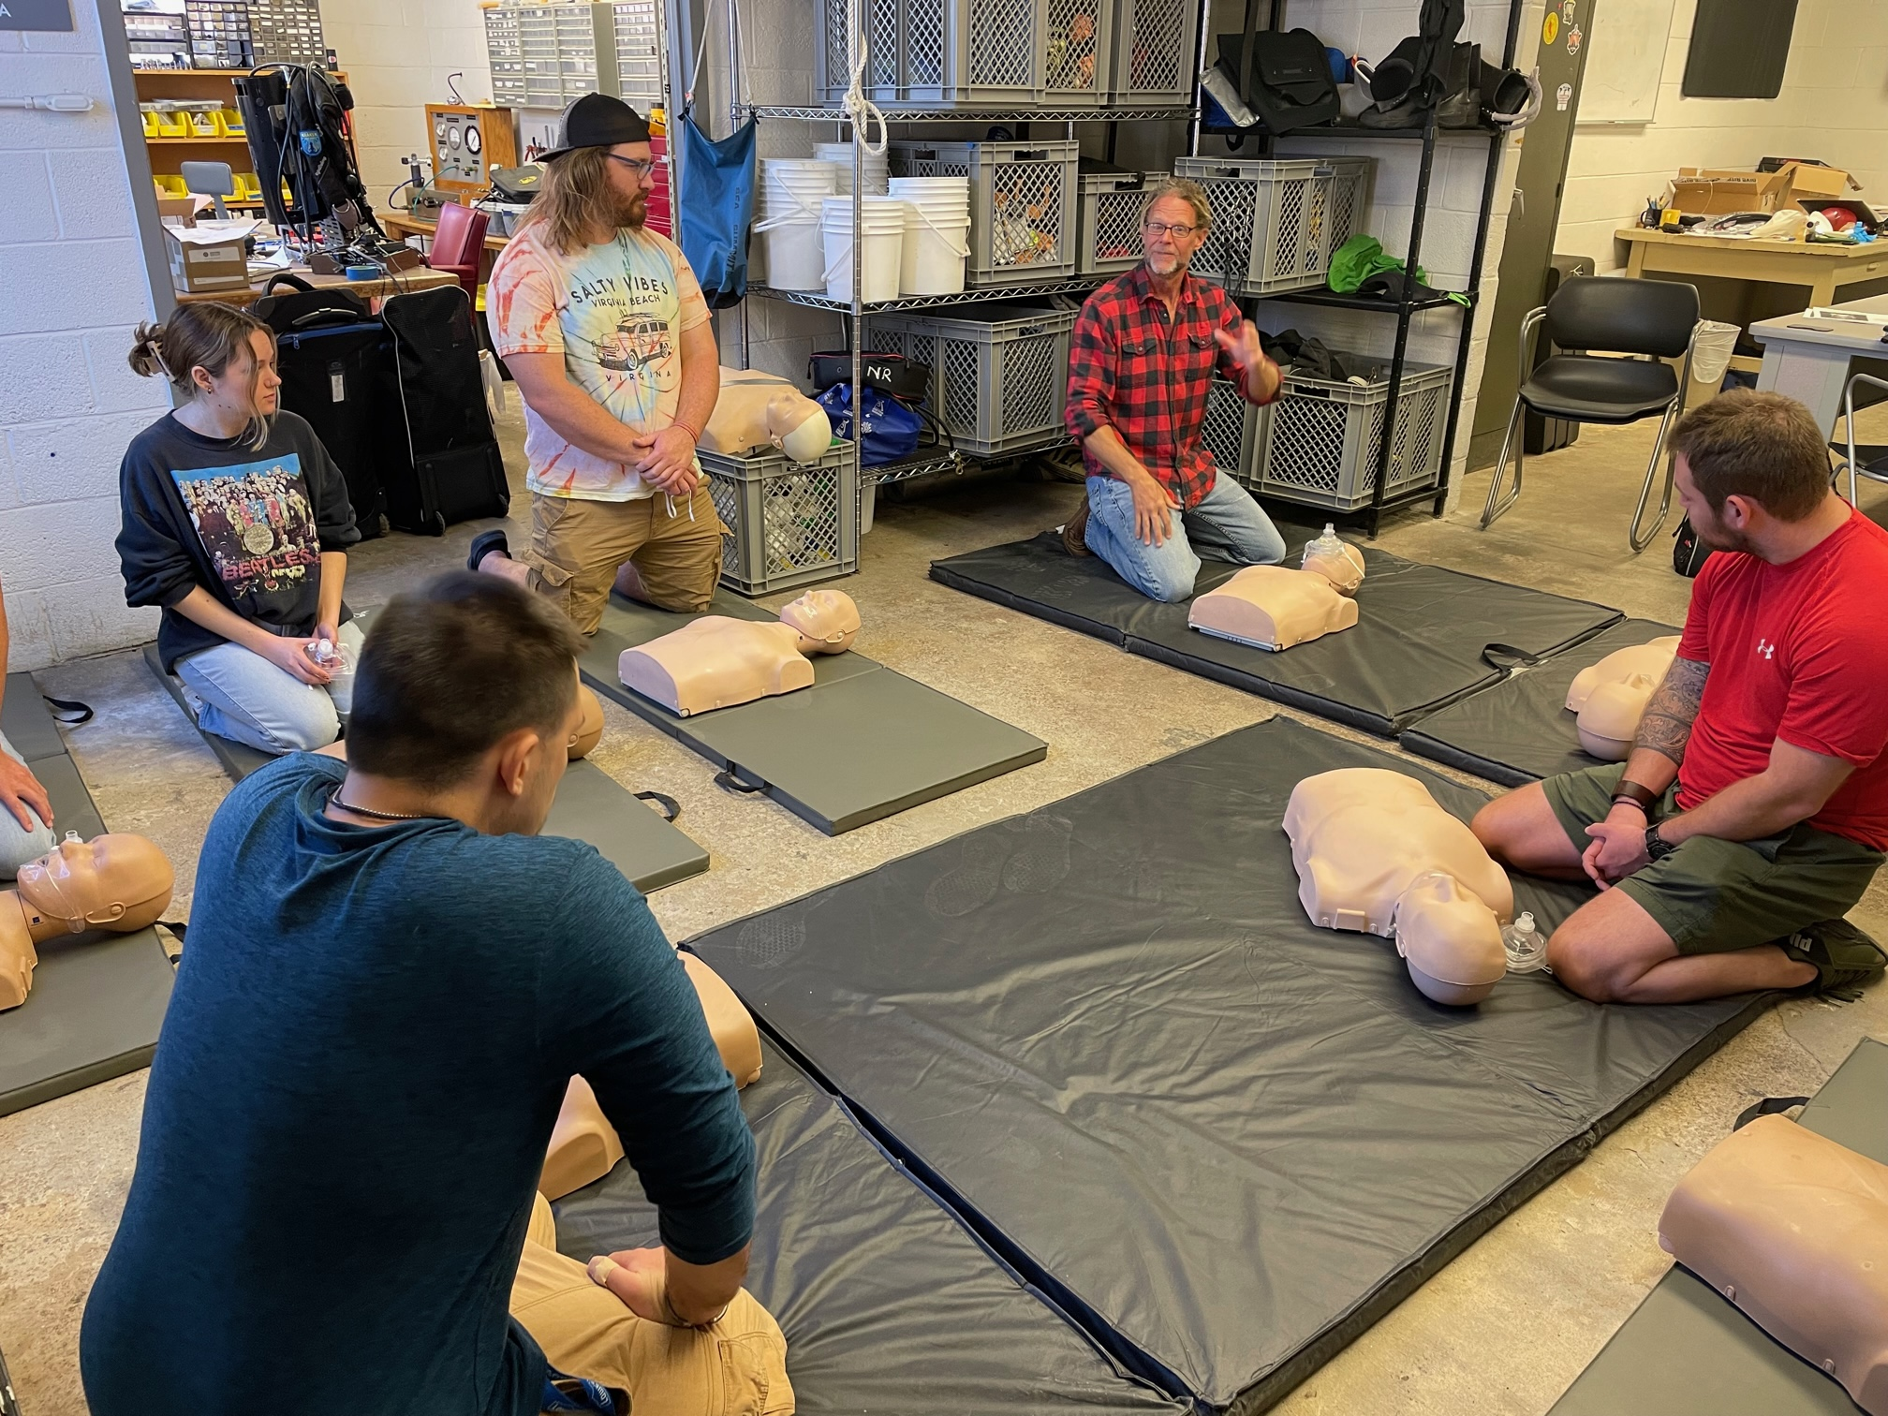
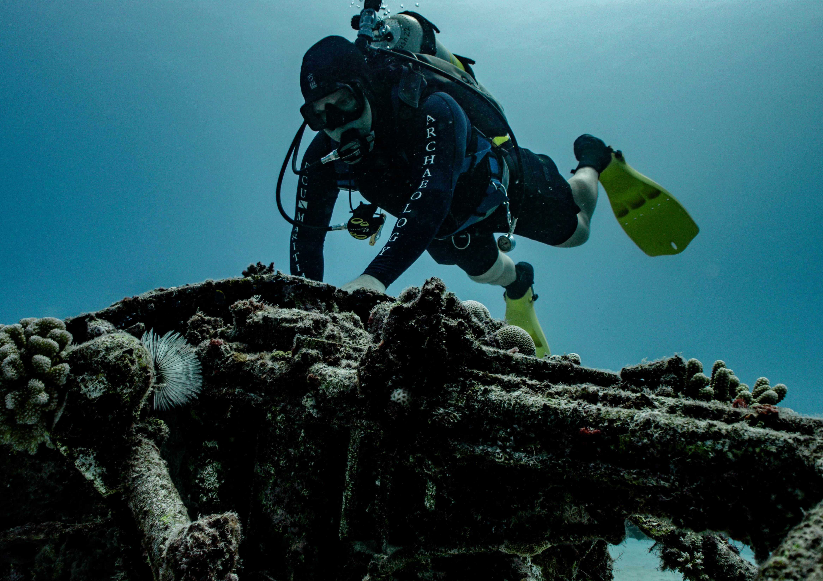
Training and Experience
Three air compressors located on Main Campus, Minges pool and at CSI are maintained to provide air fills for the over 150+ compressed gas cylinders on hand for research dives
All Scientific divers are trained in First Aid, CPR, and Emergency Oxygen Administration.
Alumni from this program have gone on to fill top-tier diving leadership roles in the private, state, and federal sectors. Currently the head of NOAA’s Scientific Diving Program is an ECU alum.
ECU is one of the longest tenured Organizational Members of the American Academy of Underwater Sciences, the nationally recognized leader in Scientific Diving

Slide 25
Questions?
Dr. Mary Farwell
Assistant Vice Chancellor
for Research Development​ ​
farwellm@ecu.edu
Becky Welch
Assistant Vice Chancellor for Research Administration and Compliance
welchb18@ecu.edu ​​
rede.ecu.edu

Slide 26
Research Development
Research Administration and Compliance

Slide 27
Outline
ECU Strategic Plan
Research Growth
REDE Overview
Resources for Research and Engagement Activities
Angela Lamson
(interim) Assistant Vice Chancellor for Economic and Community Engagement
Mary Farwell
Assistant Vice Chancellor for Research Development
Becky Welch
Assistant Vice Chancellor for Research Administration and Compliance

Slide 28
Overview​:
ECU Strategic Plan​
Research Growth​
Office of Research Overview​
  Resources for Research and Engagement Activities​ ​ ​
Mary Farwell
Assistant Vice Chancellor
for Research Development​ ​
Becky Welch
Assistant Vice Chancellor for Research Administration and Compliance ​​

Slide 29
Notes:
The university adopted a new strategic plan that will guide us through 2028. This plan, Future Focused, Innovation Driven, strikes at the core of who we are as a university community. It draws on our hallmark commitments to serve and gives us space to continue our quest to be a national model for student success, public service, and regional transformation. At the same time, we envision a future where we turn our attention toward the innovations that will have deep and meaningful impact on the people and places we serve as well as the challenges around them.
To set the stage for the plan we will share with you next, we want to share guiding definitions for this work.
Our evergreen commitments – what we sometimes talk about as our “DNA” – are our mission – our reason for being. While there may be new ways to think about achieving the mission, at its core this purpose does not change. On the other hand, as we look to the future, we think about what vision we see for our campus – what do we strive to be in five years? Our values provide the culture and action to propel us forward.

Slide 30
Strategic Plan Priority Statements
University Motto
Vision Statement
Servire: To Serve
Future Focused. Innovation Driven.
Mission Priorities
Vision Priorities
Student Success (M1)​
Social and Economic Mobility (V1)​
Public Service (M2)​
​
Workforce Success (V2)​
Regional Transformation (M3)​
Rural Health and Well-Being (V3)​
Notes:
The refreshed plan maintains a focus on areas that are core to our mission while also turning an eye toward what we aspire to be. At the intersection of our mission and vision are our priorities.
Through comments made to strategic planning and advisory committee members, surveys and campus forums, there was been robust stakeholder input in this process. The Chancellor and Executive Council rely on these two groups to provide insight into the capacities, expertise, and vision for where ECU will go.
This was a “refresh” rather than the building of an entirely new plan. The three phases of this approach ensured that we canvased the landscape around us, used a data driven approach, and engaged Pirate Nation along the way. From this iterative process, we built an inclusive, focused, and impactful plan that reflects the opportunities and needs of the stakeholders who helped develop it.
The campus has set the mission, vision, priorities, and objectives. Colleges, schools, divisions, and departments are now going through the process of identifying the initiatives that will measure our progress over the next five years.
That process will be ongoing through fall 2023 to ensure faculty, staff, students, and administrators have an opportunity to weigh in on those things that best represent how ECU is future focused and innovation driven. Unit alignment plans must advance the broader strategic goals and priorities of the university, connect with one or more UNC system performance metrics, and prioritize the university as future-focused and innovation driven. We will create publicly available strategic plan dashboards as well as internal tools to measure our progress.

Slide 31
UNC Weighted Performance Metrics
Notes:
I want to connect the strategic plan with UNC system performance metrics. From a high level, the funding model is based on the sum of enrollment change and weighted performance. Weighted performance is based on the core metrics that you see here. Campuses were allowed to select one metric while the other five are required. ECU analyzed available options and chose research productivity as our elective metric.
Reporting guidelines for sponsored program awards and licensing income are identical to those used in the annual UNC Report to the President on Research and Sponsored Programs.

Slide 32
Mapping UNC Funding Model & University Strategic Plan
 | M1.1 | M1.2 | M1.3 | M2.1 | M2.2 | M3.3 | V1.1 | V1.2 | V1.3 | V3.3
UG 4-year Graduation | X
UG Degree Efficiency | X |  |  |  |  |  | X | X
First-time Student Loan Debt | X |  |  |  |  |  | X
Transfer Student Loan Debt | X |  |  |  |  |  | X
Cost per Degree | X |  | X |  |  |  | X | X
Research |  | X |  | X | X | X |  |  |  | X
SCH Production |  |  | X |  |  |  | X | X | X
Notes:
We thought it would be helpful for you to see how connected the strategic plan objectives are to our core performance metrics. Every priority in the plan connects to at least one of the performance metrics. We feel this is an important alignment of system and campus priorities as well as a way to track our progress toward our commitment to be a future focused, innovation driven organization.

Slide 33
Sponsored Programs Activity
Notes:
ECU’s growth has been from a team effort across the university, from the Chancellor down, to create systems and structures and supports to help faculty Showing from 2019-2024.

Slide 34
Sponsored Programs Activity
Notes:
ECU’s growth has been from a team effort across the university, from the Chancellor down, to create systems and structures and supports to help faculty Showing from 2019-2024.

Slide 35
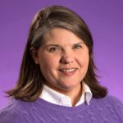
Office of Research
Leadership​:
Interim Chief Research Officer
Dr. Sharon Paynter​
AVC for Research Development
Dr. Mary Farwell​
AVC for Research Administration and Compliance
Ms. Becky Welch​
Sharon Paynter

Slide 36
Chief Research Officer
AVC
Research Development
AVC
Research Administration & Compliance
Post-doctoral
Affairs
Compliance Monitoring
Pre-Award
Undergraduate
Research
Post-Award
Research Excellence
eRA and Data Analytics
Centers and Institutes
Human Subjects Protections
Core Facilities & Shared Spaces
Data Governance & Stewardship
Res. Integrity
& Compliance
Export Controls & Foreign Influence
Notes:
Responsibility matrix

Slide 37
Chief Research Officer
Assistant Vice Chancellors
Associate Deans for Research
University Research Council (URC)
UNC-System Center and Institute Directors
Faculty Senate
Research and Creative Activities Committee
Faculty, Staff, Students, Fellows

Slide 38
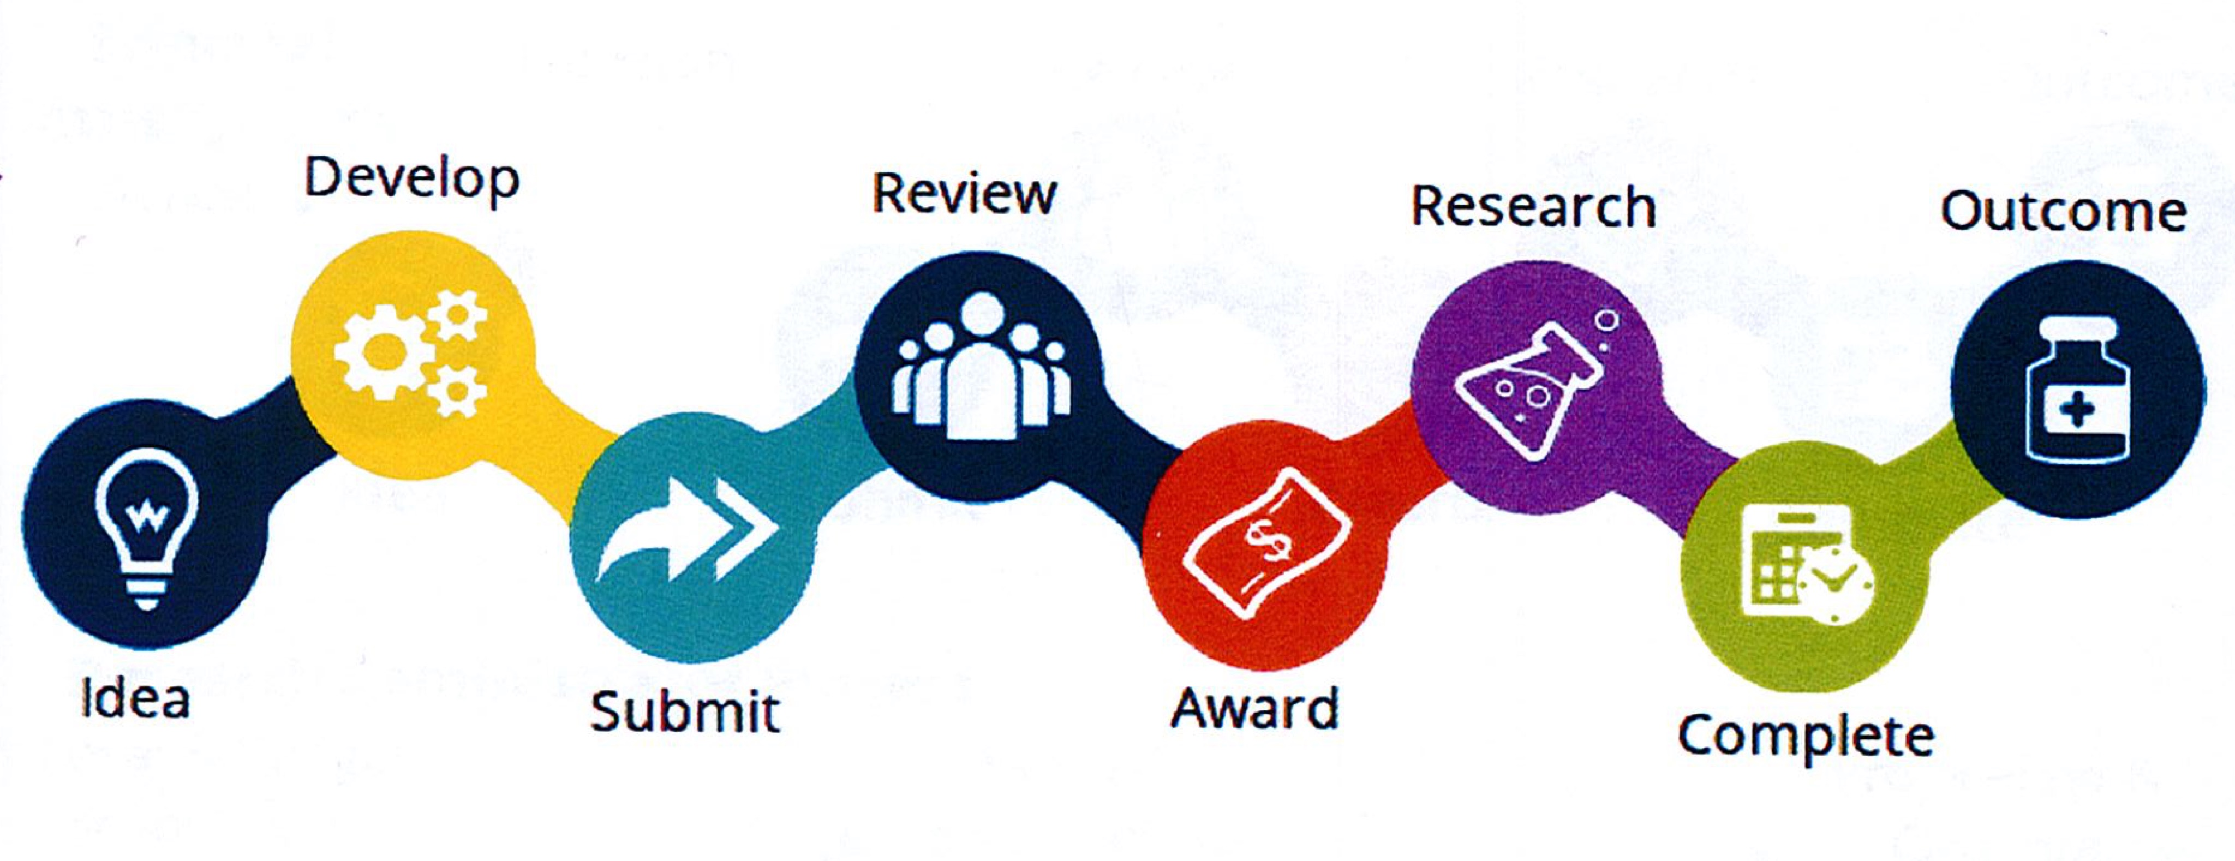
Research Project Life Cycle
38

Slide 39

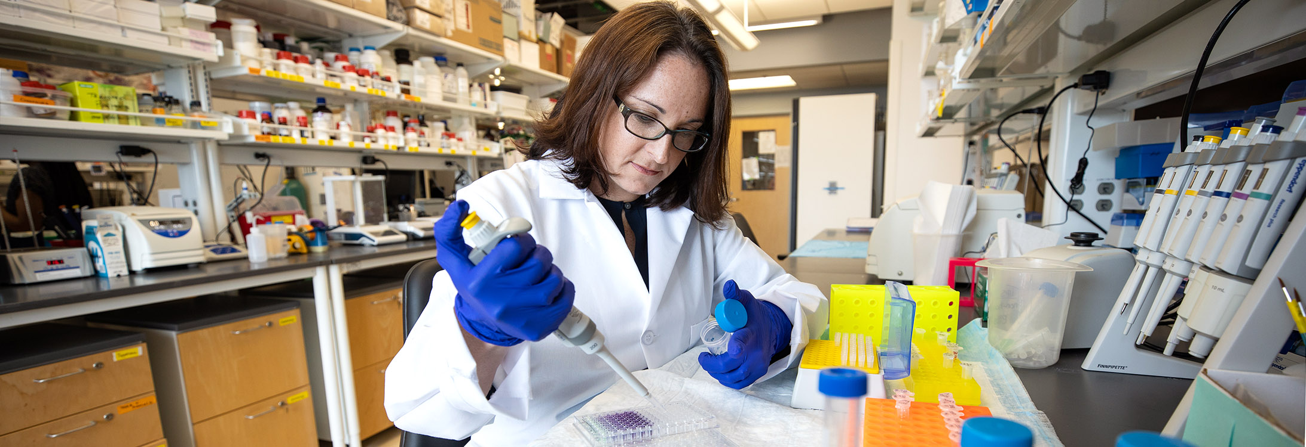
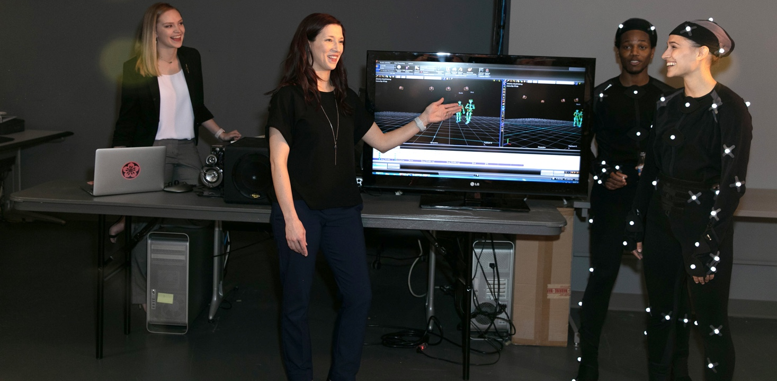
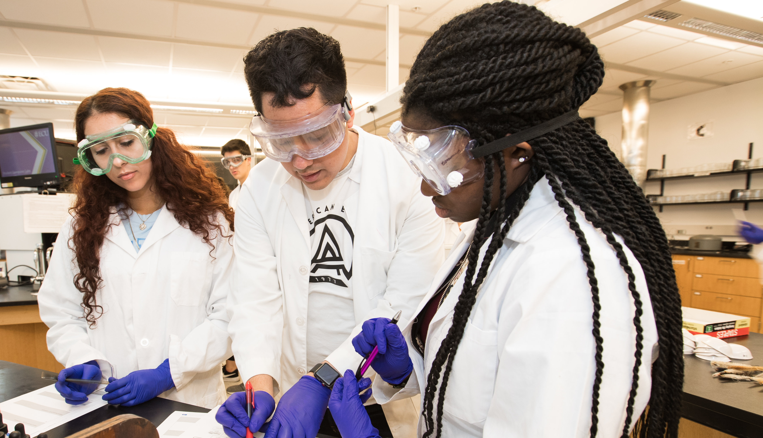
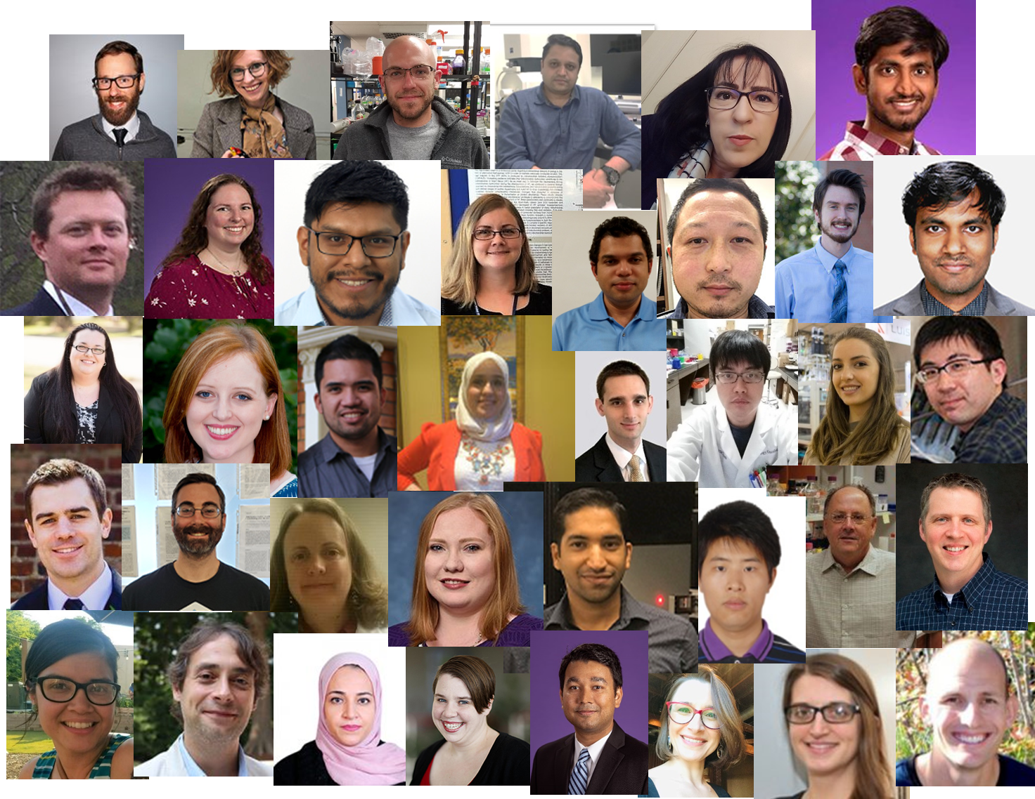
Office of Research Development
Faculty Startup Packages
Grant Editing/Review
Funded grants examples
Faculty Senate Research and Creative Activity Committee
Faculty RCA Awards
Undergraduate Research
Postdoctoral Affairs

Slide 40
Research Administration Hubs:
Pre- and Post-award grant management

Slide 41
Research Project Life Cycle
41

Slide 42
Office of Research Administration and Compliance (ORAC)
ORAC provides support to the ECU research community through:
  Proposal review, processing, and submission to external sponsors
  Review and Acceptance of awards
  Assistance in financial management of funded projects
  Closeout and final financial reporting
  Institutional Review Board (IRB) support and training
  Institutional Animal Care and Use Committee (IACUC) Support and training
  Responsible Conduct of Research (RCR) Training
  Conflict of Interest (COI) reporting and management

Slide 43
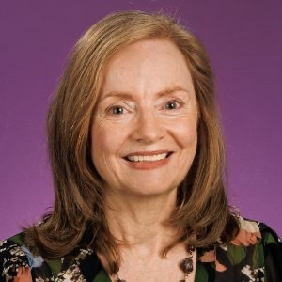
Thank you
Mary Farwell
Assistant Vice Chancellor Research Development
Becky Welch​
Assistant Vice Chancellor for Research Administration and Compliance

