Slide 1

ECU’s Faculty Information System for
Activity Reporting and Reviews

Slide 2
Faculty180 Information
Cara Gohn
Faculty180 Coordinator
252-737-1254 gohnc@ecu.edu
Email: Faculty180@ecu.edu
Website: Faculty180.ecu.edu

Slide 3
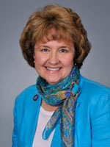
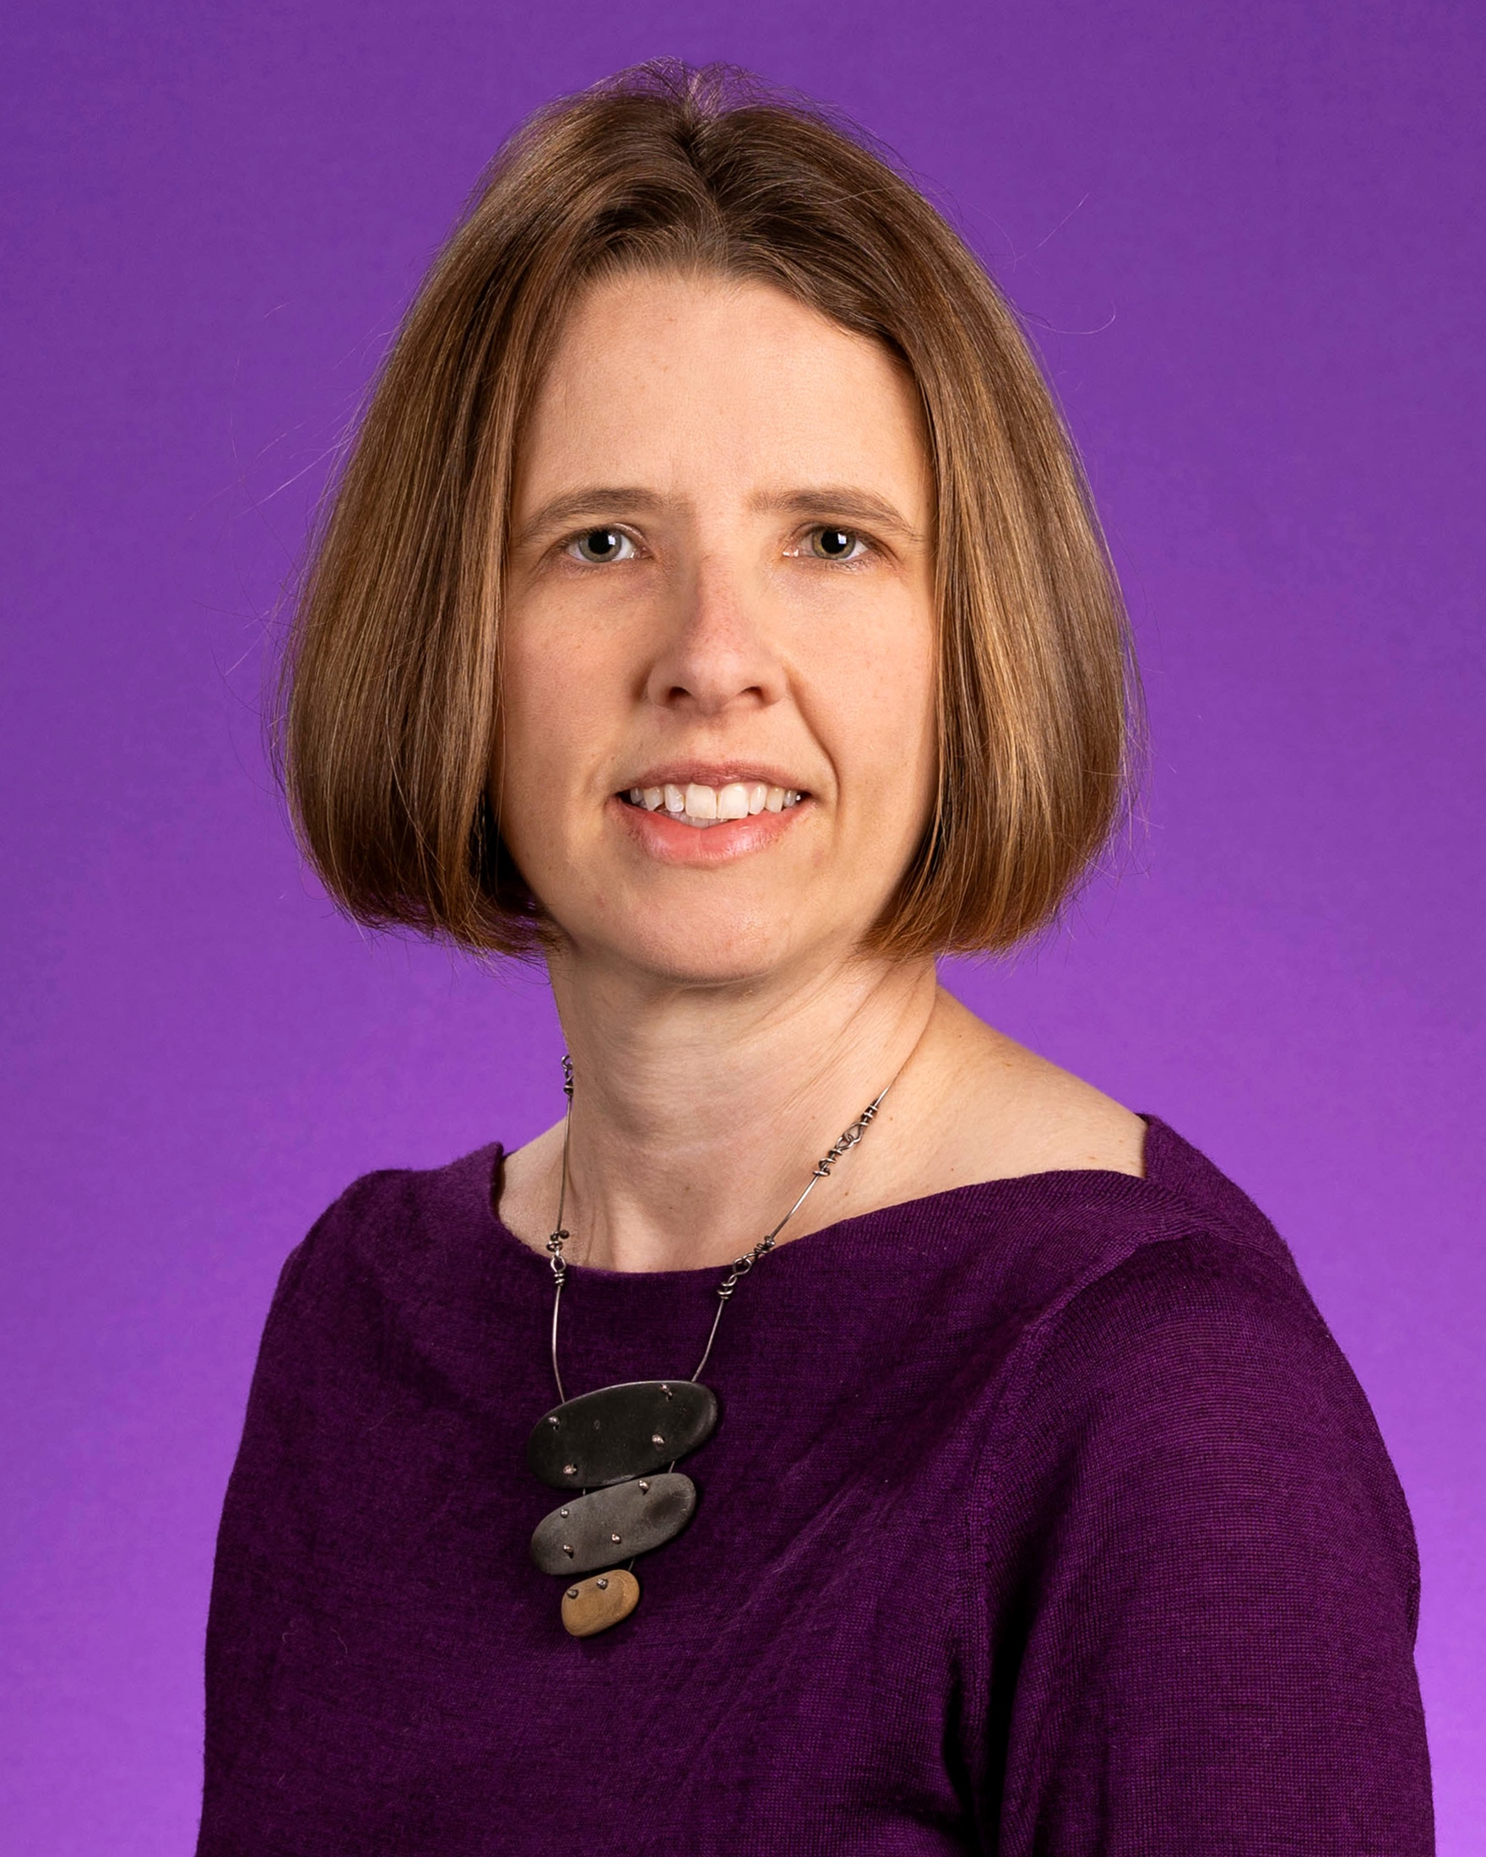
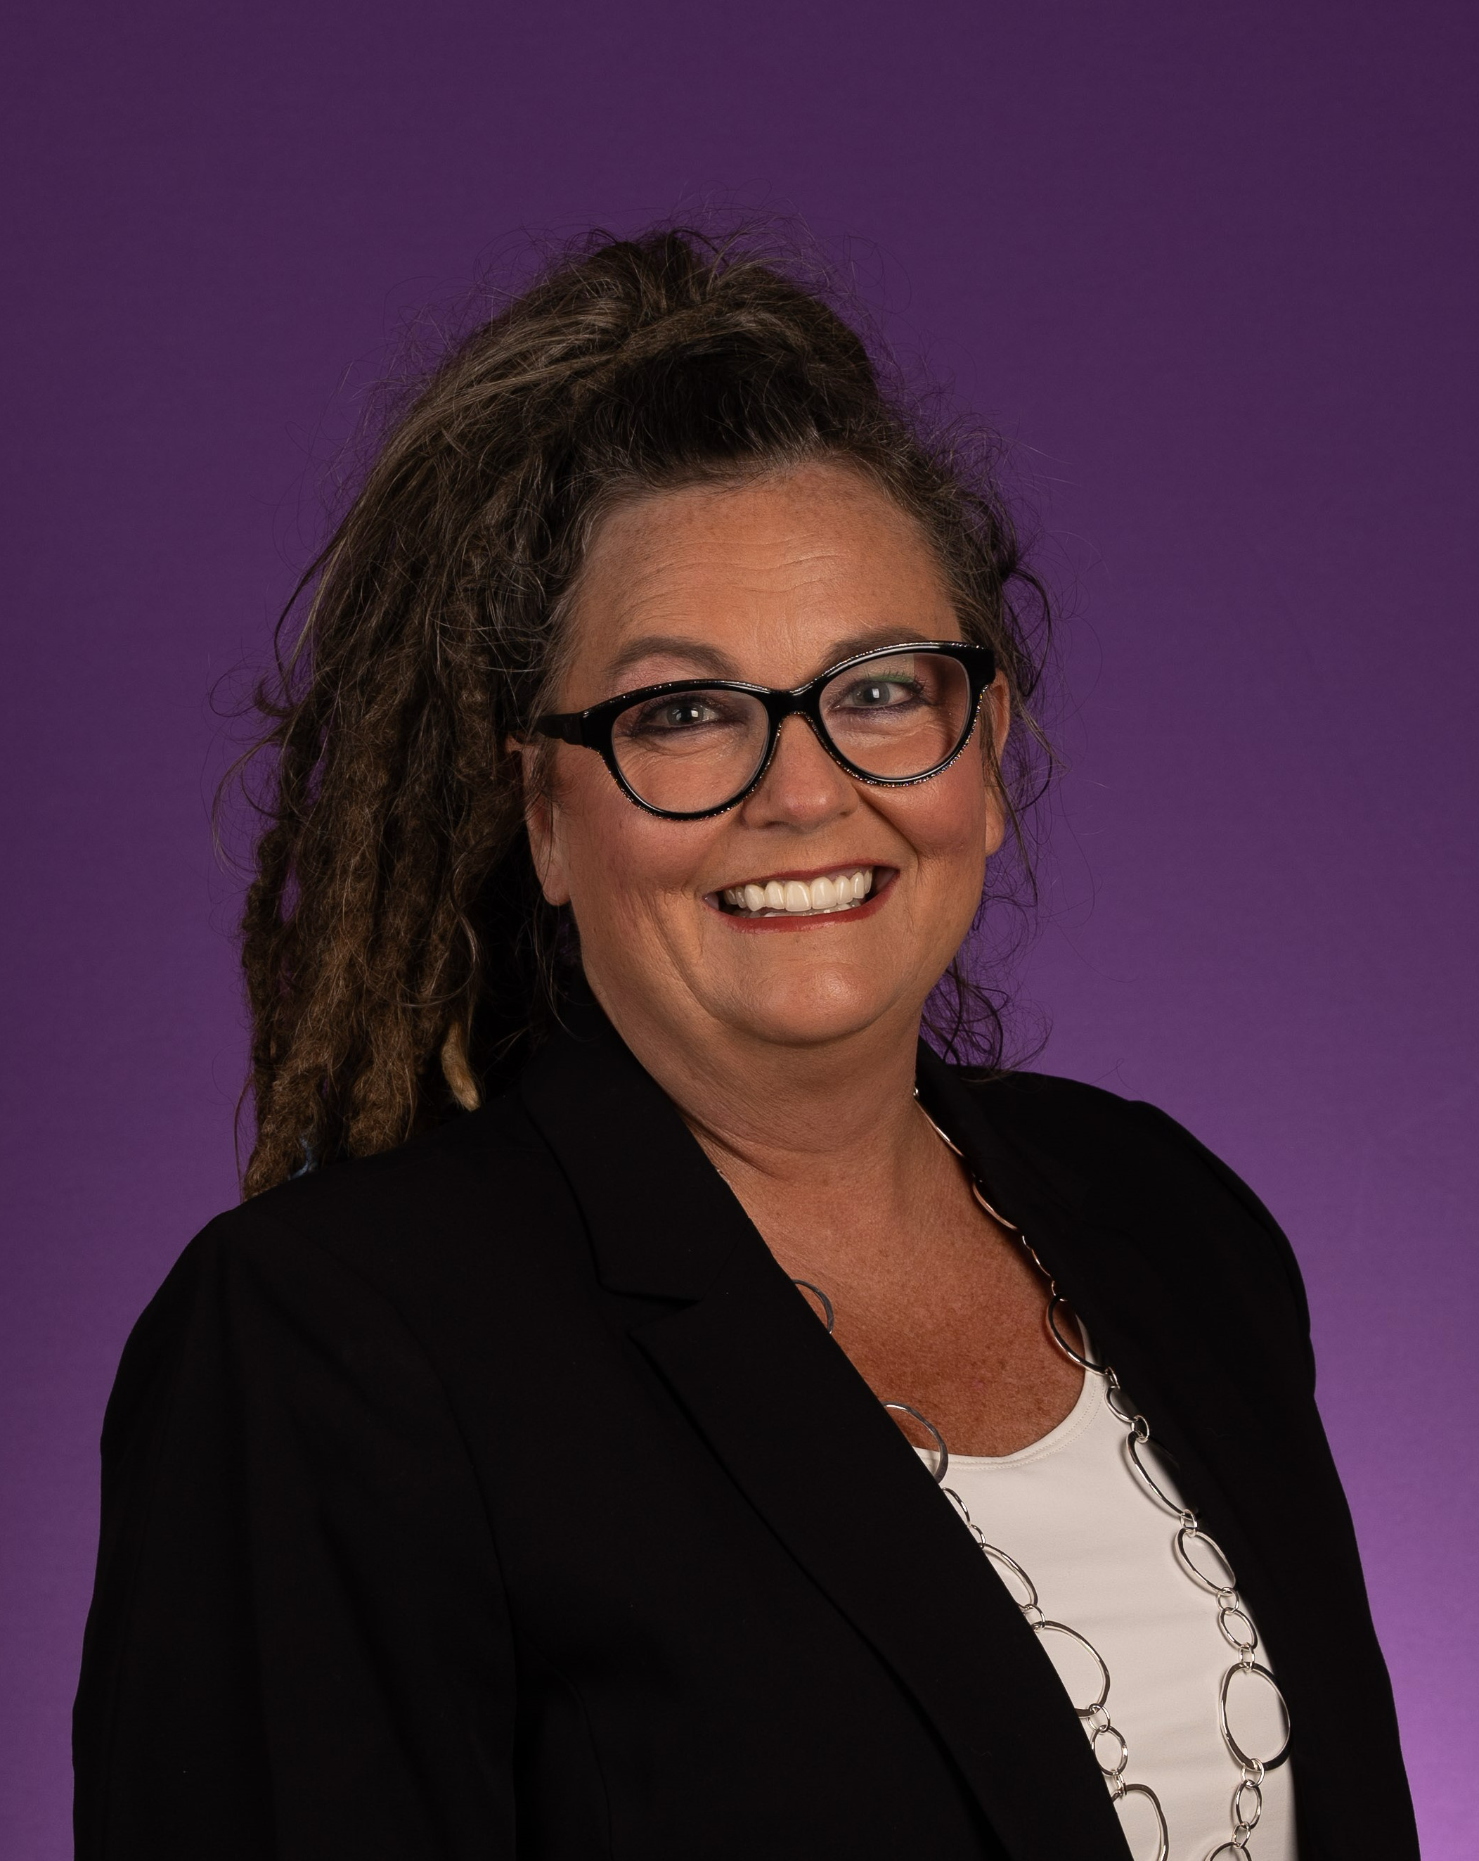
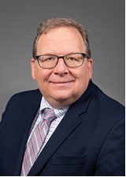
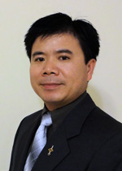
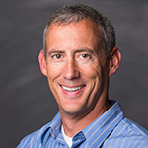
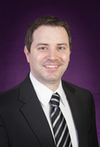
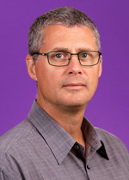
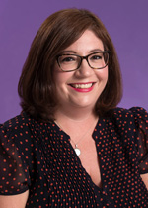
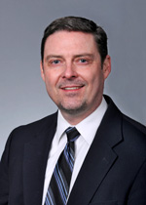
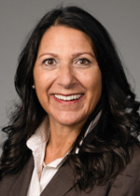
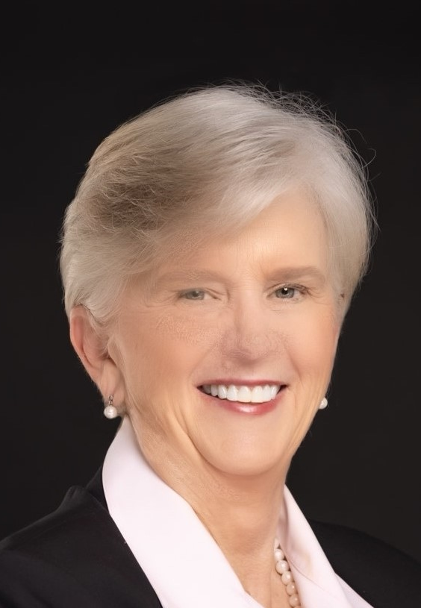
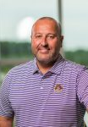
College Coordinators
College of Allied Health Sciences
Leigh Cellucci
celluccie@ecu.edu
252-744-6072
Thomas Harriot College of Arts and Sciences
Marianne Montgomery
montgomerym@ecu.edu
252-328-6041
School of Dental Medicine
Daniel Stevens
stevensd19@ecu.edu
252-737-4625
College of Engineering and Technology
Jason Yao
yaoj@ecu.edu
252-737-1029
College of Business
Amy McMillan
mcmillana@ecu.edu
252-328-5337
College of Education
Scott Glass
glassj@ecu.edu
252-328-5670
College of Fine Arts & Communication
Jay Juchniewicz
juchniewiczj@ecu.edu
252-328-6851
College of Health and Human Performance
Susannah Berry
berrys@ecu.edu
252-328-1332
Brody School of Medicine
Allison Flowers
flowersa19@ecu.edu
252-744-2870
Integrated Coastal Programs
Stuart Hamilton
hamiltons22@ecu.edu
Joyner Library
Joseph Thomas
thomasw@ecu.edu
252-737-2728
Laupus Library
Roger Russell
russellr@ecu.edu
252-744-3215
College of Nursing
Mary Jo Nimmo
nimmom@ecu.edu

Slide 4
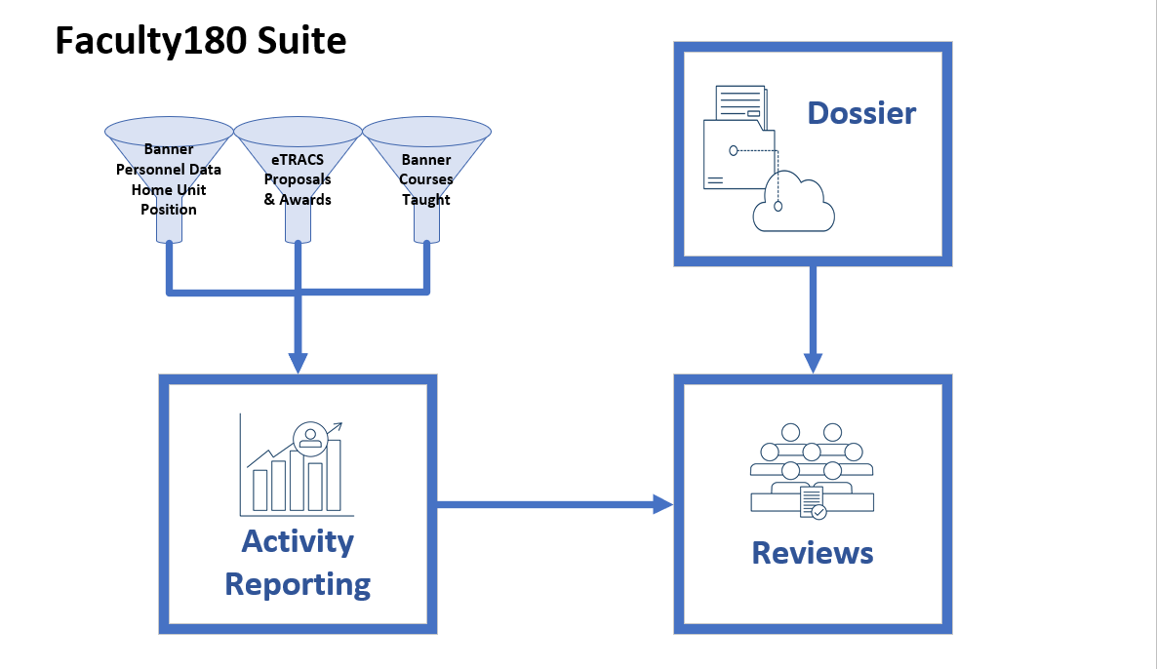

Slide 5
Faculty180 Activity Reporting
Auto loaded Course data
from Banner(Student, Financial, HR System)
Auto loaded Proposal/Award data
from eTRACS (Research Administration System)
Import records by connecting to ORCID

Slide 6
Faculty180 Activity Reporting…continued
Manually enter activities:
  Other Teaching Activities
  Clinical Activities
  Scholarly Contributions (Articles, Presentations, Book Chapters, etc.)
  Institutional Committees
  Professional Service
  Community Service
  Professional Development
  Professional Memberships
  Honors and Awards
Build CVs and Annual Reports
Activate Faculty Profile – Scholars@ECU

Slide 7
Faculty180 Dossier
Organize Portfolio/PAD materials into Collections
Share documents to other Faculty180 Users
Files can be uploaded to a Review workflow
Previous review documents automatically save to Dossier and available for future reviews

Slide 8
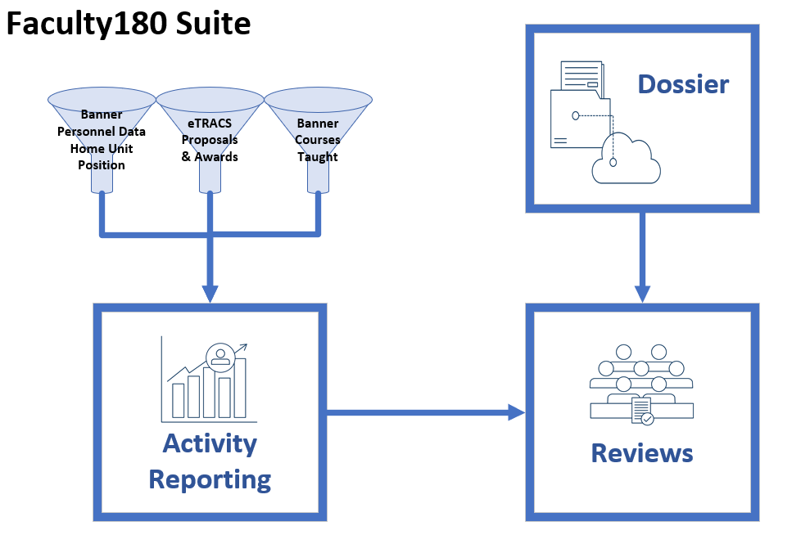
Faculty180 Reviews
Mechanism to route institutional personnel workflows:
  Annual Evaluations
  Tenure Track Reappointment
  Promotion & Tenure
  Promotion to Full
  Teaching Award Portfolios
  New workflows scheduled in upcoming academic years.

Slide 9
Which workflows apply to me?

Slide 10

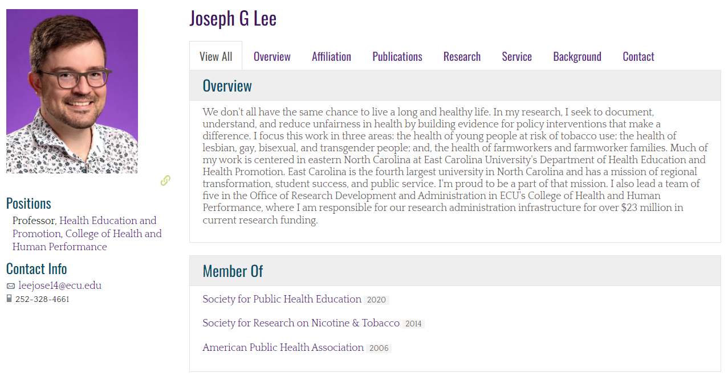
Scholars.ecu.edu

Slide 11
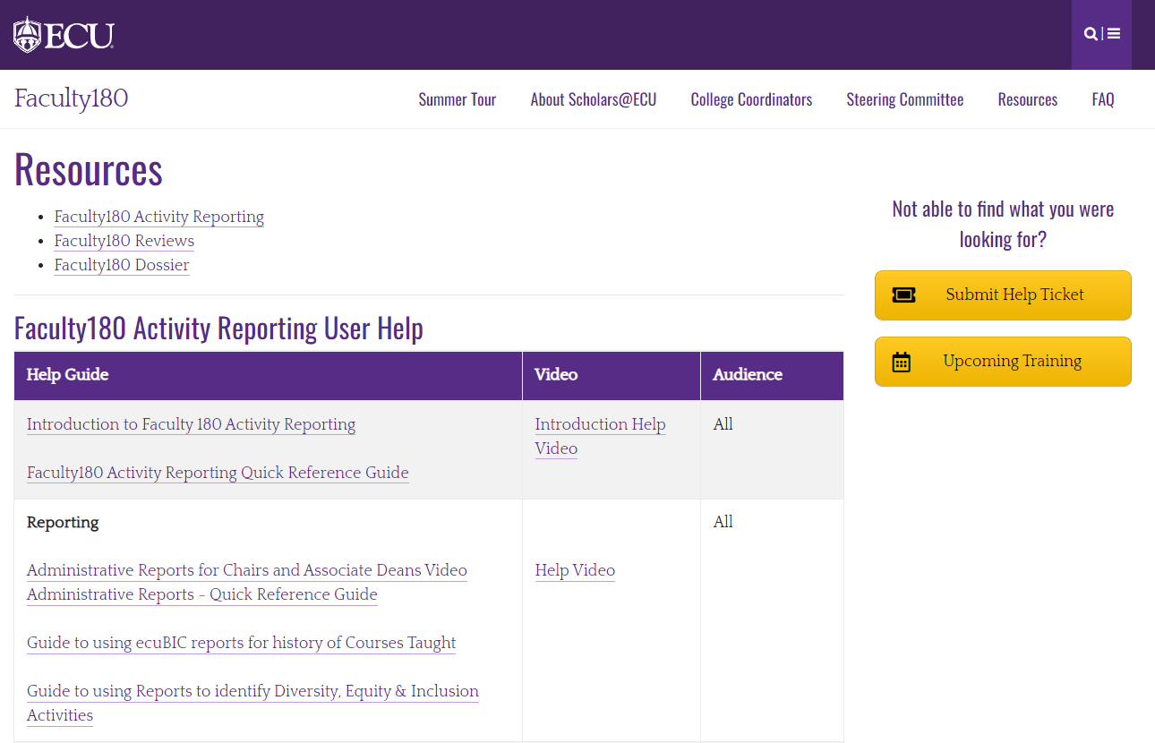
Resources
Faculty180.ecu.edu/resources

Slide 12
Upcoming Training
https://faculty180.ecu.edu/training/
Session Name | Description | Related Training Guides | Date & Time
Faculty180: Entering Activities for Annual Reviews & The Year Ahead | This training will provide faculty with an overview of Faculty180 Activity Reporting and how to enter and update activity records. Faculty will learn about other features available in Faculty180 like generating vitas, Dossier, and how Faculty180 will facilitate various personnel actions in the year ahead. | Activity Reporting Quick User Guide | 9/13/2024 12:00pm
Scholars@ECU | Learn How to Maximize Your Profile in ECU’s Scholars@ECU faculty profile system. | Scholars@ECU Quick User Guide | 10/15/2024 12:00pm
Faculty180: Annual Evaluation Training for Faculty | In this session faculty will learn how to submit their annual report in Faculty180 for the annual evaluation process. Included in the training will be a brief overview of how to update and add professional activities that generate in the annual report. | Annual Evaluation User Guidance | 2/26/2025 3:00pm 3/18/2025 12:00pm

Slide 13
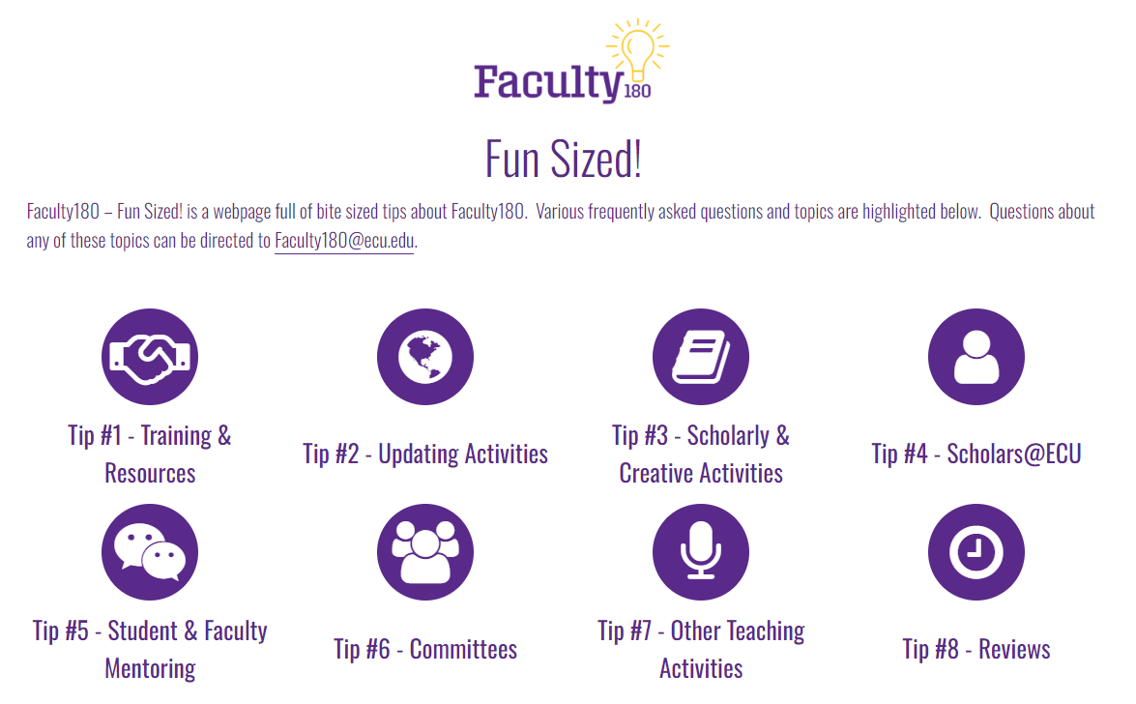
Upcoming Series – Faculty180 Fun Sized!
https://faculty180.ecu.edu/fun-sized/

Slide 14
Questions?
Contact Faculty180@ecu.edu with questions.

