Slide 1
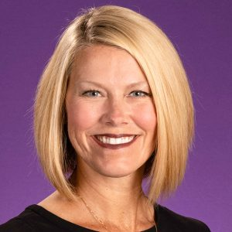
Office of Innovation & Engagement
Angela Lamson, PhD, LMFT
Senior Fellow Innovation & Engagement
lamsona@ecu.edu
Nancy W. Darden Distinguished Professor
College of Health and Human Performance

Slide 2
Research Project Life Cycle
2

