Slide 1
WELCOME PIRATES!!!
NEW EMPLOYEE
BENEFITS ORIENTATION
EHRA FACULTY EMPLOYEES
(Exempt from the Human Resources Act)
Disclaimer: Information in this presentation is a summary overview and could change at any time. To view more information please visit the ECU Benefits website.
2024

Slide 2
DEPARTMENT OF PEOPLE OPERATIONS, SUCCESS, AND OPPORTUNITY
ROLE OF THE BENEFITS DEPARTMENT
The Benefits Department provides guidance (and helps implement) to employees and management on a wide range of programs, plans-insurance benefits, enrollment, separation, retirement, leave policies and procedures.
The Benefits Department administers all state and local benefits offered through agencies such as the NC Retirement System, NC State Health Plan, UNC System Office, and the Office of State Human Resources.
The Benefits Department also ensures that each new employee joining the ECU team has been provided clear information about the benefits available to them.
Frequently asked questions:
Paycheck questions (direct deposit and tax questions) – please contact Financial Services-Payroll Department at 252-737-1133
Tuition waiver questions – please contact Financial Services-Cashier’s Office at
252-737-1133 and/or the Tuition Waiver Department at tuitionwaivers@ecu.edu

Slide 3
DEPARTMENT OF PEOPLE OPERATIONS, SUCCESS, AND OPPORTUNITY BENEFITS DEPARTMENT Located at 210 East 1st Street, Building 127 / across from Town Commons 252-328-9887 – Phone 252-328-9918 – Fax http://www.ecu.edu/cs-admin/HumanResources/Benefits.cfm – Website
Benefits Director
Lee Ann Goff
252-328-9825
goffle@ecu.edu
General
Support
HR Consultant
PAM BRANN
252-328-9887
brannp18@ecu.edu
HR Specialist
AMBER POPE
252-737-5820
popeam22@ecu.edu
Leave
Administration
Email – leave@ecu.edu
Benefits Consultants
KRISTIAN WILLIAMS
APRIL DORCENT
DAWN HALL
Retirement Administration
Email – retirement@ecu.edu
Benefits Consultants
TRINA BAKER
CORINNE HOGAN

Slide 4
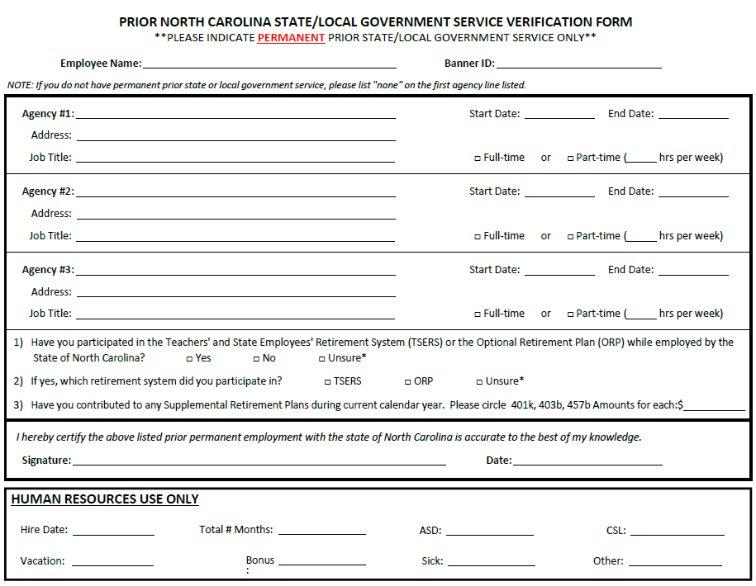
PRIOR NC STATE/LOCAL GOVERNMENT SERVICE VERIFICATION FORM
All new hires must complete this form (whether you have prior state/ local government service or not).
If no prior state/local government service, write “NONE” beside Agency #1.
If you have any prior state/local government service, complete the information for that employer.
Only permanent prior North Carolina state/local government service is eligible.
If unsure, write it on the form.
SEND COMPLETED FORM TO PAM BRANN BY EMAIL OR FAX

Slide 5
CERTIFYING EMPLOYEE STATUS UNDER RETIREMENT REEMPLOYMENT LAWS
All new hires must complete this form (whether you are a retiree or not).
Section A – enter your information
Section C –
Check the “YES” box and select the correct retirement plan if you have been receiving a monthly retirement benefit from any of the agencies listed.
Check the “NO” box if you have not been receiving a monthly retirement benefit from the NC Retirement Systems.
Section D – sign and date the form
SEND COMPLETED FORM TO PAM BRANN BY EMAIL OR FAX

Slide 6
Who should receive your completed new hire forms?

Slide 7
Pam Brann
252-328-9887
brannp18@ecu.edu
252-328-9918 - fax

Slide 8
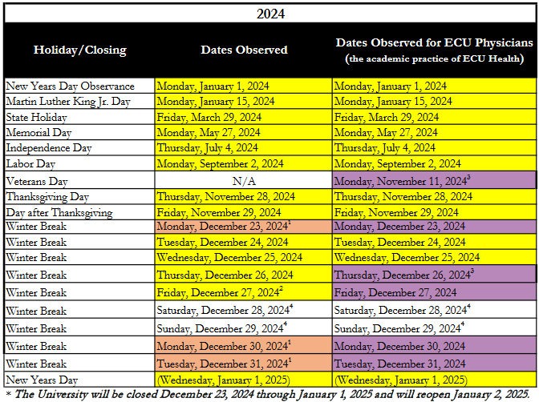
HOLIDAYS OBSERVED For more information – https://humanresources.ecu.edu/benefits/leave/holidays/ ECU announces the holiday schedule annually on the ECU Benefits Department website. There are up to 12 paid holidays per year. Please refer to the ECU Holidays website for additional information on pay. CSS and DMSS employees will follow the ECU Physicians Clinic holiday schedule.

Slide 9
TYPES OF LEAVE (if eligible)
https://humanresources.ecu.edu/benefits/leave/
CONTACT THE
LEAVE ADMINISTRATION TEAM
Email – Leave@ecu.edu
VOLUNTARY SHARED LEAVE (VSL)
FAMILY AND MEDICAL LEAVE ACT (FMLA)
Faculty Serious Illness Leave (FSIL)
FAMILY ILLNESS LEAVE (FIL)
MILITARY LEAVE
DISABILITY –
SHORT-TERM (STD)
EXTENDED SHORT-TERM (XSTD)
LONG-TERM (LTD)
CONTACT
YOUR SUPERVISOR
COMMUNITY SERVICE LEAVE
(CSL)
CIVIL LEAVE
EDUCATIONAL LEAVE
LEAVE WITHOUT PAY (LWOP)

Slide 10
TYPES OF LEAVE (cont’d)
Contact the Leave Administration Team at Leave@ecu.edu
VSL – Allows eligible employees who are away from work for 20 or more days due to the illness of themselves or immediate family member and have exhausted all of their accrued leave to apply for leave donations from other State employees. This includes new hires.
FMLA – Allows eligible employees who will be away from work for 3 or more days due to serious illness of self or immediate family member, or birth/placement of a child to take unpaid leave up to 12 weeks per 12 months if approved. To be paid, you must use your accrued leave.
FSIL – Allows eligible employees to take paid leave due to serious illness of self or immediate family member, or birth/adoption for 12 weeks per 12 months if approved.
9-month faculty–Provides 12 calendar weeks of paid leave within any consecutive 12 calendar months period
12-month faculty-Provides 60 calendar days of paid leave within any 12-month calendar month period. After 60 calendar days, faculty may exhaust sick leave, vacation leave, bonus leave or apply for voluntary shared leave
FIL – Allows eligible employees to take up to 52 weeks of unpaid leave during a 5-year period to care for the employee’s child, parent, or spouse where that child, parent, or spouse has a serious health condition. FIL does not run concurrently with FMLA and eligibility for FIL begins after FMLA leave has been exhausted. To be paid, you must use your accrued leave.
ML – Allows eligible employees to take leave for certain periods of service in the uniformed services. Leave may be paid or unpaid depending on the reason for the military activity (active or inactive leave).
STD/ESTD/LTD (available under either of the mandatory retirement plans) – Allows eligible employees who become continuously unable to perform the duties of his/her usual occupation due to a mental or physical incapacity while actively employed to continue to receive a percentage of their pay.

Slide 11
ELIGIBILITY REQUIREMENTS FOR LEAVES
(must provide forms and documentation to the Leave Administration Team at Leave@ecu.edu and must be approved to use leave)
Voluntary Shared Leave (VSL)
Family and Medical Leave Act (FMLA)
Faculty Serious Illness Leave(FSIL)
Family Illness Leave (FIL)
Military Leave (ML)
Disability plans through mandatory retirement plans:
Short-term disability (STD)
Extended short-term disability (ESTD)
Long-term disability (LTD)
VSL – Employee must be away from work for 20 or more days due to illness of themselves or immediate family member, eligible to accrue leave and must exhaust all leave before they can use VSL. New hire are eligible.
FMLA – Full-time or part-time (half-time or more) permanent, probationary, or time-limited with 12 months cumulative service with State government, including temporary service and has been in pay status at least 1,040 hours during the previous 12-months, or temporary, intermittent. Part-time (less than half-time) with 12 months cumulative service and has been in pay status at least 1,250 hours during the previous 12 months.
FSIL – Have been continuously employed by ECU for at least 12 consecutive calendar months. Have continuously held a permanent appointment of 0.75 or greater. Participant in either the TSERS or the ORP mandatory retirement plan and have met all other requirements for FMLA leave as describes in the FMLA policy.
FIL – Full-time or part-time (half-time or more) permanent, probationary, or time-limited appointment 12 months of total service with the State and has been in pay status at least 1,040 hours during the previous 12 months.
Temporary and part-time employees (less than half-time) are not eligible.
ML – Full-time or part-time (half-time or more) permanent, time-limited, probationary, or trainee employees. Part-time employees (less than half-time) are eligible and if approved the leave will be prorated. Temporary employees are not eligible for military leave benefits; however, they are covered under the “Reinstatement” policies as described in the Military Leave Policy.
STD/ESTD/LTD – The Disability Income Plan of North Carolina (DIPNC) is a benefit provided at no cost to eligible employees who participate in the Teachers’ and State Employees’ Retirement System (TSERS) or the Optional Retirement Program (ORP). After 1 year of service an employee is eligible to apply for STD (and ESTD) benefits after 60 day waiting period (if approved will receive 50% of current income, max monthly pay of $3,000, for up to 365 days of STD and 365 days of ESTD). After 5 years of service (additional requirements may apply) an employee is eligible to apply for LTD benefits (if approved will receive 65% of current income, max monthly pay of $3,900, for as long as disabled typically).

Slide 12
TYPES OF LEAVE (cont’d)
Contact Your Supervisor
CSL – 24 hours per year (prorated depending on employee’s employment status, prorated depending on start date) granted to eligible employees for: parents for child involvement in the schools, any employee for volunteer activity in the schools or in a Community Service Organization, any employee for tutoring and mentoring in the schools, or any employee for volunteering in a State of North Carolina Public University, Community College System or State agency provided that the service is outside of the employee’s normal scope of duties and responsibilities and that the employee is not receiving any form of compensation for the services rendered.
Literary Program – An employee may choose to change options from regular Community Service Leave to the special provisions for volunteering for the literary program or tutoring/mentoring or vice versa, during the calendar year, the maximum hours that may be granted is the maximum allowed under the new option chosen minus the number of hours already used.
This leave is paid if you are approved to use it.
Civil Leave – Leave with pay when serving on a jury or when subpoenaed as a witness in a court of law.
Educational Leave – Leave with pay or leave without pay for certain types of educational courses.
LWOP – May be granted leave without pay for illness, educational purposes, vacation, or for any other reasons deemed justified by the department head.
IF YOU ARE APPROVED FOR LEAVE WITHOUT PAY, PLEASE CONTACT THE LEAVE ADMINISTRATION TEAM TO CONTINUE PAYING FOR YOUR INSURANCE BENEFITS.
IF YOU DO NOT PAY FOR YOUR INSURANCE BENEFITS THEY COULD BE TERMINATED.

Slide 13
ADVERSE WEATHER For more information – https://humanresources.ecu.edu/benefits/leave/adverse-weather/ Register to receive alerts – https://alertinfo.ecu.edu/adverse-weather-emergency-event-policy/
During times of adverse weather, the Chancellor will determine to what extent the University will reduce/suspend operations or if the University is closed.
Condition 1 (Reduced Operations)
The University remains open, but certain non-mandatory operations may be reduced due to more limited staffing.
Mandatory employees must report to or remain at work.
All other employees should make a good faith effort to remain at work or report to work taking reasonable precautions and judgments for personal safety. The employee has the option to report late, leave early, or not work at all; however, the employee is responsible for informing their supervisor.
Pay and time reporting, arrange for alternative work location with approval, employee may use leave time or may be able to make-up time within 90 days discuss with supervisor.
Condition 2 (Suspended Operations)
The University remains open on a very limited basis but has formally suspended all but mandatory operations due to minimal staffing levels.
Mandatory employees must report to or remain at work.
All other employees must not report to work or must leave the workplace when this status takes effect.
Pay and time reporting, arrange for alternative work location with approval, employee may use leave time or may be able to make-up time within 90 days discuss with supervisor.
Condition 3 (Closure of the University)
Due to significant and sustained emergency conditions, University facilities are closed.
Mandatory employees must remain at or report to work, as directed by their manager and/or supervisor.
All other employees, including those who are otherwise designated as mandatory but not needed for the particular event,
are not permitted to report to or remain at work.
Employees shall not be required to use leave or make-up any work time missed.

Slide 14
MANDATORY RETIREMENT PLANS
Teachers’ and State Employees’ Retirement System (TSERS)
Optional Retirement Program (ORP)
Employees of the ECU School of Dental Medicine, hired on or after January 1, 2024, may be eligible to participate in the Optional Retirement Program (ORP) only. They may not be eligible to participate in the Teachers’ and State Employees’ Retirement System (TSERS) unless they are an immediate transfer from a participating employer. If they are an immediate transfer, they may be eligible to choose between the TSERS and the ORP or remain enrolled in the TSERS.
If you have any questions, please contact Pam Brann in the ECU Benefits Department at 252-328-9887 or brannp18@ecu.edu.
IRREVOCABLE DECISION!
You cannot make a change to your mandatory retirement plan election once you’ve saved your election in Empyrean. Even if it is within 30 days of your start date.

Slide 15
MANDATORY RETIREMENT PLANS (if eligible)
For more information – https://humanresources.ecu.edu/benefits/retirement/
Employees of the ECU School of Dental Medicine, hired on or after January 1, 2024, may be eligible to participate in the Optional Retirement Program (ORP) only. They may not be eligible to participate in the Teachers’ and State Employees’ Retirement System (TSERS) unless they are
an immediate transfer from a participating employer. If they are an immediate transfer, they may be eligible to choose between the TSERS and
the ORP or remain enrolled in the TSERS.
If you have any questions, please contact Pam Brann in the ECU Benefits Department at 252-328-9887 or brannp18@ecu.edu.
Who’s eligible?
Permanent, probationary, and
time-limited employees regularly scheduled to work 30 hours or more per week
Contribution amount?
6% of your salary will go into the retirement plan of your choice, if you are an eligible employee
When will my deduction start?
Deduction will start on first paycheck, “Undecided Employee Contribution”
TSERS = Teachers’ and State Employees’ Retirement System
or
ORP = Optional Retirement Program
MUST ENROLL WITHIN 30 DAYS OF YOUR START DATE
31st day = enrollment will default to TSERS (if eligible)
IRREVOCABLE DECISION!
You cannot make a change to your mandatory retirement plan election once you’ve saved
your election in Empyrean. Even if it is within 30 days of your start date.
IMPORTANT DECISION!
Be sure to do your homework before making your choice.

Slide 16
TSERS vs ORP
Employees of the ECU School of Dental Medicine, hired on or after January 1, 2024, may be eligible to participate in the Optional Retirement Program (ORP) only. They may not be eligible to participate in the Teachers’ and State Employees’ Retirement System (TSERS) unless they are an immediate transfer from a participating employer. If they are an immediate transfer, they may be eligible to choose between the TSERS and the ORP or remain enrolled in the TSERS.
If you have any questions, please contact Pam Brann in the ECU Benefits Department at 252-328-9887 or brannp18@ecu.edu.
The North Carolina Retirement System – Teachers’ and State Employees' Retirement System (TSERS) is a defined benefit plan (contributions are invested in stocks and bonds by the Department of State Treasurer).
To apply for retirement, you must be a vested member (contributed for at least
5 years) and meet age and/or years of service requirements
- Monthly retirement benefit amount is based on average final compensation calculation (done by the retirement system)
- May use unused sick leave as retirement service credit towards years of service (20 days = 1 month). This may help you retire early.
UNC System – Optional Retirement Program (ORP) is a contribution base plan (contributions are invested in stocks and bonds by vendor/employee).
To apply for retirement, you must be a vested member (contributed for at least
5 years). No age or years of service requirements. Tax penalties if money is distributed before age 59 ½. (Note: you are 100% vested in your contributions immediately however you are not 100% vested in the ECU contributions until you have contributed for at least 5 years)
- Monthly retirement benefit amount depends upon the value of the benefit you have accumulated when you begin receiving retirement checks. This includes the contributions made by the employee and ECU.
- Cannot use unused sick leave as retirement service credit
The Mandatory Retirement Plan Decision Guide has a comparison of the two plans on pages 7 – 8.

Slide 17
NEED HELP DECIDING ON A RETIREMENT PLAN? CAPTRUST CAN HELP
All ECU employees are eligible to receive free consulting advice from an Independent Advisor through an organization called CAPTRUST.
CAPTRUST is not affiliated with any of the approved retirement carriers, so your specific criteria will be their #1 objective when discussing the available options with you.
This resource can be beneficial for:
Information to help with enrollment decision between TSERS and ORP
Detailed information and specific personal advice about the ORP and defined contribution plans investment options
Set appointment for on-site confidential session regarding enrollment decision
Answer day-to-day questions
If you would like to take advantage of this free service, contact CAPTRUST
800-967-9948
https://www.captrustatwork.com/scheduler
Employees of the ECU School of Dental Medicine, hired on or after January 1, 2024, may be eligible to participate in the Optional Retirement Program (ORP) only. They may not be eligible to participate in the Teachers’ and State Employees’ Retirement System (TSERS) unless they are an immediate transfer from a participating employer. If they are an immediate transfer, they may be eligible to choose between the TSERS and the ORP or remain enrolled in the TSERS.
If you have any questions, please contact Pam Brann in the ECU Benefits Department at 252-328-9887 or brannp18@ecu.edu.

Slide 18
TSERS
For more information – www.myncretirement.com
Register to use the ORBIT website to view your TSERS account at https://orbit.myncretirement.com/
Employees of the ECU School of Dental Medicine, hired on or after January 1, 2024, may be eligible to participate in the Optional Retirement Program (ORP) only. They may not be eligible to participate in the Teachers’ and State Employees’ Retirement System (TSERS) unless they are an immediate transfer from a participating employer. If they are an immediate transfer, they may be eligible to choose between the TSERS and the ORP or remain enrolled in the TSERS.
If you have any questions, please contact Pam Brann in the ECU Benefits Department at 252-328-9887 or brannp18@ecu.edu.
If you choose the TSERS as your mandatory retirement plan:
Enroll in the Empyrean benefits system
You can complete Form 2C to name a beneficiary(ies) for the death benefit and the return of contributions benefit
Your signature must be notarized
Original form must be mailed to the address located at the top of the form

Slide 19
TSERS – FORM 2C ACTIVE EMPLOYEE DEATH BENEFITS
RETURN OF CONTRIBUTIONS After your death, your beneficiary will receive a return of your contributions plus interest at 4% compounded annually on your prior year ending balance, through your date of death. This is a lump-sum payment. If you meet certain eligibility requirements, a monthly Survivor’s Alternate Benefit may be paid to your beneficiary instead of a return of contributions if you have only one eligible beneficiary living at the time of your death.
SURVIVOR’S ALTERNATE BENEFIT (If you do not meet one of these two conditions, your beneficiary(ies) will be able to receive only a return of your contributions.) Provided you have not retired, the monthly Survivor’s Alternate Benefit may be payable if you have only one eligible beneficiary for the return of your contributions living at the time of your death and you die while in active service or within 180 days of your last day of service after meeting one of the following conditions:
You complete 20 years of creditable service (not including credit for unused sick leave) regardless of age.
You reach age 60 with five years of creditable service.
The Survivor’s Alternate Benefit does not apply if you have two or more eligible principal beneficiaries for the return of contributions living at the time of your death, if your estate or living trust is your eligible beneficiary at the time of your death, or if you have retired. This lifetime monthly benefit payable to your beneficiary equals the amount you would have been entitled to receive under Option 2 had you survived and retired on the first of the month following your death.
LUMP-SUM DEATH BENEFIT FOR ACTIVE EMPLOYEES If you die while still in active service after one year as a contributing member, your beneficiary will receive a lump-sum payment equal to your highest salary for 12 consecutive months during the 24 months before you die. The lump-sum payment will be at least $25,000 but no more than $50,000 and is also paid if you die within 180 days of your last day of service provided you have not withdrawn your contributions. The death benefit is in addition to any other benefits to which your beneficiary(ies) may be entitled. For this death benefit, you may name the same or a different beneficiary(ies) than the one(s) you named to receive the return of contributions. If you are a state or local law enforcement officer killed in the line of duty, your beneficiary also may be entitled to a $100,000 line-of-duty death benefit. This lump sum benefit is administered jointly by the North Carolina Industrial Commission and the Department of State Treasurer.

Slide 20
ORP
For more information–https://myapps.northcarolina.edu/hr/benefitsleave/retirement/
Register to use TIAA website to view your ORP account at
https://myapps.northcarolina.edu/hr/download/139/orp-carriers-websites/3028/tiaa.pages
Employees of the ECU School of Dental Medicine, hired on or after January 1, 2024, may be eligible to participate in the Optional Retirement Program (ORP) only. They may not be eligible to participate in the Teachers’ and State Employees’ Retirement System (TSERS) unless they are an immediate transfer from a participating employer. If they are an immediate transfer, they may be eligible to choose between the TSERS and the ORP or remain enrolled in the TSERS.
If you have any questions, please contact Pam Brann in the ECU Benefits Department at 252-328-9887 or brannp18@ecu.edu.
If you choose the ORP as your mandatory retirement plan:
Enroll in the Empyrean benefits system
Create online account with TIAA (website above)
Our TIAA representative
Sean Lawrence
sean.lawrence@tiaa.org
704-988-0577
To schedule a meeting online, www.tiaa.org/schedulenow-unc
TIAA – 800-732-8353
This is a portable plan and can be transferred out of the State of North Carolina if you leave ECU.

Slide 21
HOW DO I ENROLL IN THE MANDATORY RETIREMENT PLAN OF MY CHOICE?
Enroll online in the Empyrean benefits system
You will be asked some questions and the system will show you which mandatory retirement plan you are eligible to enroll in.
Employees of the ECU School of Dental Medicine, hired on or after January 1, 2024, may be eligible to participate in the Optional Retirement Program (ORP) only. They may not be eligible to participate in the Teachers’ and State Employees’ Retirement System (TSERS) unless they are an immediate transfer from a participating employer. If they are an immediate transfer, they may be eligible to choose between the TSERS and the ORP or remain enrolled in the TSERS. If you have any questions, please contact Pam Brann in the ECU Benefits Department at 252-328-9887 or brannp18@ecu.edu.
Select either the TSERS or the ORP (if you have a choice between the 2 mandatory retirement plans)
If you choose the TSERS, you can complete Form 2C and send it to the North Carolina Retirement System however you do not have to complete this form. If you do not complete Form 2C be sure to enter your beneficiaries in ORBIT when you are added to the retirement system (this could take a few months).
IRREVOCABLE DECISION!
You cannot make a change to your mandatory retirement plan election once you’ve saved your election in Empyrean. Even if it is within 30 days of your start date.

Slide 22
How many days do you have to enroll in a mandatory retirement plan?

Slide 23
WITHIN
30 DAYS
OF YOUR
START DATE
31st day enrollment will default to the TSERS (if eligible)
Employees of the ECU School of Dental Medicine, hired on or after January 1, 2024, may be eligible to participate in the Optional Retirement Program (ORP) only. They may not be eligible to participate in the Teachers’ and State Employees’ Retirement System (TSERS) unless they are an immediate transfer from a participating employer. If they are an immediate transfer, they may be eligible to choose between the TSERS and the ORP or remain enrolled in the TSERS. If you have any questions, please contact Pam Brann in the ECU Benefits Department at 252-328-9887 or brannp18@ecu.edu.
IRREVOCABLE DECISION!
You cannot make a change to your mandatory retirement plan election once you’ve saved your election in Empyrean. Even if it is within 30 days of your start date.

Slide 24
WHO’S ELIGIBLE FOR INSURANCE BENEFITS?
Permanent (non-temporary) full-time employees working 30 hours or more per week are considered to be benefits eligible.
Permanent (non-temporary) part-time employees working 20-29 hours per week are eligible for many benefit programs, typically without employer contributions.
The cost for medical coverage depends on an employee’s regularly scheduled hours worked per week.
Participation is excluded in the mandatory retirement plans, the State disability plans, the State 401(k) Plan, and the supplemental long-term disability.

Slide 25
MEDICAL
INSURANCE
State Health Plan (SHP)

Slide 26
Seriously Mate This is important
MEDICAL INSURANCE
www.shpnc.org under “Employee Benefits”
PLANS OFFERED
Base Plan (70/30) –
Traditional PPO
Enhanced Plan (80/20) –
Enhanced PPO
MUST ENROLL within 30 days of your start date
No exceptions!
Our medical insurance is with the State Health Plan and Blue Cross Blue Shield is our third-party administrator and we use BCBS network of doctors
If at any time you move from a temporary appointment to a permanent appointment and you are enrolled in the ACA High Deductible Health Plan (HDHP) please note that if all premiums for the ACA High Deductible Health Plan (HDHP) are not paid in full, enrollment in the 80/20 or 70/30 plans as a new permanent employee will be cancelled and you will not be eligible to elect this coverage until the next Open Enrollment period.

Slide 27
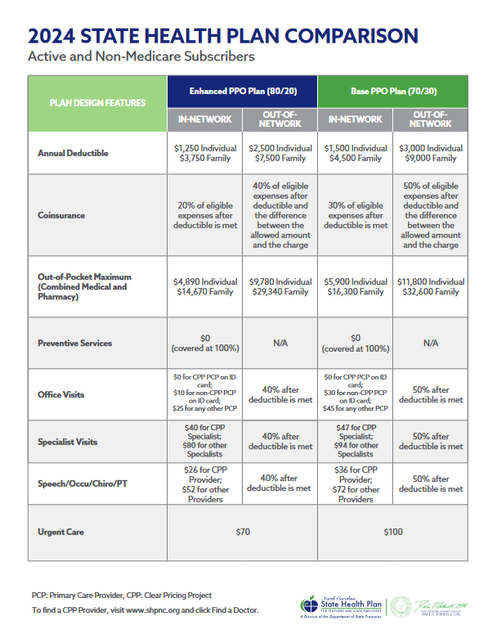
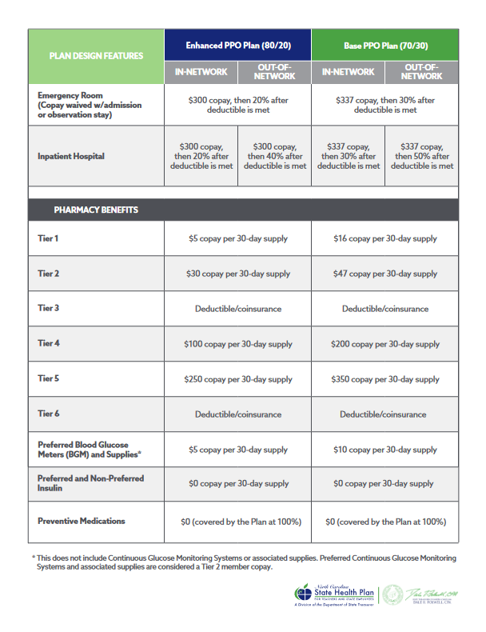

Slide 28
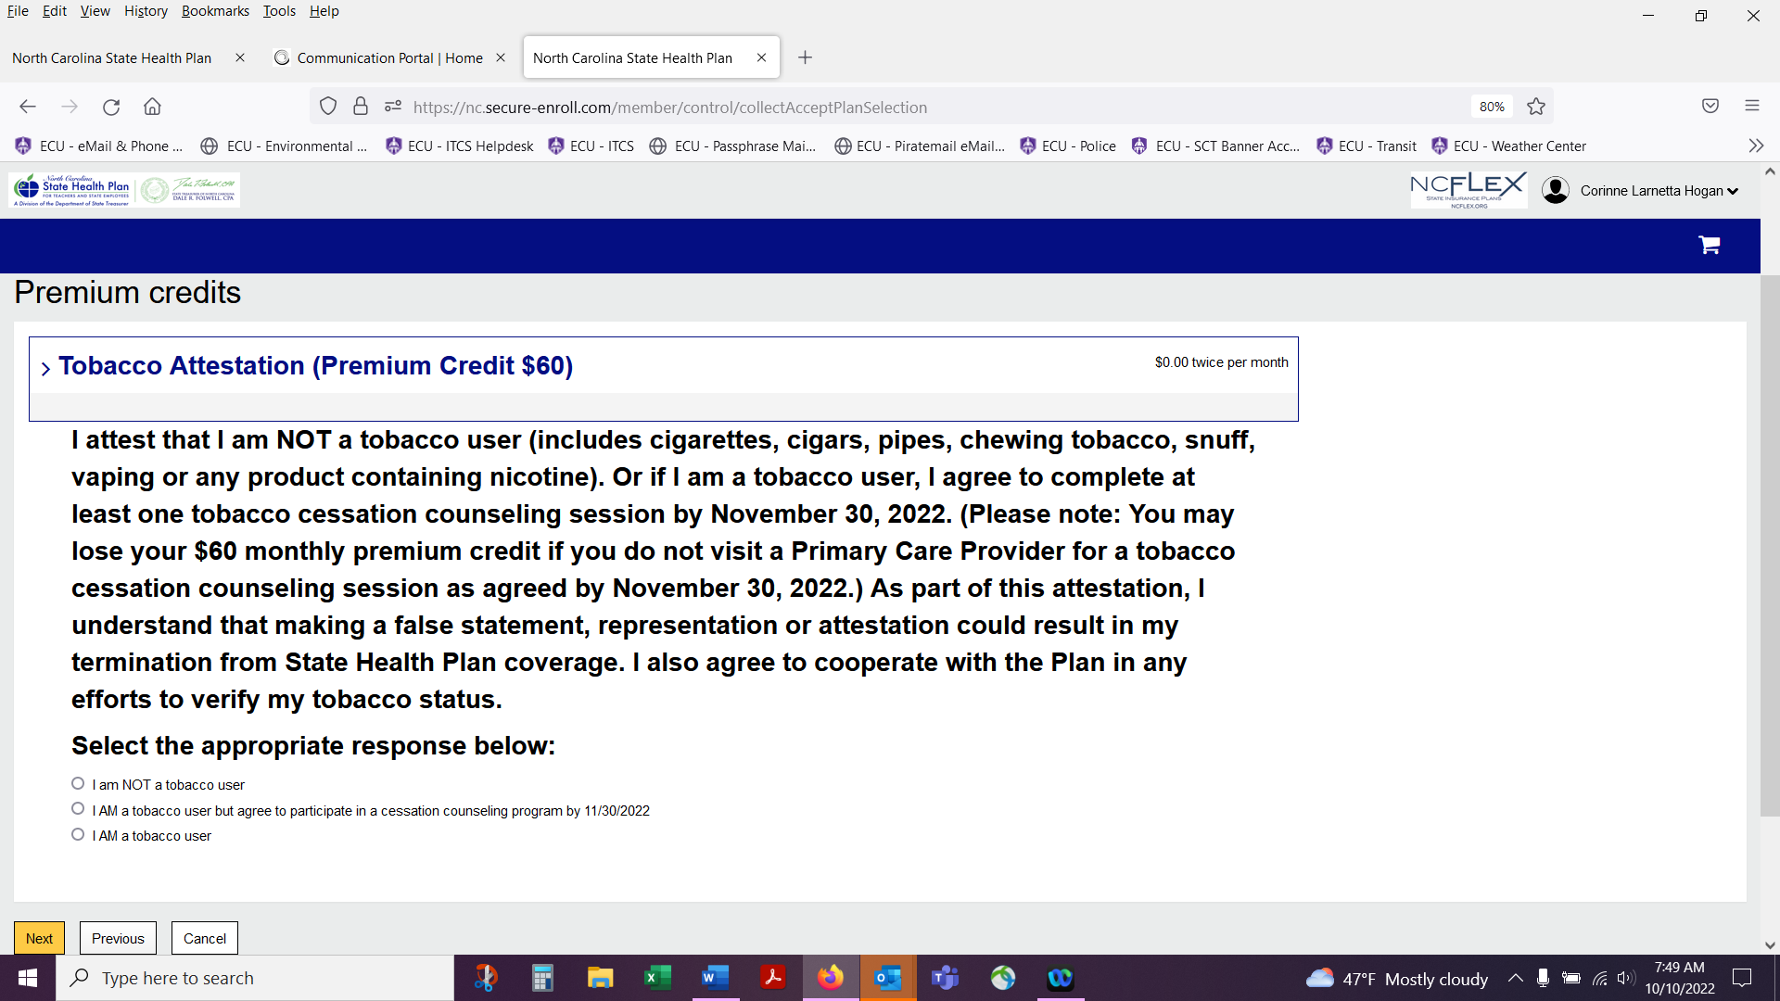
Wellness Premium Credit Opportunity
Complete the tobacco attestation survey when enrolling in the medical coverage. If you are a not a tobacco user or if you are a tobacco user and you will attend a tobacco cessation counseling session with your doctor or at a CVS Minute Clinic you can save money on your medical coverage.
The tobacco attestation credit will lower the monthly premium of your medical coverage by $60 per month. This is a savings of $720/year.
If you select that you are a tobacco user and you will attend a tobacco cessation counseling session with your doctor or at a CVS Minute Clinic, please be sure to upload your counseling session documentation into the “Document Center” in eBenefits within 60 days of your start date.

Slide 29
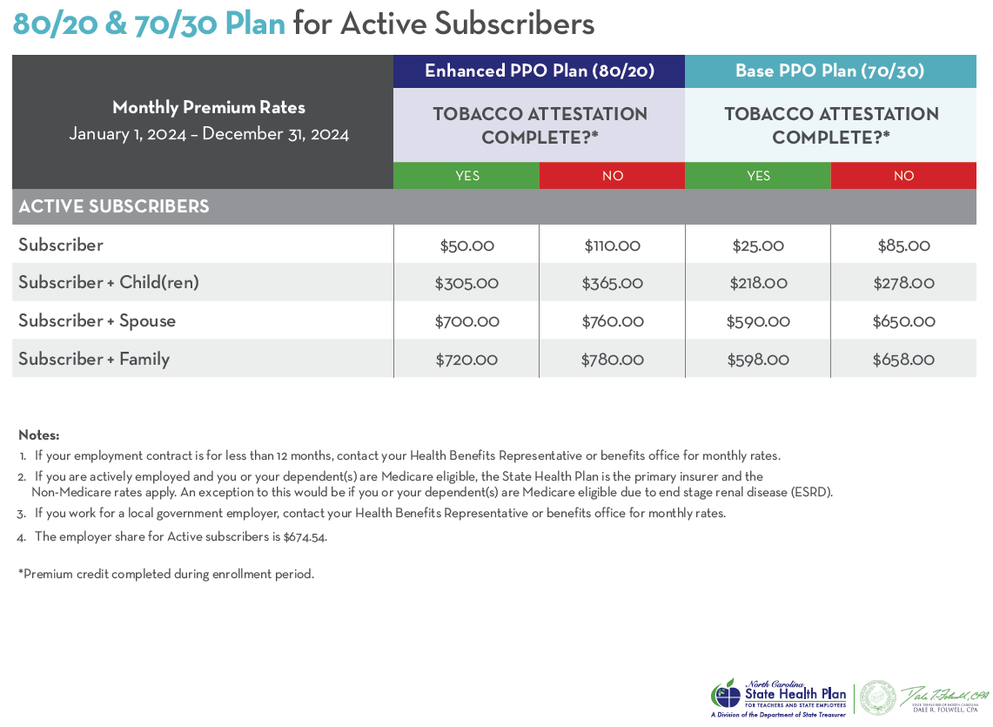
2024 MEDICAL PLAN PREMIUMS FOR ACTIVE SUBSCRIBERS
Benefits will be effective the 1st of the month following your hire date or the 1st of the month after your hire date, you choose.
Please be aware, we pay health insurance a month in advance. Depending on when your deductions begin, it is likely you will owe a “catch-up” amount. The HR Benefits Department can spread the "catch-up" amount over up to four pay periods if you have dependents. Please contact Pam Brann if you have any questions or if you would like your “catch-up” amount taken in one-lump sum.
Cost is different if you are a part-time employee.

Slide 30
ACA – EXCHANGE NOTICE –
HEALTH INSURANCE MARKETPLACE COVERAGE OPTIONS AND YOUR HEALTH COVERAGE
Even if you are offered health coverage through your employment, you may have other coverage options through the Health Insurance Marketplace (“Marketplace”).
What is the Health Insurance Marketplace?
The Marketplace is designed to help you find health insurance that meets your needs and fits your budget. The Marketplace offers "one-stop shopping" to find and compare private health insurance options in your geographic area.
For more information view the New Health Insurance Marketplace Coverage Options and Your Health Coverage (ACA Exchange Notice) located in your benefits packet.
If you feel the employee only premium is more than 9.5% of your annual household income (ours is not) or if the coverage does not meet the “minimum value” set by the ACA (ours does), you may be eligible for a tax credit through the Marketplace. For more information you may visit: https://www.shpnc.org/employee-benefits/high-deductible-health-plan.

Slide 31
How many days do you have to enroll in medical coverage?

Slide 32
WITHIN
30 DAYS
OF YOUR
START DATE
No Exceptions!

Slide 33
SUPPLEMENTAL
BENEFITS
NCFlex
UNC System

Slide 34
Visit www.ncflex.org scroll to the bottom of the page and choose one of the guides for detailed information and/or short video clips
SUPPLEMENTAL BENEFITS OFFERED THROUGH NCFLEX
NCFlex Benefits
Flexible Spending Accounts
Dental
Vision
Accident
Critical Illness
Cancer & Other Specified Diseases
TRICARE Supplement

Slide 35
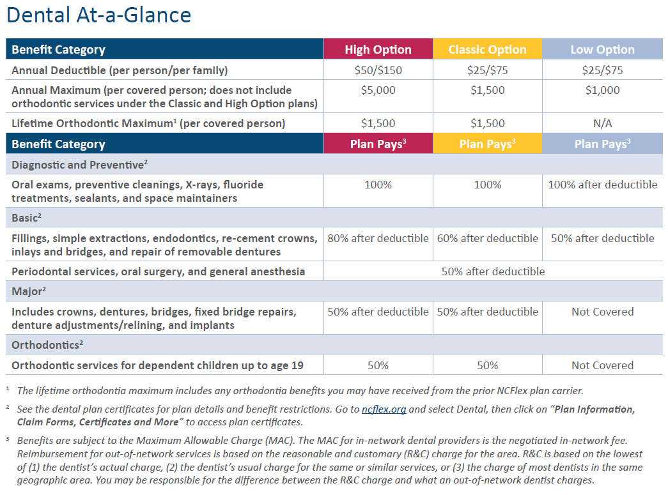
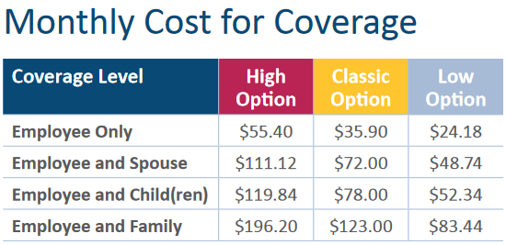
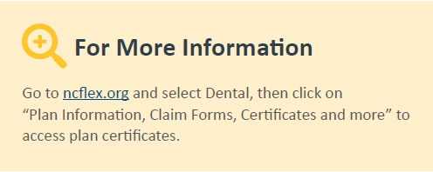
DENTAL INSURANCE
with MetLife
NCFlex Enrollment Guide (Universities) - pages 6-7

Slide 36
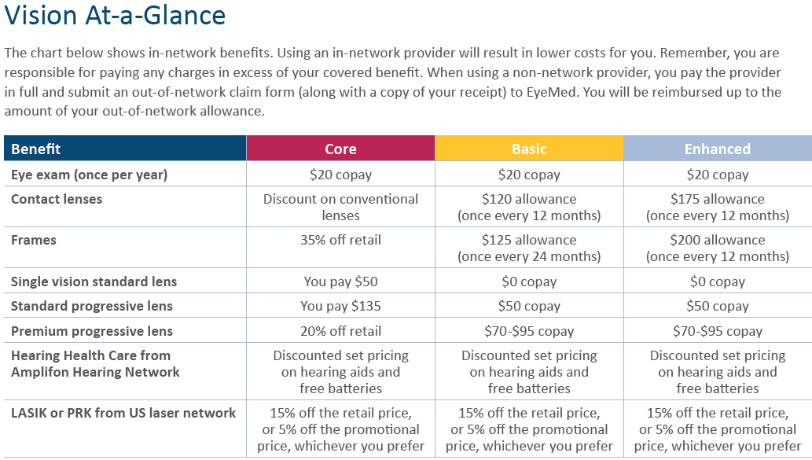
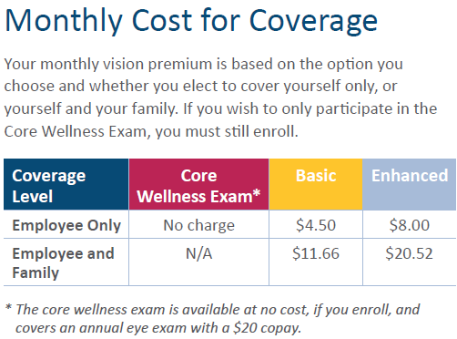
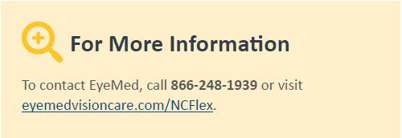
VISION INSURANCE
with EyeMed
NCFlex Enrollment Guide (Universities) pages 8-9

Slide 37
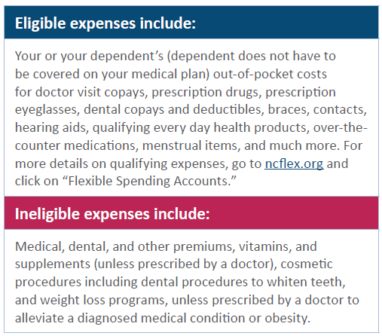
FLEXIBLE SPENDING ACCOUNT (FSA) –
HEALTH CARE with P&A Group
Set aside pre-tax dollars to use for eligible health care expenses.
Expenses must be incurred 1/1/24 – 12/31/24 Claims submission until 3/31/25
You can contribute $120 to $3,050 each plan year. Rollover amount from 2024 to 2025 is $610, with a minimum amount of $25.
The full amount you elect to contribute to your Health Care Flexible Spending Account (HCFSA) is available in your account on the first day of the plan year or the first day your benefits become effective.
Your contributions will be deducted on a pre-tax basis from your paycheck evenly over the calendar year.
If your spouse is a State of NC employee or an employee of a University of North Carolina System Institution or Affiliate entity, he or she can also contribute up to $3,050 each plan year.
You cannot contribute to a HCFSA at the same time your spouse is making or receiving tax-favored Health Savings Account (HSA) contributions, check IRS rules.

Slide 38
FLEXIBLE SPENDING ACCOUNT (FSA) –
DEPENDENT DAY CARE with P&A Group
Set aside pre-tax dollars to use for childcare and adult day care expenses
Expenses must be incurred 1/1/24 – 3/15/25 Claims submission until 3/31/25
You can contribute $120 to $5,000 each plan year per family, if both you and your spouse work, your spouse goes to school full-time, or your spouse isn’t able to care for himself or herself.
No rollover amount from year to year but you have until 3/15/25 to use contributions for eligible expenses.
Unlike the HCFSA, your contributions are added to your account as they are deducted from your paychecks (reported monthly to P&A Group). You can only use the amount that is available in your balance.
Your contributions will be deducted on a pre-tax basis from your paycheck evenly over the calendar year.
Eligible expenses include:
Day care, summer day camp, after- school programs, and preschool expenses for children under age 13 or disabled dependents of any age. Sleep-away or overnight camps and virtual camps are not covered. You may also use this account to pay for adult day care services for a spouse or other dependent who receives more than one-half of his or her support from you (e.g., your disabled elderly parent), who is physically or mentally incapable of caring for himself or herself and has the same principal place of residence as you for more than one-half of the year.
For more information on both FSA
NCFlex Enrollment Guide (Universities)
pages 10-13

Slide 39
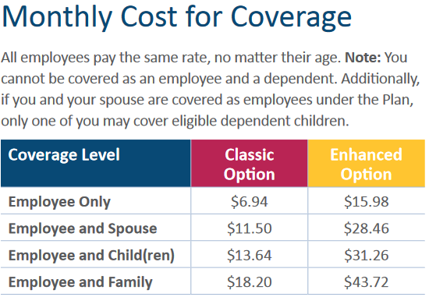
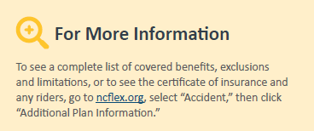
ACCIDENT
with Voya
Accident Plan pays you cash benefits for specific injuries and events resulting from a covered accident that occurs on or after your coverage effective date.
Pays in addition to any other insurance you may have.
Pre-tax deduction.
Benefits included:
Wellness Benefit, Sports Rider, and Voya Travel Assistance – Classic and Enhanced Options
Sickness Hospital Confinement Benefit – Enhanced Option only
NCFlex Enrollment Guide (Universities) pages 19-21

Slide 40
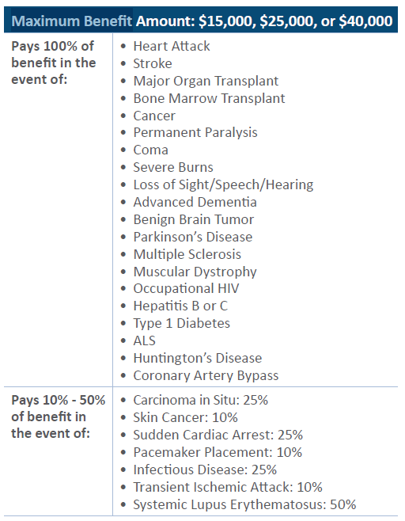
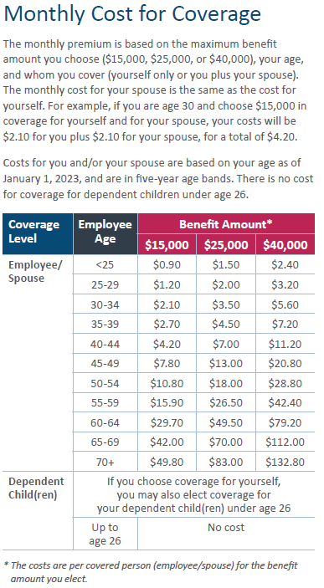
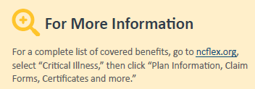
CRITICAL ILLNESS with Voya
Critical Illness Insurance pays you cash benefits if you are diagnosed with a covered critical illness.
You do not have to provide evidence of good health/insurability to enroll in this plan and no pre‑existing conditions are excluded. Pays in addition to any other insurance you may have. Pre-tax deduction.
Wellness Benefit and Infectious Disease Benefit Rider (COVID-19) included.
NCFlex Enrollment Guide (Universities) pages 16-18

Slide 41
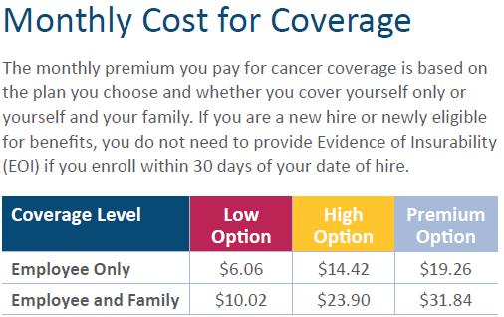
CANCER AND SPECIFIED DISEASE
with Allstate
Cancer and Specified Disease insurance pays you cash benefits for Cancer and 29 other specified diseases to help with the costs associated with treatments and expenses as they happen.
This coverage can also help pay for hospitalization, surgery, radiation/chemotherapy, and more.
Pays in addition to any other insurance you may have.
Pre-tax deduction.
NCFlex Enrollment Guide (Universities) –
pages 14-15

Slide 42
TRICARE SUPPLEMENT
with Selman and Company
Supplemental medical coverage for retired military or qualified National Guard and reserve members.
This plan is portable, if you leave ECU you can take it with you.
To be eligible:
You must work for the State 20 or more hours per week
You must be enrolled in one of the TRICARE Plans offered by the Military
You cannot be Medicare eligible (age 65 or over)
For a full list of who is eligible, see the details in the NCFlex Enrollment Guide (Universities).
NCFlex Enrollment Guide (Universities) page 23

Slide 43
SUPPLEMENTAL BENEFITS OFFERED
THROUGH UNC SYSTEM
For more information – https://myapps.northcarolina.edu/hr/benefits-leave/income-protection-benefits/
Securian Financial Microsite – https://securian.com/uncs-insurance
Group Term Life Insurance
Accidental Death & Dismemberment (AD&D) – voluntary, core, and matching

Slide 44
GROUP TERM LIFE INSURANCE
with Securian Financial
For more information – https://myapps.northcarolina.edu/hr/benefits-leave/income-protection-benefits/
More information in the Income Protection Plans Guide, pages 4-5
Pays a benefit to the beneficiary(ies) should you (or covered family member) die while covered under the policy. Also includes access to legal, financial and grief resources, travel assistance, legacy planning resources, and beneficiary financial coaching.
Coverage options:
Employee – can elect 1 to 10 times your annual salary.
Guaranteed coverage amount is 1 to 3 times your annual salary, not to exceed $500,000.
Evidence of insurability is required if you elect more than 3 times your salary or $500,000. Maximum coverage amount is $1,500,000.
Spouse/domestic partner – can elect either a $10,000 policy or a policy in increments of $25,000.
Guaranteed coverage amount is one increment or $50,000, not to exceed $500,000.
Coverage amount may not be more than employee’s coverage amount.
Child(ren) – $10,000 (only option). Guaranteed issue.
You pay the full cost of the coverage on an after-tax basis. Employee/spouse coverage cost is based on the amount of the policy and the employee’s age, even for the spouse’s coverage. Child(ren) coverage cost is $0.50 per month regardless of the child’s age and regardless of how many children are covered.
If you enroll, you receive matching accidental death & dismemberment (AD&D) coverage (for employee only) that is equal to the amount of your life insurance policy.
If you do not enroll during your new hire period, you can enroll during open enrollment however you will need to complete an evidence of insurability form.

Slide 45
ACCIDENTAL DEATH & DISMEMBERMENT
(AD&D) with Securian Financial
For more information – https://myapps.northcarolina.edu/hr/benefits-leave/income-protection-benefits/
More information in the Income Protection Plans Guide, pages 6-7
Pays a percentage of the benefit if you (or covered family member) die or suffer a loss or certain disabling injuries as a result of a covered accident (at work or elsewhere) while covered under the policy.
Includes access to travel assistance.
Voluntary AD&D coverage – coverage options:
Employee – increments of $50,000 up to $500,000
Employee + Family (coverage is a percentage of the employee’s voluntary AD&D coverage amount):
Spouse/domestic partner (with children) – 50%
Spouse/domestic partner (no children) – 60%
Each child (with spouse/domestic partner) – 10%
Each child (no spouse/domestic partner) – 15%
You pay the full cost of voluntary coverage on an after-tax basis. Coverage cost is based on the amount that you elect for yourself and/or your family and who is covered under a policy; employee only coverage is $0.017 per $1,000 per month and employee and family coverage is $0.025 per $1,000 per month.
Employee coverage amount reduces to 50% on January 1st following your (the employee) 75th birthday which would cause spouse and/or child policy amount to change.
If you do not enroll during your new hire period, you can enroll during open enrollment however you will need to complete an evidence of insurability form.
Core AD&D coverage (employee only) – all benefit eligible employees will be automatically enrolled in a $10,000 Core AD&D benefit at no cost to the employee. The UNC System pays the full cost of this coverage. Amount of coverage is reduced after you reach age 75.

Slide 46
How many days do you have to enroll in supplemental benefits (dental, vision, etc)?

Slide 47
WITHIN
30 DAYS OF YOUR START DATE

Slide 48
BENEFITS SYSTEMS
ADDING DEPENDENTS
ID CARDS
DEDUCTIONS FOR BENEFITS
IMPORTANT THINGS TO KNOW WHEN ENROLLING IN BENEFITS

Slide 49
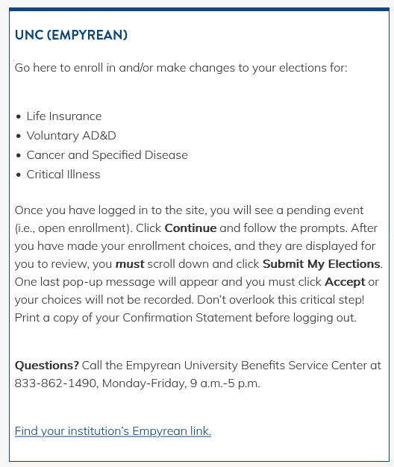
TWO ENROLLMENT PLATFORMS
Be sure to log into both platforms to make your benefit elections. You can access systems 24/7.
https://myapps.northcarolina.edu/hr/benefits-leave/health-and-welfare-benefits/health-benefits-enrollment/
Empyrean (UNC System)
- UNC life insurance
- UNC Voluntary AD&D
- Cancer
- Critical Illness
- Dental
- Vision
- Accident
- Flexible Spending Accounts
- Tricare Supplement
- Mandatory Retirement
- Supplemental Disability
eBenefits (BenefitFocus)
- Medical
*
* You cannot make any changes to your mandatory retirement plan election once you’ve saved your election in Empyrean. Even if it is within 30 days of your start date.

Slide 50
HOW TO LOGIN AND ENROLL
As a new hire, you have 30 days from your start date to enroll in benefits
You can log into both benefit systems by using the UNC System website:
https://myapps.northcarolina.edu/hr/benefits-leave/health-and-welfare-benefits/health-benefits-enrollment/
To log into both benefit systems – Username is your ECU email address and Password is your ECU passphrase
(the same login information you use for your ECU computer)
eBenefits: https://www.ebenefitsnow.com/sso/saml/ECU
For Step-By-Step enrollment instructions in the eBenefits system:
https://humanresources.ecu.edu/wp-content/pv-uploads/sites/21/2019/10/SSO-Benefits-Job-Aid.pdf
Any questions, concerns or if you need assistance with enrollment:
Eligibility & Enrollment Customer Service Center at 855-859-0966, Monday-Friday 8am-5pm
ECU Benefits Department at 252-328-9887, Monday-Friday 8am-5pm
Empyrean: https://compass.empyreanbenefits.com/unc/spsso/company/ecu
For Step-By-Step enrollment instructions in the Empyrean system:
https://myapps.northcarolina.edu/hr/download/588/system-group-life-insurance/12282/employee-stepbystep-enrollment-guide-for-compass.pdf
Any questions, concerns or if you need assistance with enrollment:
Empyrean University Benefits Service Center at 833-862-1490, Monday-Friday 9am-5pm
ECU Benefits Department at 252-328-9887, Monday-Friday 8am-5pm
Additional information about University Benefits can be found at the websites below:
State Health Plan – www.shpnc.org
NCFlex benefits – www.ncflex.org
UNC System benefits – https://myapps.northcarolina.edu/hr/benefits-leave
Mandatory retirement plans –
Teachers’ and State Employees’ Retirement System (TSERS) – www.myncretirement.com
Optional Retirement Program (ORP) – https://myapps.northcarolina.edu/hr/benefits-leave/retirement/orp/
Supplemental long-term disability – https://myapps.northcarolina.edu/hr/service/

Slide 51
IMPORTANT INFORMATION IF YOU ARE
ENROLLING DEPENDENTS
If you elect to add a dependent(s) to medical coverage, you will be required to upload dependent verification documentation into your “Document Center” in eBenefits within 30 days of your start date (new hires).
If you need assistance with uploading the documentation, contact the ECU Benefits Department at 252-328-9887.
The ECU Benefits Department must approve the documentation before your dependent(s) is added to your insurance.
Failure to provide the required documentation will result in termination of dependent(s) coverage.
Dependent children can remain on your plan until the last day of the month in which they turn 26.
Acceptable Dependent Verification Documentation:
Legal Married Spouse – Pages 1 and 2 of employee's most recent Federal Income Tax Return (1040, 1040A, or 1040EX) as filed with the IRS, listing the spouse OR official marriage certificate PLUS current billing statement for motor vehicle payment, utility bill or other financial statement or loan showing employee and spouse at the same address.
Biological Child (under the age of 26) – Pages 1 and 2 of employee's most recent Federal Income Tax Return (1040, 1040A, or 1040EX) as filed with the IRS, listing child as dependent OR birth certificate with subscriber's name listed as parent.
Stepchild (under the age of 26) – Pages 1 and 2 of employee's most recent Federal Income Tax Return (1040, 1040A, or 1040EX) as filed with the IRS, listing stepchild as dependent OR birth certificate PLUS marriage certificate (indicating employee's spouse is married to employee).
Adopted Child (under the age of 26) – Pages 1 and 2 of employee's most recent Federal Income Tax Return (1040, 1040A, or 1040EX) as filed with the IRS, listing adopted child as dependent OR international adoption papers from country of adoption/papers from adoption agency showing intent to adopt
Foster Child (under the age of 26) – Evidence of a legitimate foster child relationship, identifying the foster child by name and setting forth all relevant aspects of the relationship.
For additional documents approved by the State Health Plan, visit www.shpnc.org and click ‘eBenefits’ and click ‘List of Required Documentation for Dependent Eligibility’.

Slide 52
ID CARDS – WHAT ID CARDS WILL I RECEIVE?
Verify that your mailing address is correct in eBenefits and Empyrean.
If it is incorrect, you can update it in PiratePort.
Medical – A card is mailed to new hires. Register at www.bcbsnc.com and print/request additional cards and access your account. You can also call 1-888-234-2416. If you need your card sooner than you receive it through the mail, please contact the ECU Benefits Department. You will receive a new card each year that you are enrolled in medical insurance. Mobile app – Blue Connect NC
Dental – A card is mailed to new hires. Register at www.mybenefits.metlife.com and print/request additional cards and access your account. Enter NCFlex as the employer when you register. If you need your card sooner than you receive it through the mail, please contact the ECU Benefits Department. Mobile app – MetLife US
Vision – A card is mailed to new hires. Register at www.eyemedvisioncare.com/NCFlex and print/request additional cards and access your account. You can also call 1-866-248-1939. If you need your card sooner than you receive it through the mail, please contact the ECU Benefits Department. ID cards are not typically required to visit a provider.
Mobile app – EyeMed
Flexible Spending Accounts (FSA) – A convenience card is mailed to first-time users (for those that have both health care and dependent day care, only one card is issued) and only re-issued if reported lost or stolen, or once it expires after three years (valid through date is listed on the card). Register at www.ncflex.padmin.com and print/request additional cards and access your account(s) (including balances). You can also call 1-866-916-3475. Also, a claims kit is mailed yearly to participants and can also be found at www.ncflex.org in the FSA section. Mobile app – P&A Group-Mybenefits
Accident – No mailings or ID cards. Go to www.ncflex.org for additional information including claims form.
Cancer and Critical Illness – Welcome letters are mailed to new participants and to anyone who makes a change to their coverage during open enrollment. Go to www.ncflex.org for additional information including claims form.
Group Term Life Insurance and Accidental Death & Dismemberment (AD&D) – No mailings or ID cards. Go to https://myapps.northcarolina.edu/hr/benefits-leave/income-protection-benefits/ or Securian Financial Microsite – https://securian.com/uncs-insurance for additional information on these plans including claims form.

Slide 53
BENEFIT DEDUCTIONS
Deductions for your elected benefits are deducted each paycheck
SHP (medical insurance) premiums are paid a month in advance
(ex. April deductions are for May’s coverage)
Medical coverage will be effective the 1st of the month following your start date or
the 1st of the second month following your start date. You choose the effective date.
Depending on when the deductions begin on your paycheck, it is likely you will owe a “catch-up” amount
Employee only, the “catch-up” amount is typically deducted from one paycheck
If your coverage includes dependents, your “catch-up” amount is typically divided
over 4 paychecks.
Please reach out to Pam Brann if you want your “catch-up” amount taken in one lump sum or if you have questions about your “catch-up” amount.
NCFlex and UNC System benefits are paid on a current monthly basis
(ex. April deductions are for April’s coverage)
Coverage will be effective the 1st of the month following your start date.
If you have to complete an Evidence of Insurability form, coverage will be effective the 1st of the
month following the approval date.
Please be sure to review your paycheck for your benefits and the deduction amounts.
If your benefits and/or your deduction amounts are incorrect, please contact Pam Brann.

Slide 54
IMPORTANT THINGS TO KNOW WHEN ENROLLING IN BENEFITS
You cannot make any changes to your mandatory retirement plan election once you’ve saved your election in Empyrean. Even if it is within 30 days of your start date.
If you need to make changes to other benefits in Empyrean you have to contact the Empyrean University Benefits Service Center at 833-862-1490, Monday-Friday 9am-5pm.
Please verify that your address is correct in both benefit systems. If it’s incorrect, please update your address in PiratePort. If you cannot change your address, please contact the ECU Benefits Department.
Please be sure to list a beneficiary(ies) in the Empyrean benefit system.
Please be sure to print your confirmation statements from both benefit systems.
eBenefits system – use Firefox or Chrome as your web browser
Medical insurance – employees must enroll on their own plan. They cannot be on a plan as a dependent. If this pertains to you, please contact the ECU Benefits Department.
NCFlex benefits – employees can be covered as a dependent but cannot be dually enrolled (as employee and dependent). Children may not be covered under both parents’ plans.
UNC System benefits –
Life insurance – employees can be covered as an employee and as a spouse/domestic partner. If child is eligible for coverage as an employee, they cannot be covered as a dependent. A child may be covered by only one parent.
Accidental death and dismemberment – employees cannot be covered as an employee and as a spouse/domestic partner. If child is eligible for coverage as an employee, they cannot be covered as a dependent. A child may be covered by only one parent.

Slide 55
WHEN CAN YOU ELECT BENEFITS/CHANGE YOUR BENEFIT ELECTIONS?
New Hire Enrollment
Change of Employment Status
Qualifying Life Event (QLE)
Open Enrollment (OE)

Slide 56
NEW HIRE (NH)/QUALIFYING LIFE EVENT (QLE)/ OPEN ENROLLMENT (OE)
New Hire Enrollment – must complete insurance benefits enrollment in both benefit systems (eBenefits and Empyrean) within 30 days of start date. The benefits that you elect will be in effect for the remaining months of the current plan year (unless you experience a qualifying life event).
Qualifying Life Event (QLE) – if you and/or a dependent experience a change in insurance coverage(s) you can make changes to your insurance coverage(s) during the plan year. You will need to upload life event documentation to make a change to your insurance and/or dependent verification documentation if you are adding a dependent.
Examples of QLE: loss of coverage, gain other coverage, marriage, more QLEs on the State Health Plan Required Documentation for Qualifying Life Events & Dependent Eligibility.
Open Enrollment (OE) – can make any changes to your insurance coverage(s) annually without having a qualifying life event (QLE). Elections made during open enrollment are effective on January 1st of the following year. If you are adding a dependent(s), you will need to upload dependent verification documentation.
NO MATTER WHEN YOU COMPLETE YOUR NEW HIRE ELECTIONS,
YOU MUST PARTICIPATE IN OPEN ENROLLMENT EACH YEAR

Slide 57
TRANSFERS/REHIRES / NEWLY ELIGIBLE FOR BENEFITS
Transfers/Rehires
When an employee transfers between participating state agency, university, community college or charter school, they are considered either a rehire or a transfer depending on how many days they had as a break in service. Employees will be classified into one of two categories if there is a break in service:
Transfers – An employee who is separated and rehired within 30 days from their date of separation.
MUST be re-enrolled with the same benefit elections they had with the previous employer.
o Coverage is effective the first day of the month coincident with or after the transfer date.
o If an employee’s transfer is effective the 1st of the month at the new employer, benefits will begin the 1st of that month. Transferred employees are not eligible to enroll in NCFlex benefits previously declined, unless the employee was enrolled in a state sponsored post-tax plan at their previous Employing Unit. If this is the case, the transferring employee may elect the same type of NCFlex benefit plan. This is considered a Loss of Other Coverage Qualifying life event.
o There should be no gap in benefits. If, based on the date of separation from one employing unit and hire with another employing unit, there would normally be a gap, but the time period is within 30 days, the gap should be bridged.
If this applies to you, please contact Pam Brann
Rehires – An employee who is separated and rehired more than 30 days from their date of separation. This includes transfers or employees who separate from one Employing Unit and are hired by another Employing Unit more than
30 days from their date of separation. These employees are treated as new hires and benefits must be elected through the benefits enrollment systems. You do not have to select the same benefits that you had with your previous employer. Benefit elections will be effective the first day of the month following their rehire date.
Newly Eligible for Benefits
Employees who previously worked in a permanent position less than 20 hours per week and begin working 30 hours or
more per week in a permanent position, become newly eligible for some benefits and will have 30 days to enroll in the benefits. The effective date of the benefits would be the first day of the month following the date of the hours change. If part-time and working 20 hours per week and change to full-time (working 30 hours or more per week) you are eligible again to enroll in medical coverage. You will also be eligible for full-time benefits.

Slide 58
QUALIFYING LIFE EVENT (QLE)
If you and/or your dependent(s) experience a QLE you can make changes to your benefits within 30 days of the event date.
If you are adding yourself and/or your dependent(s) to insurance benefits, you can only add yourself and/or your dependent(s) to the same benefit(s) that were lost.
If you are removing yourself and/or your dependent(s) from your insurance benefits, you can only remove yourself and/or your dependent(s) from the benefit(s) that were gained.
Please remember, that you will need to provide life event documentation to verify your life event for any insurance benefits you are changing within 30 days of the event date. Upload documentation in eBenefits even if making changes to insurance benefits in Empyrean. If you are adding a dependent(s) to your medical coverage within 30 days of the event date, you must upload dependent verification documentation. View the State Health Plan Required Documentation for Qualifying Life Events & Dependent Eligibility for acceptable documentation.
Don’t forget to print your confirmation statement(s) and be sure that everything is correct.
QLE request(s) must be approved by the ECU Benefits Department. They cannot be approved without acceptable documentation.
Review your paycheck to be sure the changes were made. If you do not see that the changes were made, log into the benefit systems to be sure your QLE request(s) was approved. If your request(s) has not been approved, please contact the ECU Benefits Department.
Please be aware that when you make changes to your benefits you will have to pay for any missed deductions and you will receive refunds for any overpayments.

Slide 59
OPEN ENROLLMENT – OCCURS ANNUALLY (October)
ALL EMPLOYEES MUST PARTICIPATE IN OPEN ENROLLMENT EVERY YEAR
**2025 Open Enrollment is 9/30/24 – 10/25/24**
Medical insurance – the State Health Plan moves all employees who are enrolled in the medical insurance to the Base Plan (70/30) and they also remove the tobacco attestation credit. You must re-enroll into the Enhanced Plan (80/20) and complete the tobacco attestation survey.
2024 Open Enrollment, our third-party administrator will change to Aetna and you will need to enter a primary care provider during open enrollment.
Flexible Spending Accounts (health care and dependent day care) – you will need to re-enroll during open enrollment for the next plan year.
All other benefits will remain the same.
Please remember to upload dependent verification documentation if you are adding a dependent(s) to your medical insurance and the ECU Benefits Department will need to approve it. View the State Health Plan Required Documentation for Qualifying Life Events & Dependent Eligibility for acceptable documentation.
Please remember to upload documentation if you must attend a tobacco cessation counseling session for the tobacco attestation credit by the deadline date.
Don’t forget to print your confirmation statements and be sure everything is correct.
Review your paychecks (in December for medical and in January for other benefits) to be sure the changes were made. If you do not see that the changes were made, log into the benefit systems to be sure your open enrollment changes were approved. If your request(s) has not been approved, please contact the ECU Benefits Department.

Slide 60
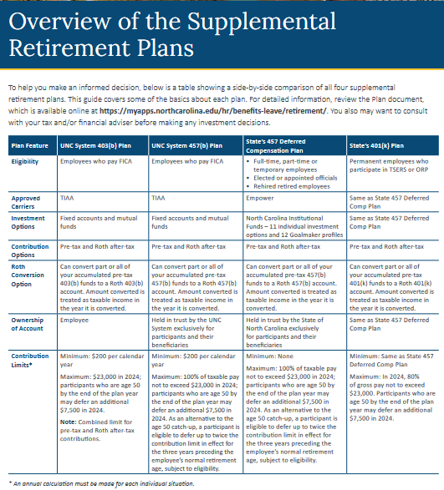
SUPPLEMENTAL
RETIREMENT
ACCOUNTS
UNC System – 403b and 457b
NC State – 401k and 457 deferred compensation

Slide 61
SUPPLEMENTAL RETIREMENT ACCOUNTS (SRA) For more information – https://humanresources.ecu.edu/benefits/retirement/
Save additional money towards retirement
ECU does not contribute unless you are a sworn law enforcement officer.
Enroll any time, no deadlines, unlimited changes, end at anytime.
There are contribution limits (minimum and/or maximum) depending on which SRA you choose.
You must keep track of your contribution amounts each year (403b and 401k contributions are added together).
TIAA – 403b and 457b
Sean Lawrence
704-988-0577
sean.lawrence@tiaa.org
To schedule a meeting online: www.tiaa.org/schedulenow-unc
TIAA – 800-732-8353
TO ENROLL:
Go to the TIAA website and create an account, www.tiaa.org/public/tcm/unc
AND
Completed the UNC 403b and/or 457b Plan – Salary Deferral Agreement form (located on the ECU website at the top of this slide)
Send the completed form to Amber Pope at popeam22@ecu.edu
Empower (formally Prudential) –
401k and 457 deferred compensation
Cecilia Fields
252-204-3297
cecilia.fields@empower.com
TO ENROLL:
Go to the Empower website and create
an account, www.ncplans.retirepru.com
OR
Complete a Participant Enrollment form (located at the ECU website at the top of this slide)
Send the completed form to Pam Brann at
brannp18@ecu.edu
The Supplemental Retirement Plan Decision Guide shows how SRA can work with the TSERS or the ORP to help maximize the opportunity in preparing for retirement including side-by-side comparisons.

Slide 62
ADDITIONAL SUPPLEMENTAL
BENEFITS
Supplemental Long-term disability
Supplemental Short-term disability
Universal Life/Heart and Stroke Indemnity/Critical Illness

Slide 63
SUPPLEMENTAL LONG-TERM DISABILITY (LTD)
(Supplemental Income Protection Program) (additional cost)
For more information – https://humanresources.ecu.edu/benefits/disability-workers-comp/
https://myapps.northcarolina.edu/hr/benefits-leave/income-protection-benefits/calculate-standard-disability-premium/
Eligibility – must be enrolled in a mandatory retirement plan (TSERS or ORP)
You must enroll within 30 days of your start date for guaranteed issue
Although the mandatory retirement plans offer LTD benefits (after 5 years of contributing to one of the mandatory retirement plans) at no cost to you, you may wish to consider purchasing additional protection should you become unable to perform your job.
Supplemental long-term disability coverage pays a benefit when you are unable to perform your job due to mental or physical reasons and increases your overall monthly benefit.
The specific supplemental long-term disability policy that is available to you depends on which mandatory retirement plan you participate in.
If you do not enroll during your new hire period and you want to enroll later, you will need to complete an evidence of insurability form.
For more information view the Income Protection Plans Guide, starting on page 9.

Slide 64
SUPPLEMENTAL LONG-TERM DISABILITY (cont’d)
TSERS Members
with Lincoln Financial Group
60 day waiting period to apply for disability
minimum monthly benefit is $250 or 1/10 of the 66 ⅔% benefit, whichever is greater, and the maximum monthly benefit is 66 ⅔% of your monthly salary.
However, your benefit combined with the other income-replacement benefits noted above cannot exceed 100% of your pre-disability earnings.
The plan pays 66⅔% of your monthly salary, minus deductible income, up to a total of $10,000 per month for Lincoln Financial participants if you’ve contributed to 1 of the mandatory retirement plans for less than 1 year.
ORP Members
with The Standard Insurance Company
90 day waiting period to apply for disability
minimum total monthly benefit of $100 or 1/10 of the 66 ⅔% benefit, whichever is greater, and the maximum monthly benefit is 66 ⅔% of your monthly salary.
However, your benefit combined with the other income-replacement benefits noted above cannot exceed 100% of your pre-disability earnings.
The plan pays 66⅔% of your monthly salary, minus deductible income, up to a total of $15,000 per month for The Standard participants if you’ve contributed to 1 of the mandatory retirement plans for less than 1 year.

Slide 65
HOW DO I ENROLL IN THE
SUPPLEMENTAL LONG-TERM DISABILITY?
Must enroll online in the Empyrean benefits system within 30 days of your start date
Lincoln Financial Group if you are enrolling in the TSERS
Standard Insurance Company if you are enrolling in the ORP

Slide 66
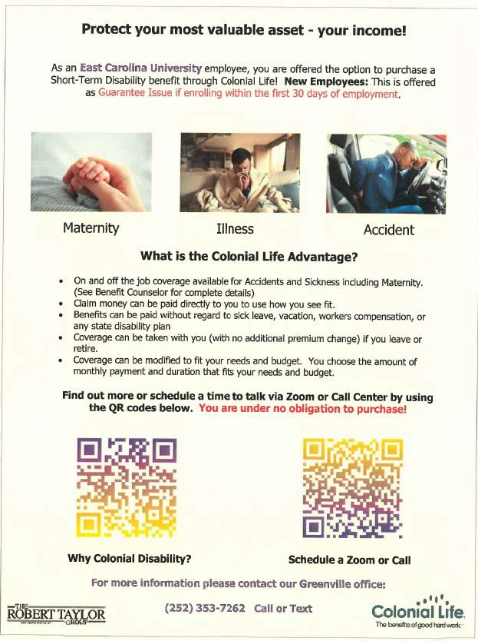
SUPPLEMENTAL BENEFIT PLANS (additional cost)
Supplemental Short-term Disability with Colonial Life
Universal Life/
Heart & Stroke Indemnity/
Critical Illness with Pierce Insurance
Must enroll within 30 days of start date to qualify for guaranteed issue
Contact Colonial Life to enroll
Covers accidents (off the job), sickness, and includes maternity
Seven-day waiting period for sickness and zero waiting days for accidents as well as for maternity (as long as pre-ex is satisfied)
Benefits are paid directly to you, unless you specify otherwise, for up to 3 months or 12 months
Coverage is portable (can take it with you if you leave ECU)
Must enroll within 60 days of start date to qualify for guaranteed issue
If interested or need additional information, follow the instructions on their cover letter
Contact Pierce Insurance to enroll
They also have open enrollment (outside of our typical open enrollment period) for current employees who are interested in enrolling
All programs are portable (can take it with you if you leave ECU)

Slide 67
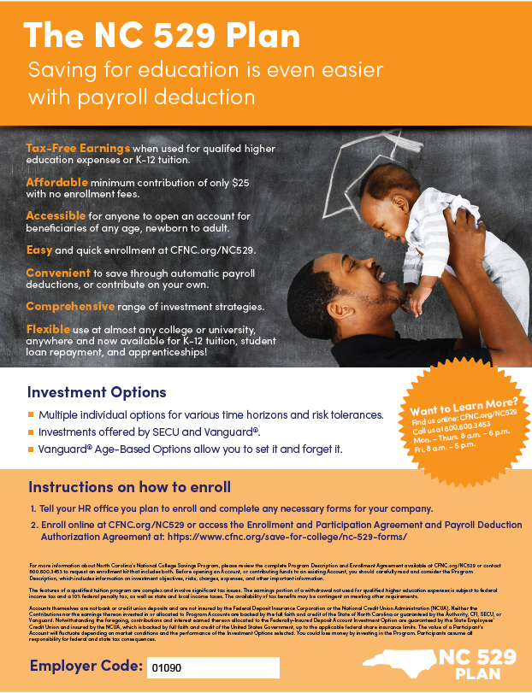
NATIONAL COLLEGE SAVINGS
For more information – www.cfnc.org/savings
This program helps you save for a college education for your child, yourself or someone else you care about.
Program is available through payroll deduction, offers you choices, meets your investment needs and gives you freedom.
To learn more call,
800-600-3453 or 919-828-4904

Slide 68
New hire paperwork questions – contact Pam
Deduction amount questions – contact Pam
Benefits’ questions – contact Trina Baker or Pam Brann
Benefits’ systems questions – contact the support center for that system or contact Pam
Check your ECU email, if we need to reach you this is how we would contact you
Check your address in both benefit systems
If you are a tobacco user and attended a counseling session, be sure to upload documentation in eBenefits
Transfers do not need to enter a qualifying life event to enroll in ECU benefits. If the system asks, please notify us immediately. Do not continue.
Notes:
This Photo by Unknown Author is licensed under CC BY-SA-NC

Slide 69
SOME THINGS TO REMEMBER
Enrollment in medical and other supplemental benefits within 30 days
Enrollment in mandatory retirement plan within 30 days, on day 31 you will be auto enrolled into TSERS (if eligible)
2 Benefits’ Systems – eBenefits & Empyrean
If enrolling dependents, be sure to upload documentation
Enrollment in supplemental long-term disability with Lincoln Financial (TSERS) or The Standard Insurance Co. (ORP) within 30 days
Enrollment in supplemental universal life, heart & stroke indemnity, and critical illness benefits with Pierce Insurance within 60 days
Enrollment in supplemental
short-term disability with Colonial Life within 30 days
Notes:
This Photo by Unknown Author is licensed under CC BY-SA-NC

Slide 70
Newsletters you can register to receive
Member Focus for the State Health Plan - https://www.shpnc.org/ - select “Sign Up for Our Monthly e-Newsletter”
NCFlex - https://oshr.nc.gov/state-employee-resources/benefits/ncflex – select “Sign Up for the NCFlex Newsletter
Notes:
This Photo by Unknown Author is licensed under CC BY-SA-NC

